Slide 1
Starter
What is the name, shape and bond angle of each of the following?
H₂S
CH₄
BF₃
CO₂

Slide 2
What is Electronegativity?
Write your answer on a piece of paper.

Slide 3
Electronegativity and Polarity
Learning Outcomes:
Describe electronegativity in terms of an atom attracting bonding electrons in a covalent bond (Grade C)
Explain how a permanent dipole can result in a polar bond (Grade B)
Link electronegativity to the bonding type on a compound. (Grade A)
Key words:
Electronegativity, permanent dipole, polar bond, polar molecule

Slide 4
Electronegativity and Polarity
5 minutes
Definition: Electronegativity is a measure of the tendency of an atom to attract a bonding pair of electrons in a covalent bond.
Therefore: The greater the electronegativity of an atom, the more it attracts electrons towards it.
What factors will affect how electronegative an atom is?

Slide 5
Electronegativity and Polarity
The factors affecting electronegativity are the same as those that affect ionisation energies:
Atomic charge;
Distance from the nucleus (Atomic Radius);
Electron shielding

Slide 6
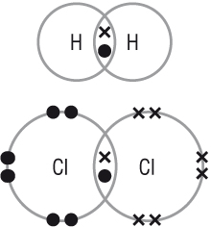
Bonds between Identical atoms
In a covalent bond, electrons are shared.
When the 2 atoms are identical, the electrons are shared equally.
H-H
Cl-Cl

Slide 7
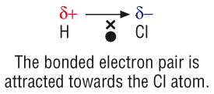
Bonds between different atoms
The more electronegative atom will have a greater share of the electrons.
E.g. Cl is more electronegative than H so in a molecule of HCl, the electrons are pulled towards the Chlorine.
This symbol is called delta and means “slightly”

Slide 8
Charge Difference
The charge difference between H and Cl is called a permanent dipole.
HCl is therefore a polar covalent bond.
HCl is non-symmetrical so it is a polar molecule.

Slide 9
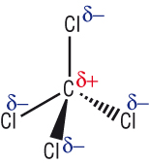
Non-polar molecules.
Symmetrical molecules are non-polar even though they contain polar bonds.
4 dipoles acting in different directions cancel each other out.

Slide 10
Key Concept
The greater the difference in electronegativity between the bonded atoms, the greater the permanent dipole.
The more electronegative atom will take the δ- charge.

Slide 11
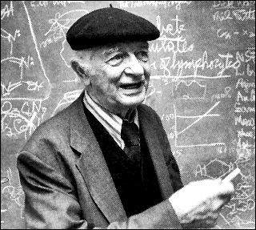
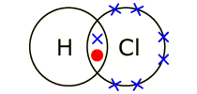
Linus Pauling
1932 – Linus Pauling invented Pauling scale to measure electronegativity on an atom.

Slide 12
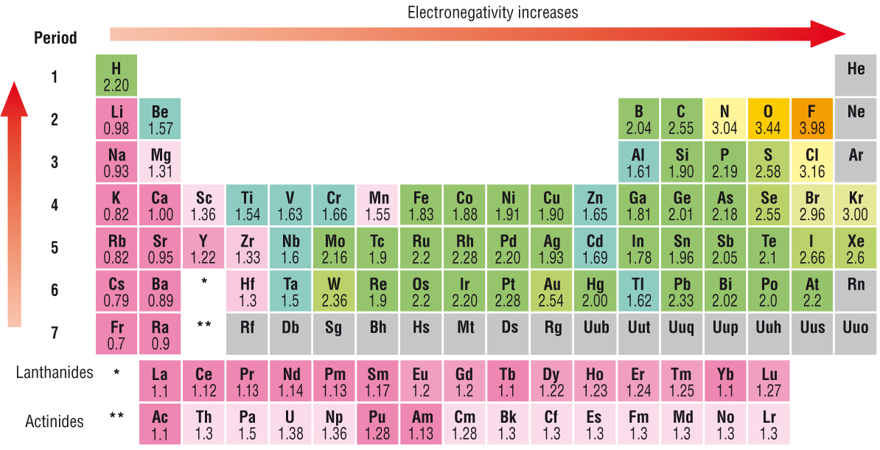
Pauling Scale

Slide 13
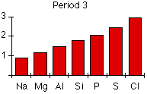
Across a Period
Explain why electronegativity increases across a period.

Slide 14
Across a Period
Both sodium and chlorine have their bonding electrons in the 3-level. The electron pair is screened from both nuclei by the 1s, 2s and 2p electrons, but the chlorine nucleus has 6 more protons in it.

Slide 15
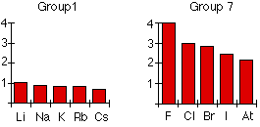
Down a Group
Explain why electronegativity decreases down a group.

Slide 16
Down a Group
The bonding pair is shielded from the fluorine's nucleus only by the 1s² electrons. In the chlorine case it is shielded by all the 1s²2s²2p⁶ electrons.

Slide 17
Covalent → Ionic
No difference between electronegativity = non polar covalent bond.
Small difference in electronegativity = polar covalent bond.
Large difference in electronegativity = ionic bond.

Slide 18
Non Polar Covalent Bond
No difference between electronegativity = non polar covalent bond.
H-H
Cl-Cl

Slide 19
Polar Covalent Bond
Small difference in electronegativity = polar covalent bond.

Slide 20
Ionic Bonding
Large difference in electronegativity = ionic bond.

Slide 21
Think about how electronegativity changes across and down the periodic table.
Give an example of a non-polar covalent bond, a polar covalent bond and an ionic bond.

Slide 22
Questions
For the following molecules predict the polar bonds. Show dipoles on the diagrams.
Br₂ b)H₂O c) O₂ d)HBr e) NH₃ f)CF₄
2. a)
i)Predict the shape of the molecules BF₃ and PF₃
ii)Explain why BF₃ is non-polar and PF₃ is polar
b)
i)Predict the shapes of H₂O and CO₂
ii)Explain why H₂O is polar and CO₂ is non-polar

Slide 23
What is Electronegativity?
Re-answer your question on the other side of the paper.
Must: Describe electronegativity in terms of an atom attracting bonding electrons in a covalent bond (Grade C)
Should: Explain how a permanent dipole can result in a polar bond (Grade B)
Could: Link electronegativity to the bonding type on a compound. (Grade A)

