Slide 1
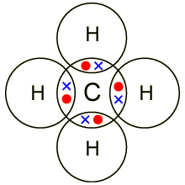
Further Covalent bonding
Learning Objectives:
Use dot and cross diagrams to represent covalent bonding
Understand when to apply the expansion of the octet rule.
Key Words:
Covalent, sharing, bonding, octet rule.

Slide 2
How many covalent bonds?
When covalent bonds form the unpaired electrons pair up so that the bonded atoms obtain a noble gas configuration, generally having 8 electrons in the outer shell.
This is called the Octet Rule.
However this is not always possible to achieve;
There may not be enough electrons to react an octet.
More than four electrons may pair up when bonding occurs (expansion of the octet)

Slide 3
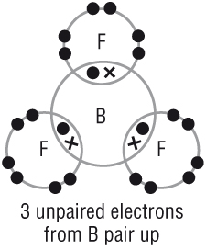
Not enough electrons to reach the octet.
Within period 2 beryllium and boron both form compounds with covalent bonding.
However, Be and B don’t have enough unpaired electrons to reach an octet. So they pair up all the electrons they have available.
Example: Boron Tri fluoride, BF₃
Boron has 3 electrons in its outer shell
Fluorine has 7.
3 covalent bonds are formed
Each of Boron’s 3 electrons are paired
6 electrons surround B
Each of the 3 Fluorine atoms have 8 electrons – are stable

Slide 4
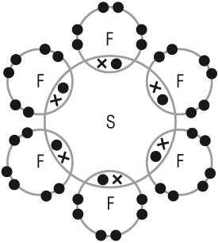
Expansion of the octet.
Elements in groups 5-7 in period 3 also behave differently
As we move down the periodic table more of the outer electrons can take part in bonding. So some molecules have more than 8 electrons in the outer shell.
Expansion of the octet
Example: Sulphur hexafluoride, SF₆
Sulphur has 6 electrons in its outer shell
Fluorine has 7.
6 covalent bonds are formed
Each of sulphur’s 6 electrons are paired
12 electrons surround S
Each of the 6 Fluorine atoms have 8 electrons – are stable

Slide 5
Expansion of the octet.
Elements that expand their octet:
Expansion of the octet
Group 5 | Group 6 | Group 7
P | S | Cl
As | Se | Br
 | Te | I
 |  | At
General Rules
Non-metal atoms in Group 5 can form 3 or 5 covalent bonds depending on how many electrons are needed for bonding.
Non-metal atoms in Group 6 can form 2,4 or 6 covalent bonds depending on how many electrons are needed for bonding.
Non-metal atoms in Group 7 can form 1,3,5 or 7 covalent bonds depending on how many electrons are needed for bonding.

Slide 6
A better rule.
Unpaired electrons always pair up
The maximum number of electrons that can pair up is equivalent to the number of electrons in the outer shell.

Slide 7
Questions.
Draw dot and cross diagrams for:
a) PCl₄⁺
b) H₃O⁺
c) H₂F⁺
2. Draw dot and cross diagrams for:
BF₃
PF₅
SO₂
SO₃

Slide 8
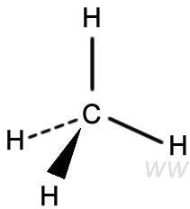
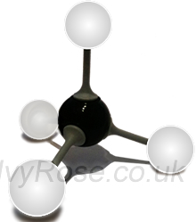
Shapes of Molecules and Ions
Learning Objectives:
Explain how the shape of a simple molecule is determined.
State that lone pairs of electrons repel more strongly than bonded pairs.
Explain and predict the shapes of, and bond angles in, molecules and ions.
Key Words:
Electron pairs, bonding pairs, lone pairs, double bonds

Slide 9
Shapes of Molecules and Ions
Electron Pair Repulsion Theory.
The shape of a molecule is determined by the number of electron pairs surrounding the central atom.
As all electrons are negatively charged, each electron pair repels the others near it.
The electron pairs arrange themselves as far apart as possible.

Slide 10
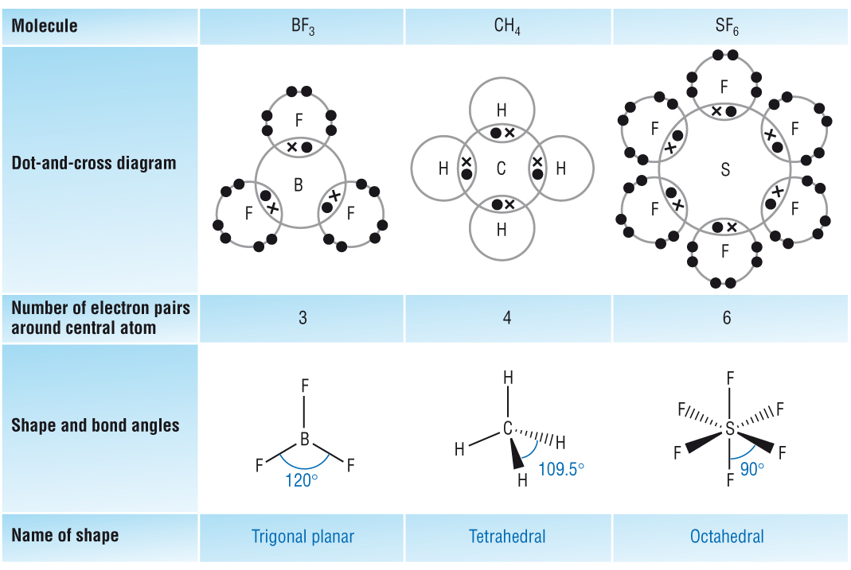
Shapes of Molecules and Ions

Slide 11
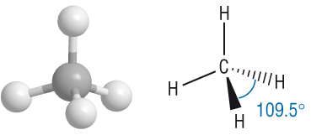
Drawing 3D Diagrams

Slide 12
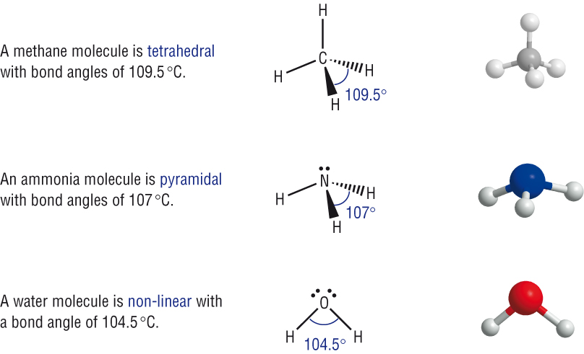
Molecules with Lone Pairs
A lone pair (l.p) of electrons is more repulsive than a bonding pair. IT is more electron dense.
Therefore a lone pair repels more than a bonded pair.
Lone pair/Lone pair > bonded pair/lone pair > bonded pair/bond pair

Slide 13
Molecules with Lone Pairs
Lone pair/Lone pair > bonded pair/lone pair > bonded pair/Lone pair

Slide 14
Molecules with Double Bonds
A double bond counts as 2 bonded pairs. To work out the shape for a molecule with double bonds each double bond is treated as a bonded region in the same way as a bonded pair
Shape of CO₂

Slide 15
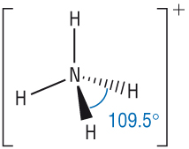
Shapes of Ions
The principles discussed previously still apply to molecular ions.
e.g. the shape of the ammonium ion, NH₄⁺
There are 4 electron pairs
around the central atom
The shape will be tetrahedral

Slide 16
Questions.
Draw dot and cross diagrams and predict the shapes and bond angles for:
a) H₂S b) AlCl₃ c) SiF₄ d) PH₃
2. Draw dot and cross diagrams and predict the shapes and bond angles for :
NH₄⁺ b) H₃O⁺ c) NH₂⁻
3. Each of the following has at least one multiple bond. Draw diagrams and predict the shapes and angles.
a) HCN b) C₂H₄ c) SO₂ d) SO₃

