Slide 1
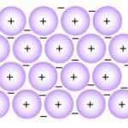
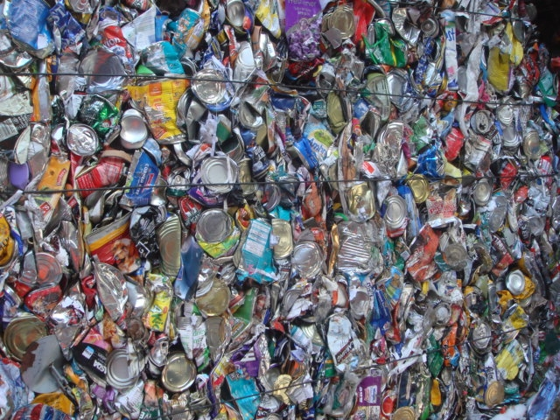
Metallic Bonding and Structure
Describe metallic bonding as the attraction of positive ions to delocalised electrons.
Describe giant metallic lattices.
Key words: Metallic bonding, delocalised electrons, giant metallic lattice.

Slide 2
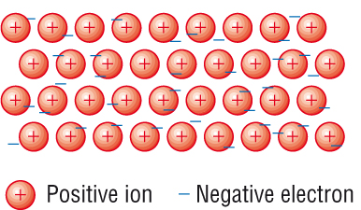
How are Metals Bonded?

Slide 3
Metallic Bonding: is the electrostatic interaction between positive metal ions and delocalised electrons.
Metallic Bonding and Structure
Atoms in a solid metal are held together by metallic bonding
In metallic bonding the atoms are ionised.
Positive ions occupy fixed positions in the lattice
The outer shell electrons are delocalised. They are shared between all the atoms in the metallic structure.
The metal is held together by the attraction between the positive ions and the negative electrons

Slide 4
Delocalised electrons: are shared between two or more atoms
Metallic Bonding and Structure
Giant Metallic Lattice: is a 3-D structure of positive ions and delocalised electrons, bonded through strong metallic bonds.
In a giant metallic lattice:
Delocalised electrons are spread throughout the structure.
These are able to move within the structure
It is impossible to tell which electron originated from which particular ion.
Over the whole structure, the charges must balance.

Slide 5
Example
Sodium has the electronic structure 1s²2s²2p⁶3s¹.
When sodium atoms come together, the electron in the 3s atomic orbital of one sodium atom shares space with the corresponding electron on a neighbouring atom to form a molecular orbital.
This is similar to the way that a covalent bond is formed.

Slide 6
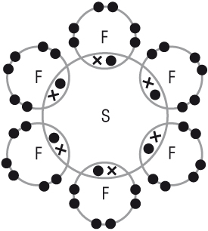
How is metallic bonding different from covalent bonding?
Covalent bonds are localised
Metallic bonds are delocalised.

Slide 7
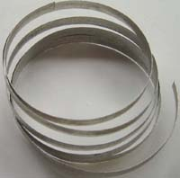
Describe the bonding in magnesium.

Slide 8
Magnesium has 2 electrons in outer shell.
2 delocalised electrons shared by each atom in the lattice
The positive ions are attracted to the delocalised electrons.
Magnesium atom smaller so electrons closer to nucleus
This gives stronger bonding leading to higher melting and boiling points.

Slide 9
Properties of Giant Metallic Lattices
High melting and boiling points
Good electrical conductors
Malleable and Ductile

Slide 10
High melting and boiling points
Most metals have high melting and boiling points.
The electrons are free to move throughout the structure, but the positive ions are fixed in the lattice.
The metallic bonds between the positive metal ions and the delocalised electrons are strong.
High temperatures are needed to break the metallic bonds and move the ions from the fixed points within the lattice.

Slide 11
Na⁺
Mg²⁺
Al³⁺
Increasing electron cloud density as more electrons are donated per atom. This means the ions are held more strongly

Slide 12
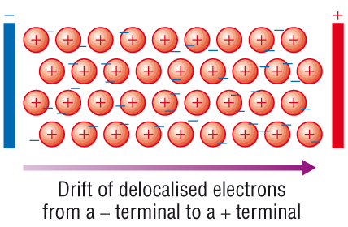
Why do metals conduct electricity so well?
The delocalised electrons can move freely anywhere within the metal lattice allowing them to conduct electricity.

Slide 13
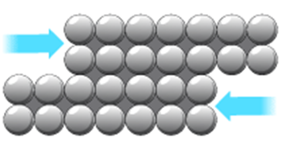
Why are metals malleable?
“Malleable” means that the metal can be hammered and pressed into shape.
The atoms are able to roll over each other into new positions without breaking the metallic bonds.

Slide 14
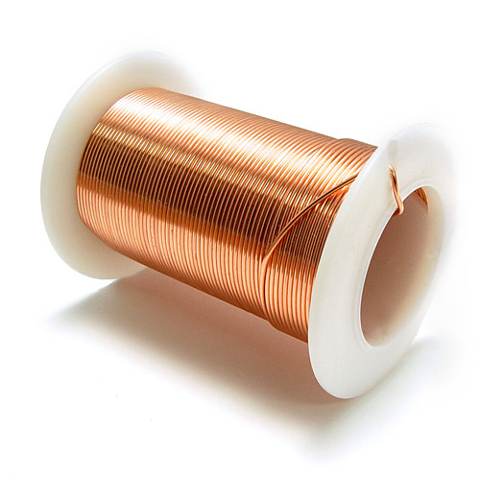
Why are metals ductile?
“Ductile” means that they can be drawn out into a wire.
This is also due to the ability of the atoms to roll over each other.

Slide 15
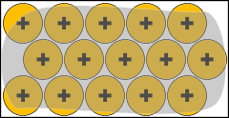
Malleability and Ductility
The atoms are able to roll past each other into new positions without breaking the metallic bonds.

Slide 16
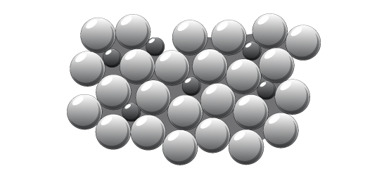
What is an alloy?
Alloys
A mixture of metals
Metal
Alloy
They are not a compound – as there can be different proportions/ratios of metals
Alloys modify a metal’s properties – The ions may be different sizes, stopping the layers moving past each other, making the metal harder as a result.

Slide 17
Questions
What is meant by metallic bonding?
How does a metal conduct electricity?
Explain how metallic bonding is different from covalent bonding.

Slide 18
Questions
What is meant by metallic bonding?
How does a metal conduct electricity?
Explain how metallic bonding is different from covalent bonding.

Slide 19
Questions
Someone looking at a model showing the arrangement of atoms in a copper crystal might think that the following statements are true. Which of these ideas are correct? Which ideas are false? And why.
Copper crystals are shaped like cubes because the atoms are packed in a cubic pattern.
There is air between the atoms in a crystal of copper.
Copper is dense because the atoms are closely packed.
The atoms in a copper crystal are not moving at room temperature.
Copper has a high melting point because the atoms are strongly bonded in a giant structure.
Copper melts when strongly heated because the atoms melt.
There are positive metal ions in a metal crystal, but a metal is not an ionic compound. Explain.

