Slide 1
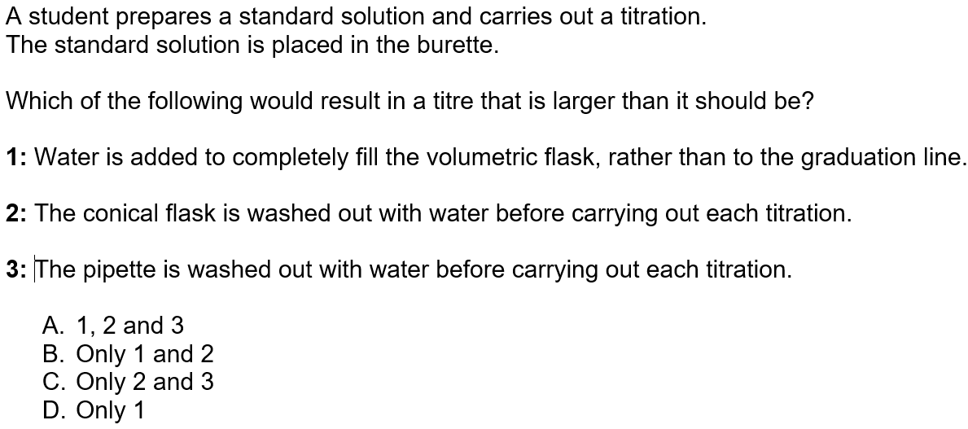
D

Slide 2
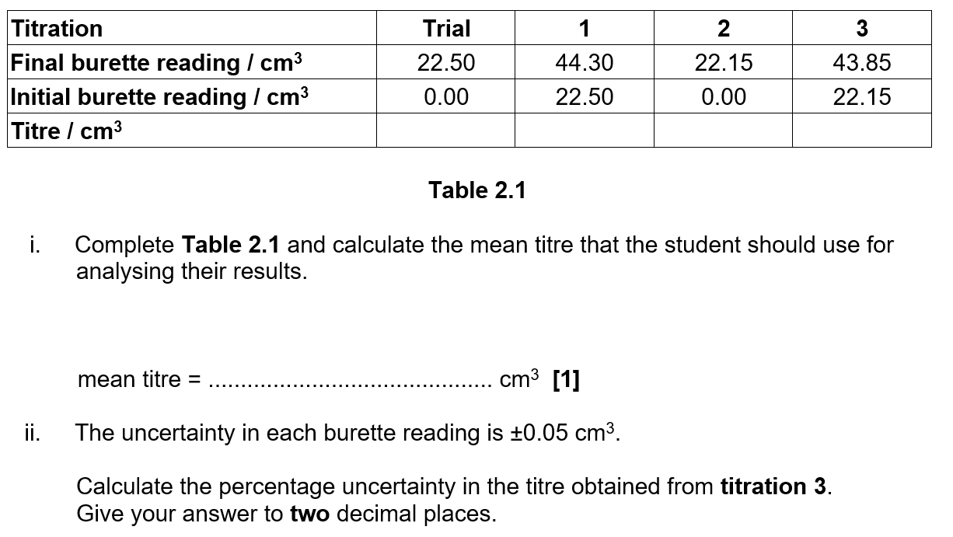
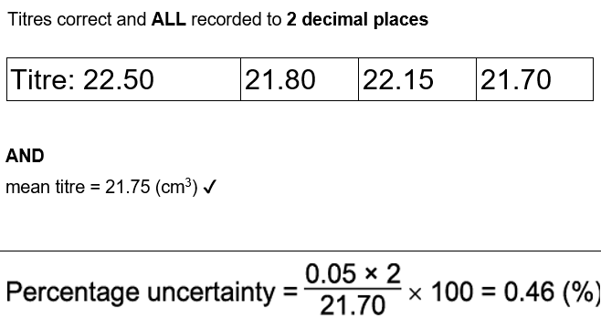

Slide 3
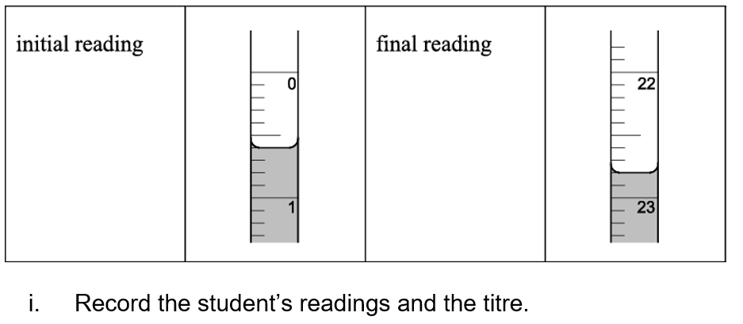
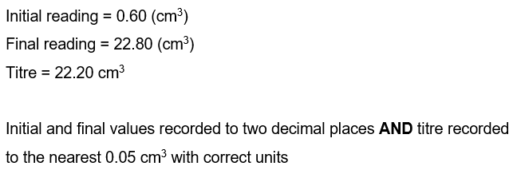

Slide 4
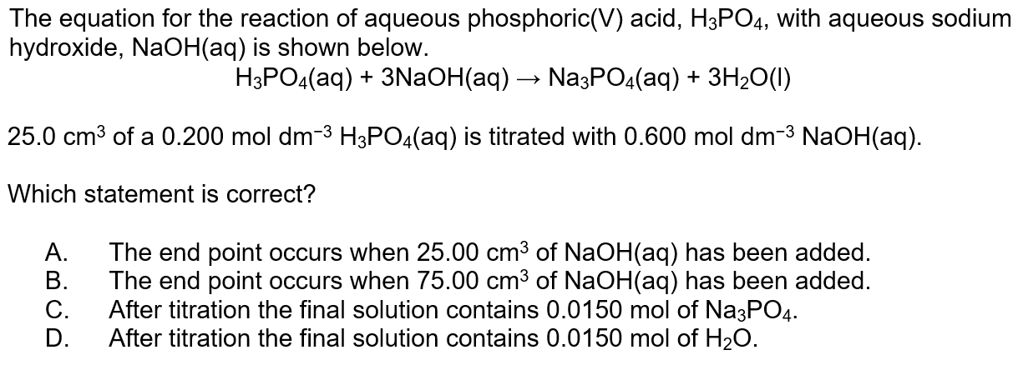
A

Slide 5
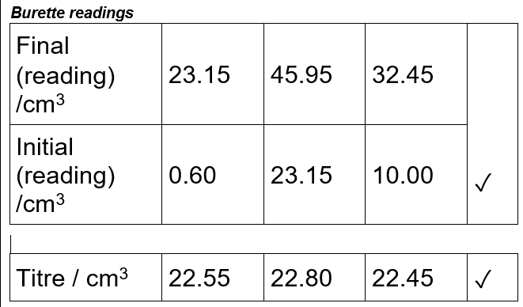
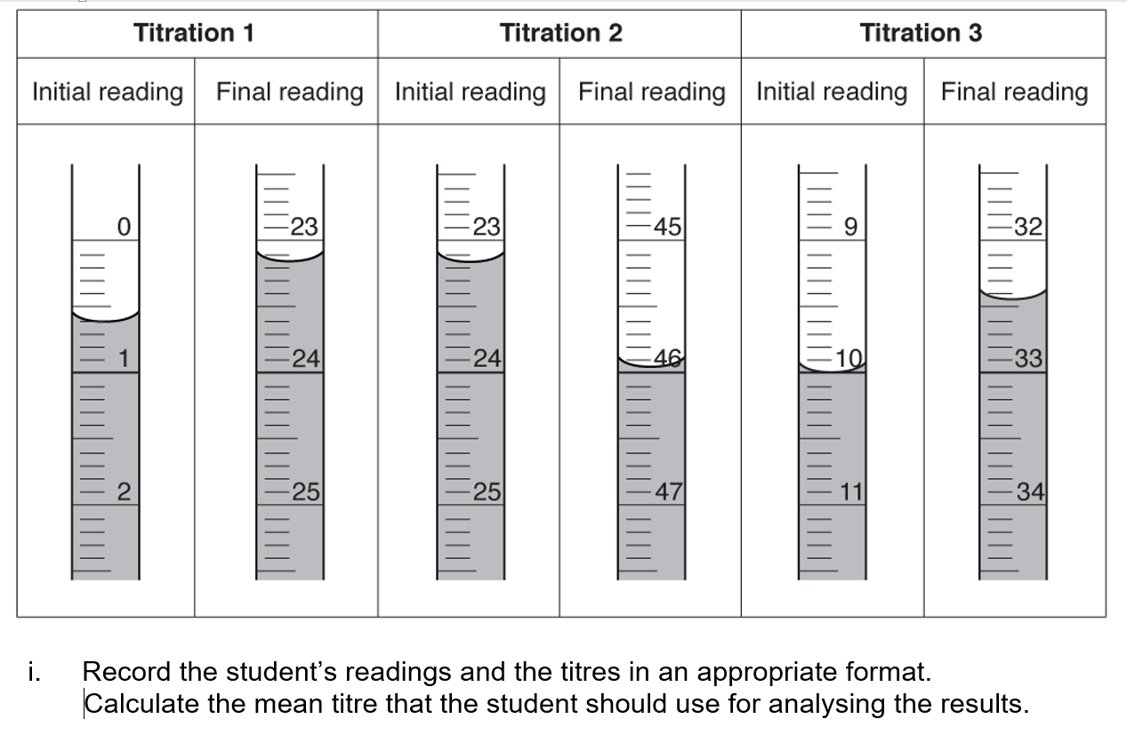

Slide 7
Average Titre = 22.20 cm³

Slide 8
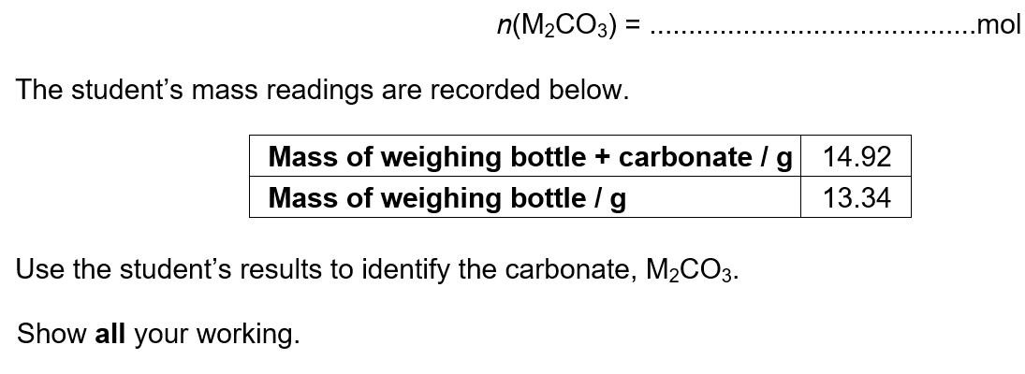
0.00111 x10 = 0.0111
25cm³→ 250cm³
n(M₂CO₃) in total = 0.00111 x 10 = 0.0111 mol (1) (took 25 cm³ from 250cm³ hence x10) Molar mass = 1.58/0.0111 = 142.3 g mol⁻¹ (1) (14.92-13.34=1.58g, divide by mol for MR) Mass of M = (142.3 − 60)/2 = 41.15 (= K) (1) (subtract 60 for Mr of CO₃ divide 2 for M₂) K₂CO₃ (1)

Slide 9
mol, of H₂SO₄ used to neutralise only the NaOH in 25.0 cm³ =

Slide 10
Mol of H₂SO₄ = 0.100 × 18.00 / 1000 = 1.80 × 10^{–3} mol ✔

Slide 11
Mol of NaOH in = 1.80 × 10^{–3} × 2 × 1000 / 25.0 = 0.144 mol dm^{–3} ✔

Slide 12
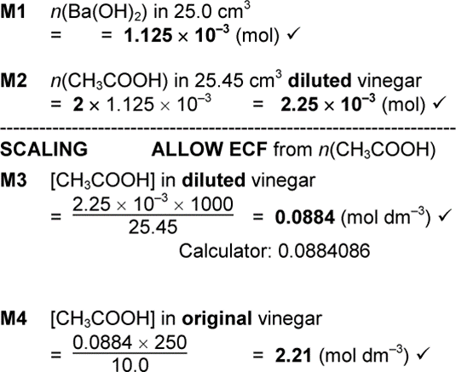
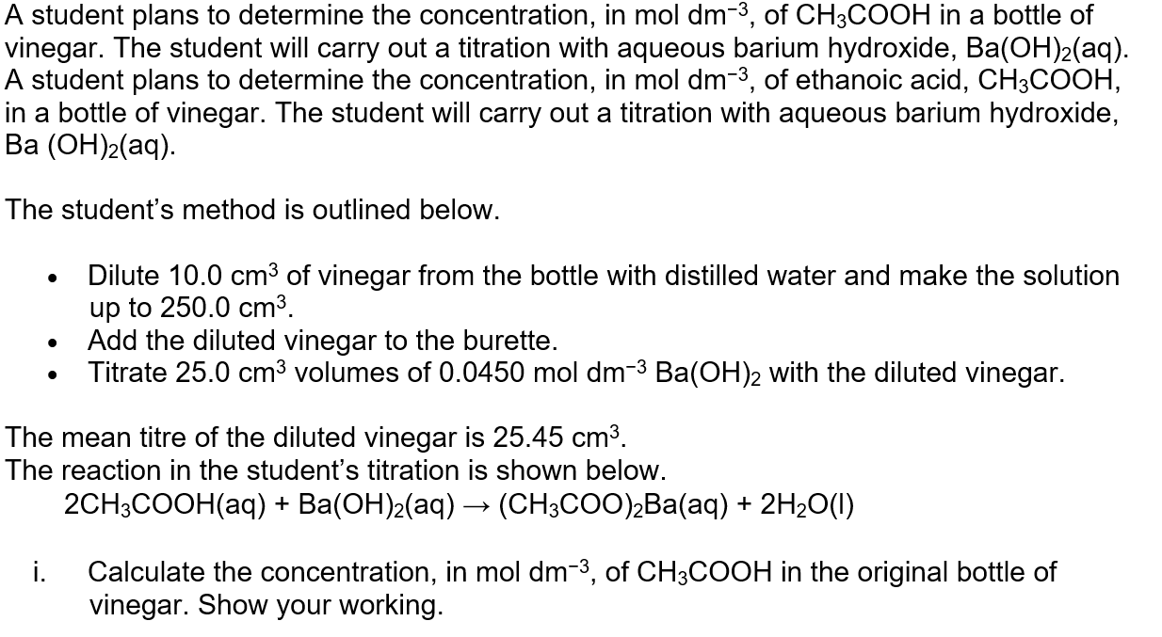
1. Mols standard Ba(OH)₂
2. Ratio to CH₃COOH, hence moles acid
3. Conc. CH₃COOH in diluted vinegar
3. Conc. CH₃COOH in original vinegar

Slide 14
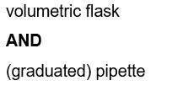

Slide 15
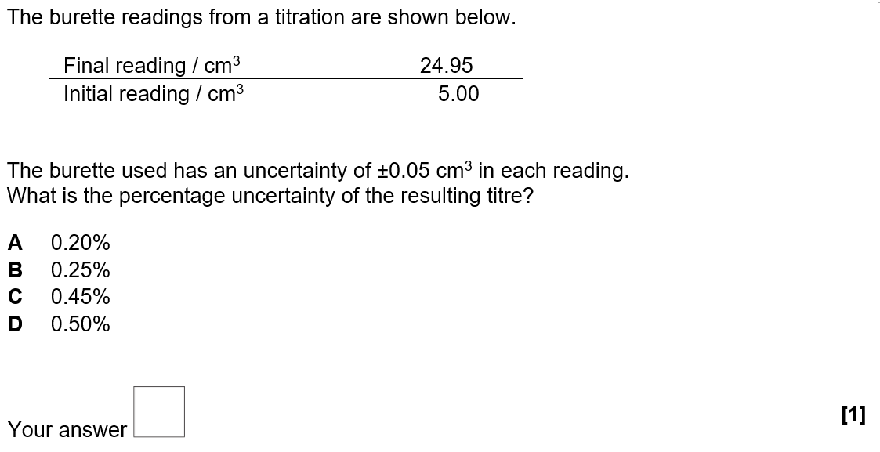
D: 0.5x2x100/(24.95-5.00)

Slide 16
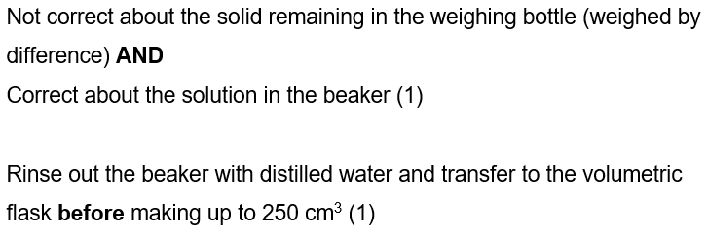

Slide 17
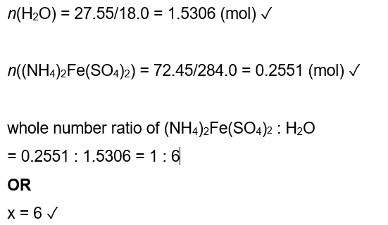
Note, to save time:
Mr (NH₄)₂Fe(SO₄)₂ = 284.0

