Slide 2
Aim
To discuss our similarities and differences.
To introduce the term ‘discrimination’.
To introduce the term ‘diversity’.
Success Criteria
I will be able to identify ways in which we are different and the same.
I will understand that the people I know are all different, and that these differences should be celebrated.
I will know what to do if I see discrimination.

Slide 3
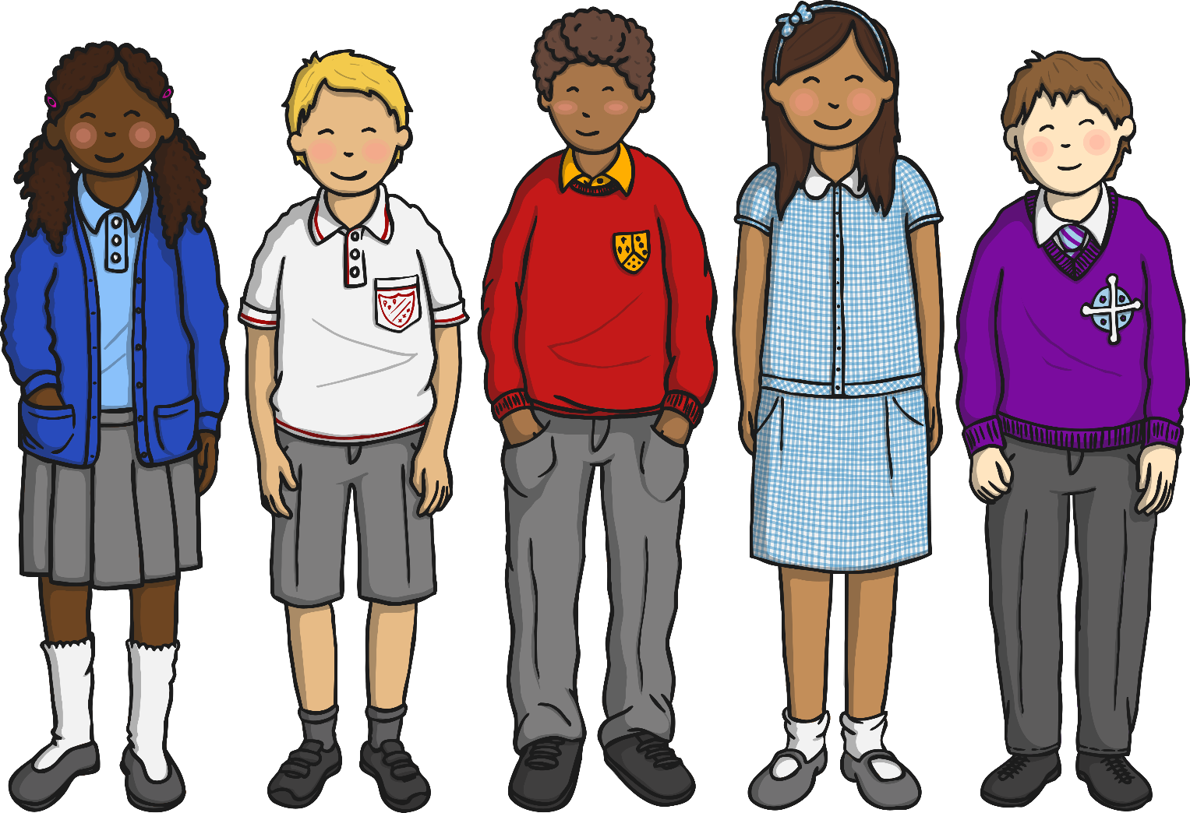
What Things Make Us Different?
No two people are ever the same! Look around your classroom and think about different people you know. What makes you different from each other?
Hair colour
Eye colour
Height
Skin colour
Type of family
What else?

Slide 4
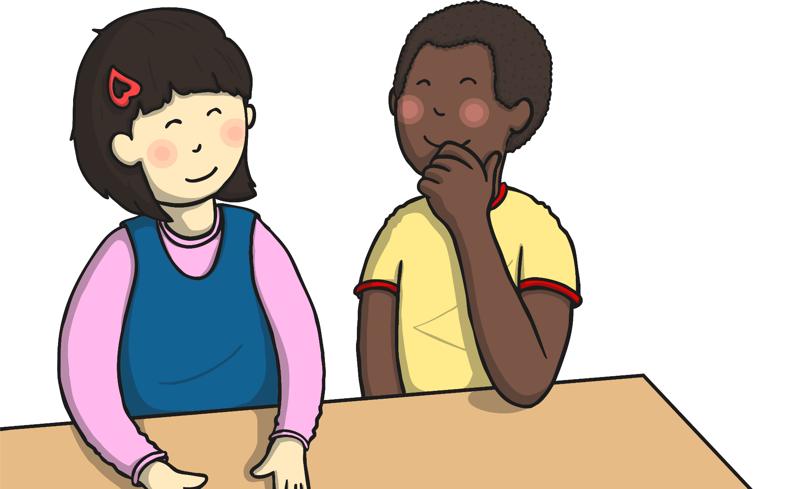
What Things Make Us Special?
Tell your partner one thing about them that is special. It might be the colour of their hair, or something that you know they like or are really good at.

Slide 5
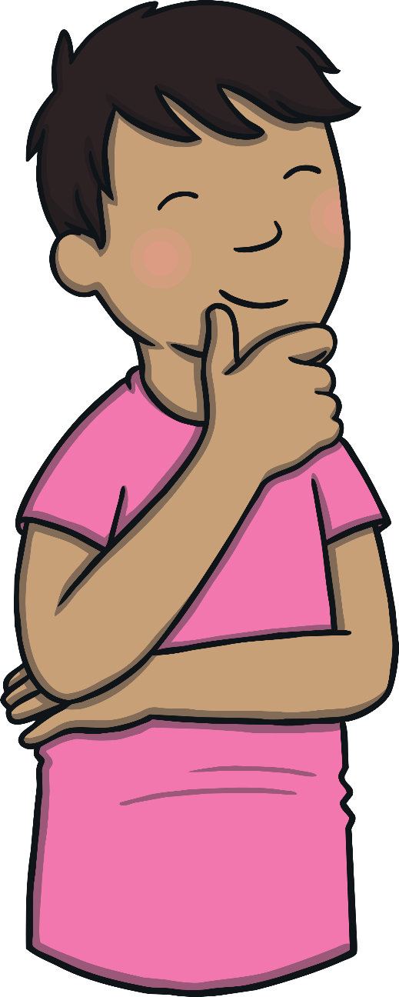
What If We Were All The Same?
Just imagine if everyone looked exactly the same and we all liked the same things.
Would life be as fun if we all looked the same and thought the same things? Probably not!
Talk to your partner about what you think life would be like if everyone looked the same and were good at the same things.

Slide 6
Why are People Different
Lots of people in this country have come from other countries – or their, families came from other countries. This is a good thing, because it means we have a mix of lots of different people living together.
We call this mix of different people living together diversity.
Look at this map of the world.
Do you or anyone in your family come from a different country? Do you know anyone who comes from a different country? Do you have any family who live in a different place?

Slide 7
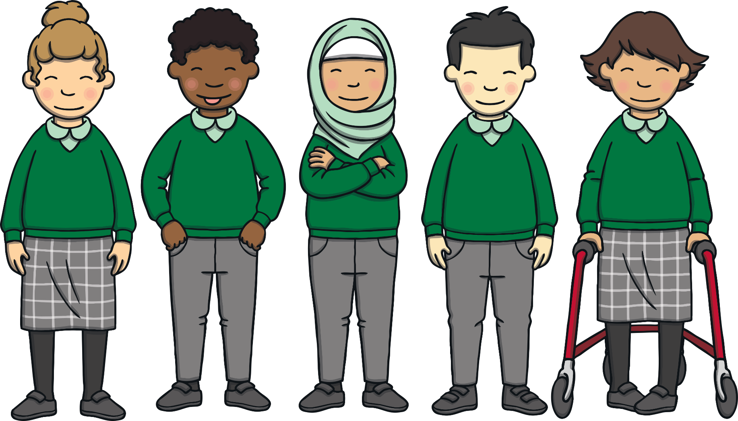
Respecting Differences
It is very important to respect people’s differences and not make fun of them. Being different is what makes us all special and interesting!
If you are unkind about the ways someone is different, this is called discrimination.

Slide 8
What to do if Discrimination is happening
If you thought you were being bullied because of your differences, what do you think you should do?
If you heard someone being unkind about differences at school, who would you tell? What would you do?
If you heard someone being unkind about differences at home, who would you tell? What would you do?

Slide 9
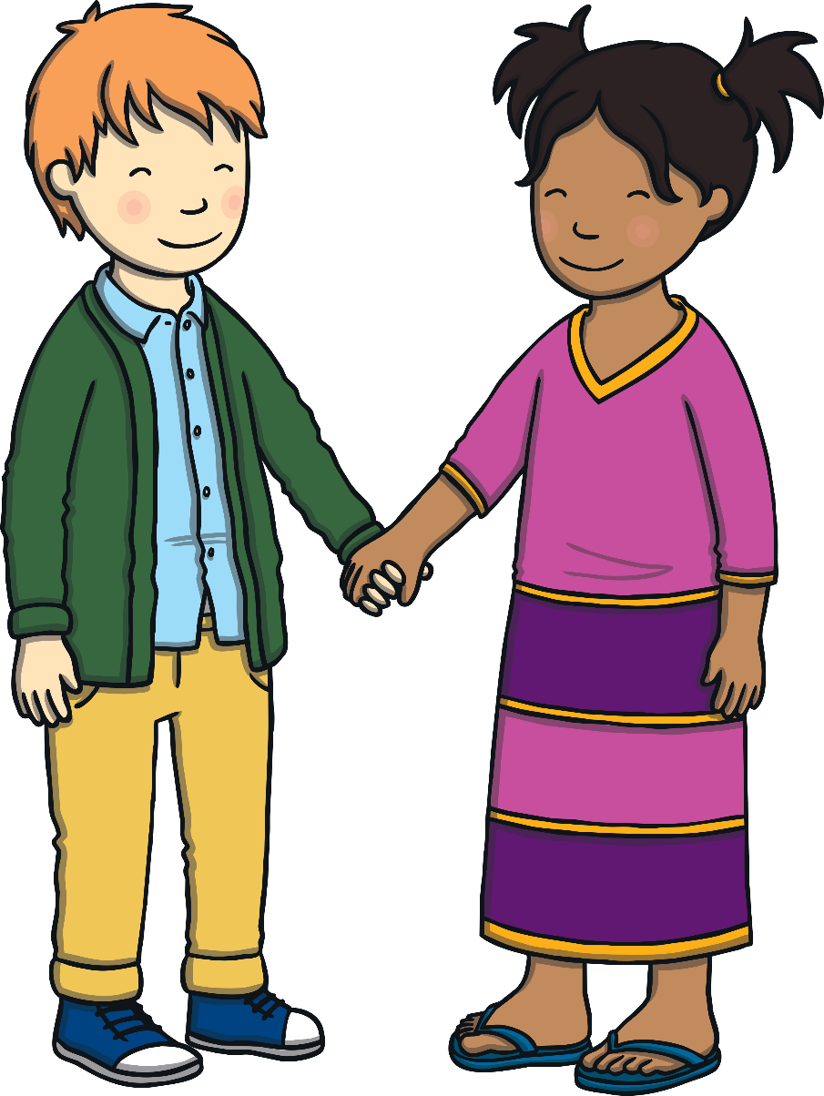
Reflection
What did you find out today that you didn’t know before?
If someone looks, acts or sounds different to you, this is a good thing! We are all different!
Differences are what make us all special.
We all have the right to our own thoughts and beliefs and this is what makes our school, and our world, a special place.

Slide 10
Aim
To discuss our similarities and differences.
To introduce the term ‘discrimination’.
To introduce the term ‘diversity’.
Success Criteria
I will be able to identify ways in which we are different and the same.
I will understand that the people I know are all different, and that these differences should be celebrated.
I will know what to do if I see discrimination.

