Slide 1
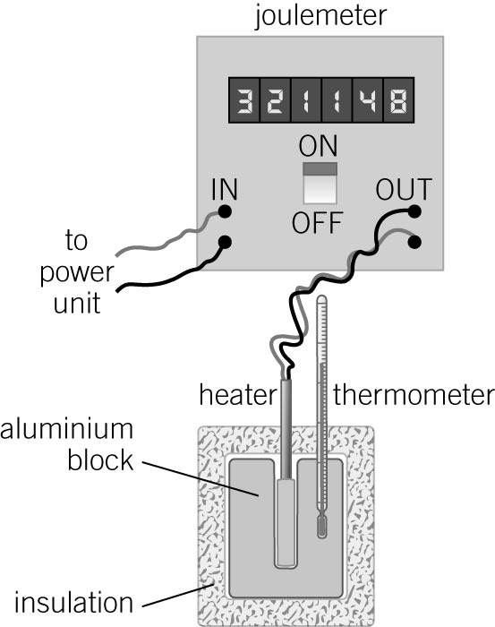
GCSE Required Practical – Physics 1 – Specific Heat Capacity
Specific Heat Capacity: the amount of energy needed to raise the temp of 1kg by 1°C
What’s the point of the practical?
To find out the specific heat capacity of a material.
(You’ll need to heat it and work out how much energy has gone in.)
Example Apparatus
Joulemeter – measures energy
going into the heater in joules
Heater – heats the block
Insulation – stops heat escaping
into the atmosphere
Thermometer – measures the
temperature rise
If you haven’t got a joulemeter, but do have a ammeter, voltmeter or power meter you can work out the amount of energy by:
Energy = power x time
Power = current x potential difference
Results:
What may they ask us about?
Why do you need to insulate the block (to stop heat loss to the atmosphere)
Why is your answer not the true value (because not all the heat was transferred into the block and through to the thermometer)
Why is the temperature increase slower at first? (because it takes some time for the block to heat up and for the heat to reach the thermometer.)
It may not be a block of metal. You could use a kettle to heat an amount of water or any other way of heating something.
What’s the resolution of temperature measurements? This experiment could be repeated and you’d get slightly different readings. They could ask about repeatability and ask you to calculate the mean or the uncertainty.

Slide 2
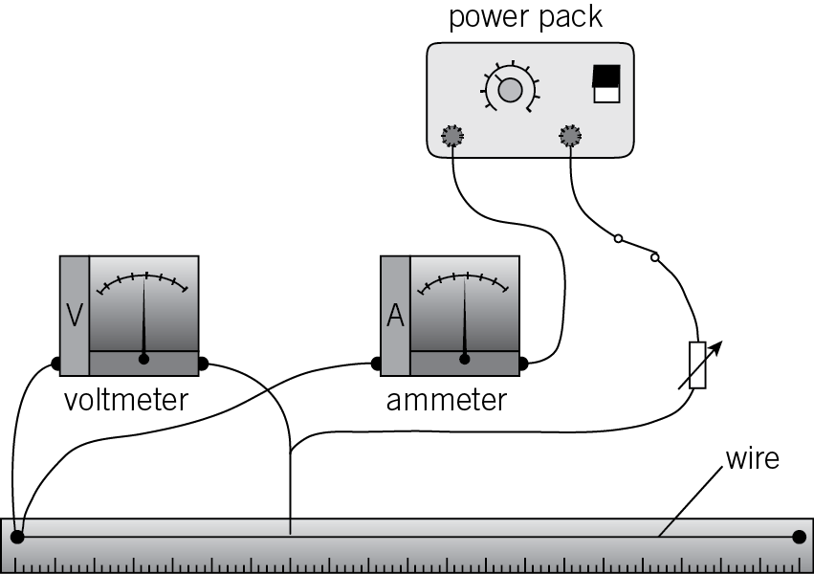
GCSE Required Practical – Physics 1 – Investigating Resistance
Resistance: how difficult it is for current to flow through part of the circuit.
What’s the point of the practical?
To find out resistance of a wire.
(You could look at different lengths of wire, different thicknesses, or even different temperatures)
Example Apparatus
Voltmeter: measures
the potential
Difference
Ammeter: measures
the current
Metre stick:
Measures the length of wire that the current is going through
Results:
The longer the wire, the more resistance
The thicker the wire, the less resistance
The higher the temperature the more resistance
What may they ask us about?
- Why must the power pack be kept on a low potential difference / What are the hazards (The wire will get very hot, could burn you)
- Explain how the temperature affects the resistance (as the wire gets hot, the ions inside the wire vibrate faster so there are more collisions with the electrons cannot flow as easily)
- Why is it important to switch the electricity off in between each reading (to let the wire cool down, as temperature affects resistance)
- What sort of error could cause all the ammeter/voltmeter readings to be too high (a zero error – the meters need to be set at zero to start with)
- Resolution of measurements, repeatability, reproducibility, control variables etc etc

Slide 3
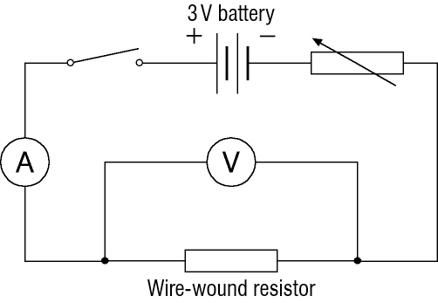
GCSE Required Practical – Physics 1 – Investigating Electrical Components (lamp, diode, resistor)
Component: part of a circuit Current: the flow of charge diode: only allows current to flow one way
Potential Difference (V): the energy transferred to part of a circuit by each coulomb of charge
Resistor: limits the current in a circuit
Example Apparatus
Voltmeter: measures
the potential
Difference
Ammeter: measures
the current
Resistor: what we’re testing. (can be replaced with a lamp, then a diode
What’s the point of the practical?
To find out how current and potential difference change in different components
Results:
Resistor lamp Diode
What may they ask us about?
- Explain the pattern for each component (resistor: fixed resistance – more PD =more current. Lamp: more PD = more current but at high PD, the filament gets hot, ions vibrate so resistance increases and current levels off. Diode: current can only flow in one direction)
- Resolution of measurements, repeatability, reproducibility, control variables etc etc

Slide 4
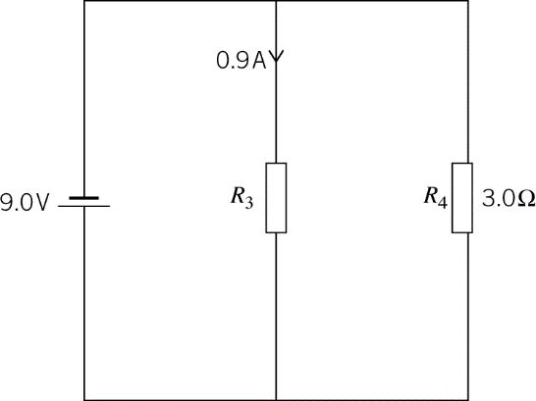
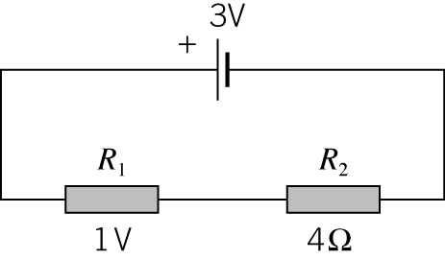
GCSE Required Practical – Physics 1 – Resistors in Series and Parallel
Resistor: limits the current in a circuit
Example Apparatus
What’s the point of the practical?
To find out what happens to the total resistance when resistors are put in series and in parallel
Results for series circuits
the total resistance is the same as both resistors added up. Each time you add a resistor, you get more resistance and less current
Series circuit
Parallel circuit
Results for parallel circuits
The total resistance is less than the smallest resistor. Each time you add more resistors, the current increases and the total resistance decreases. (the are more ‘routes’ overall for the current)
What may they ask us about?
Why aren’t your results completely accurate? (because the meters aren’t completely accurate, the power pack potential difference fluctuates slightly, the temperature of the wires changes which affects resistance)
What is the resolution of measurements? (e.g. 0.41A, 0.32A, 0.39A are all to 0.01 resolution)
They may ask you to calculate resistance, current or PD. Or ask what happens if you add/take away resistors.

Slide 5
GCSE Required Practical – Physics 1 – Resistors in Series and Parallel
Resistor: limits the current in a circuit
Example Apparatus
What’s the point of the practical?
To find out what happens to the total resistance when resistors are put in series and in parallel
Results for series circuits
the total resistance is the same as both resistors added up. Each time you add a resistor, you get more resistance and less current
Series circuit
Parallel circuit
Results for parallel circuits
The total resistance is less than the smallest resistor. Each time you add more resistors, the current increases and the total resistance decreases. (the are more ‘routes’ overall for the current)
What may they ask us about?
Why aren’t your results completely accurate? (because the meters aren’t completely accurate, the power pack potential difference fluctuates slightly, the temperature of the wires changes which affects resistance)
What is the resolution of measurements? (e.g. 0.41A, 0.32A, 0.39A are all to 0.01 resolution)
They may ask you to calculate resistance, current or PD. Or ask what happens if you add/take away resistors.

Slide 6

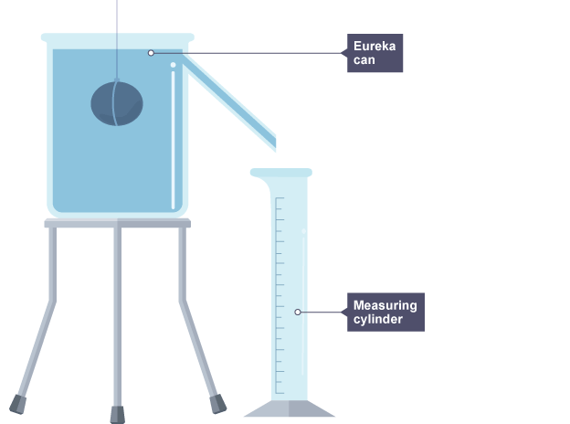
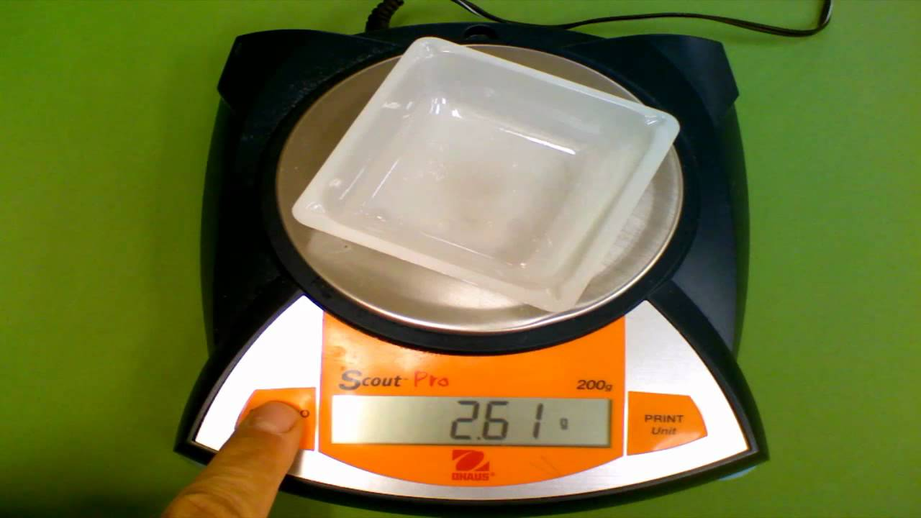
GCSE Required Practical – Physics 1 – Calculating Density
Density = a substance’s mass per unit volume.
What’s the point of the practical?
To find out the density of different materials.
Cubes of material are easy for volume (length x width x height). For irregular shapes, you need a eureka can to work out the volume
Example Apparatus
Results
Material | Mass (g) | Volume (cm³) | Density (g/cm³)
Aluminium | 22.3 | 8.0 | 2.79
Steel | 50.2 | 6.4 | 7.84
Finding Volume
Finding Mass
What may they ask us about?
What is the resolution of the balance? (0.1g in this case)
How could you get errors when using the eureka can? (water may spill out of the sides if you drop the object in too quickly / there may already be some water in the measuring cylinder / the water might not be at exactly the level of the spout)
How could you get errors when weighing the object (the balance may not be at exactly zero to start with (not calibrated))
What is the uncertainty of the measurements? (the balance has a ±0.05 uncertainty here as it only goes up in 0.1’s)

