Slide 1
D

Slide 2
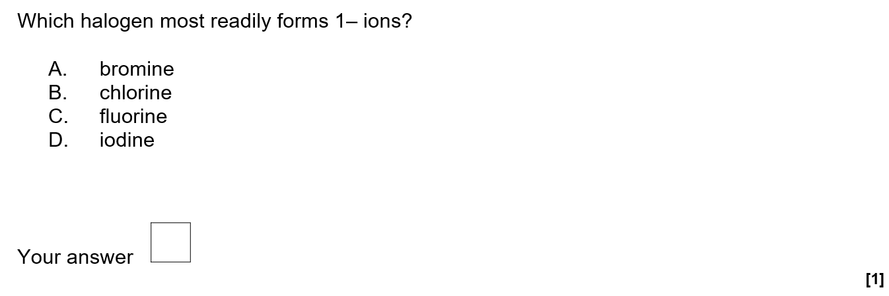
C

Slide 3
A

Slide 4
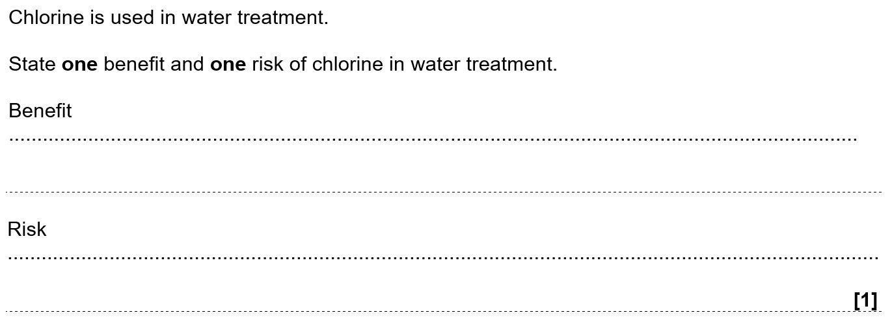
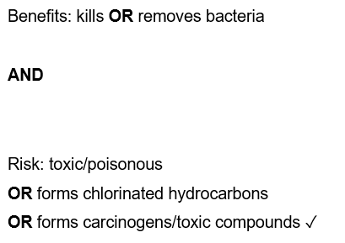

Slide 5
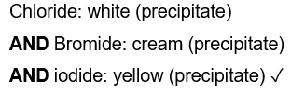

Slide 6
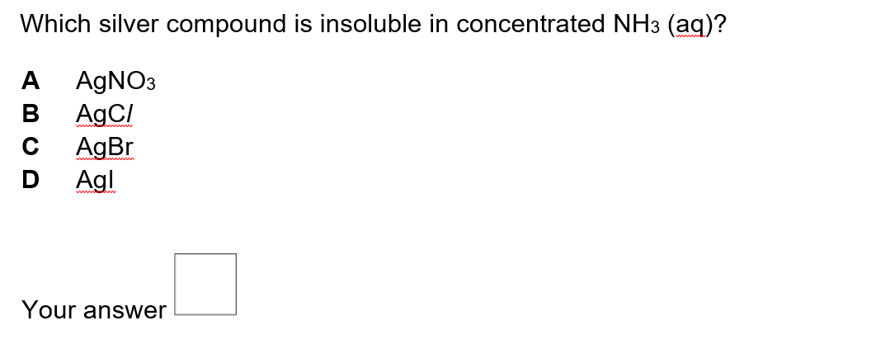
D

Slide 10
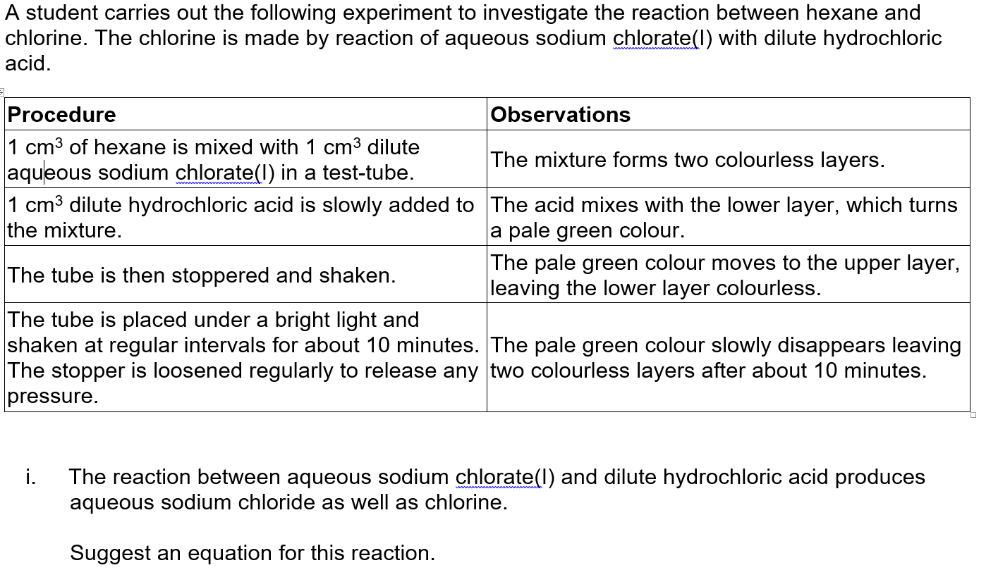

Slide 12
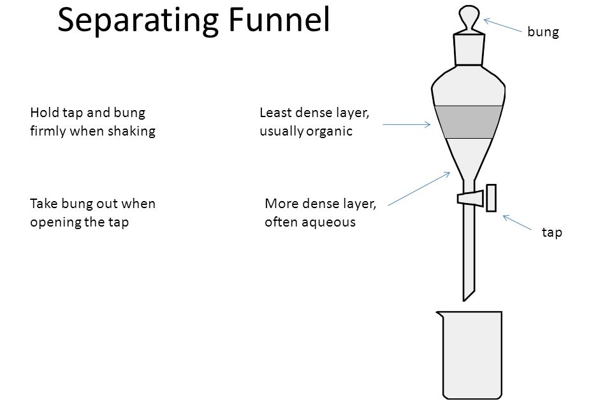
Name the apparatus that could be used to separate two immiscible liquid layers.

Slide 13
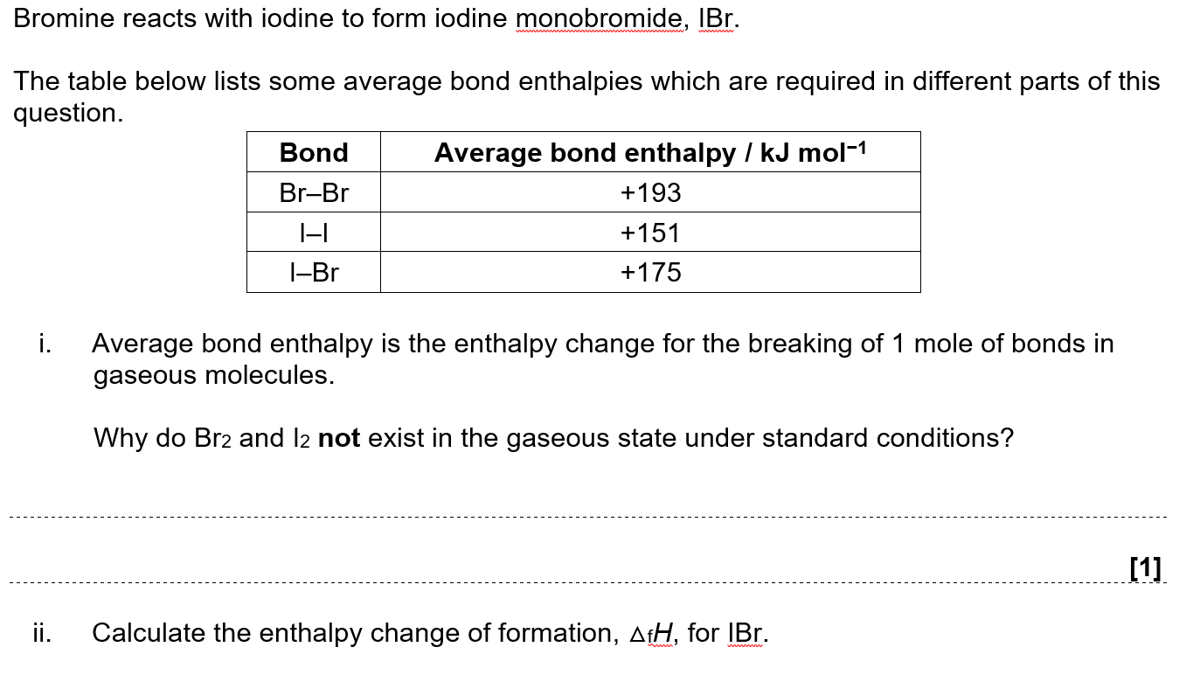
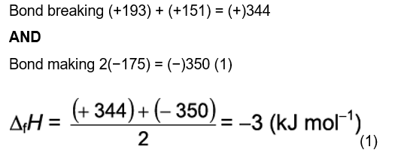

Slide 17
Complete the electron configuration of a bromide ion. [1]
1s2..........................................................................................................................
A student adds a small volume of aqueous silver nitrate to an aqueous solution of bromide ions in a test-tube. The student then adds a similar volume of dilute aqueous ammonia to the same test-tube.
Describe what the student would see in the test-tube after the addition of aqueous ammonia. [1]
Write an ionic equation for any precipitation reaction which occurs in the student's tests.
Include state symbols.

Slide 18
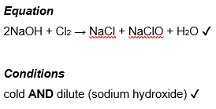
The Group 7 element chlorine reacts with sodium hydroxide, NaOH, under different conditions to give different products.
Chlorine reacts with aqueous sodium hydroxide to form bleach.
Write the equation and state the conditions for this reaction.
equation
conditions

Slide 19
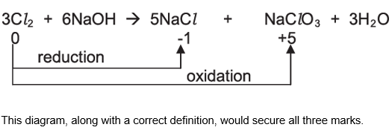
A disproportionation reaction takes place as shown below.
3Cl₂(g) + 6NaOH(aq) → 5NaCl(aq) + NaClO₃(aq) + 3H₂O(l)
State what is meant by disproportionation and show that disproportionation has taken place in this reaction. Use oxidation numbers in your answer.

Slide 20
Chlorine gas can be added to a cold, dilute alkaline solution to form bleach. Write the equation for this reaction. [1] A student bubbles chlorine gas through aqueous potassium iodide. A reaction takes place. State what the student would observe. [1] Write the ionic equation for this reaction. Include state symbols. [1]

Slide 21
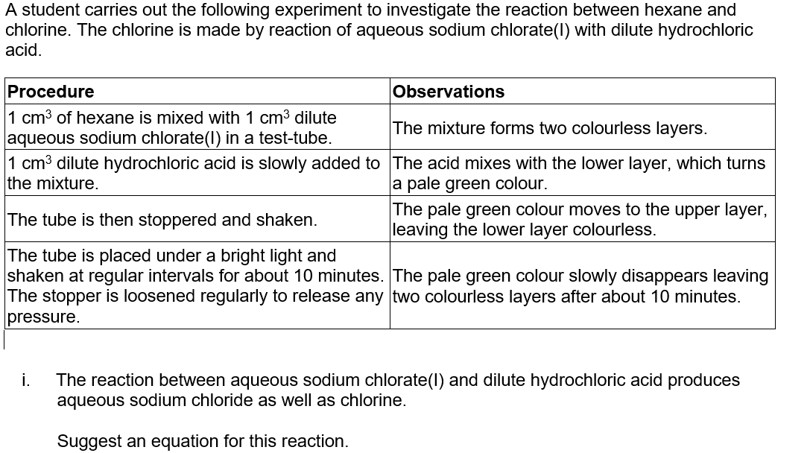

Slide 22
Outline a simple practical test that would confirm the presence of chloride ions in the lower layer, and give the expected result.
test: result:
Name the apparatus that could be used to separate the two liquid layers present at the end of the experiment.

Slide 23
Which halogen most readily forms 1– ions?
A. bromine
B. chlorine
C. fluorine
D. iodine

Slide 24
HBr(aq), forms two ions in solution.
Which observation is correct for reactions of HBr(aq)?
A. It effervesces addition of sodium carbonate solution.
B. It forms a white precipitate on addition of silver nitrate solution.
C. It turns orange on addition of silver nitrate solution.
D. It turns brown on addition of potassium chloride solution.

Slide 25
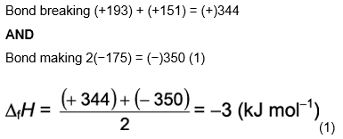
Bromine reacts with iodine to form iodine monobromide, IBr.
The table below lists some average bond enthalpies which are required in different parts of this question.
Average bond enthalpy is the enthalpy change for the breaking of 1 mole of bonds in gaseous molecules.
Why do Br₂ and I₂ not exist in the gaseous state under standard conditions?
Calculate the enthalpy change of formation, △_{f}H, for IBr.
ΔfH= .......................................... kJ mol−1 [2]

Slide 26
Bromine disproportionates when it reacts with potassium hydroxide solution.
Suggest an equation for this reaction.

Slide 27
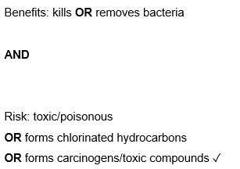
Chlorine is used in water treatment.
State one benefit and one risk of chlorine in water treatment.
Benefit
Risk

Slide 28
Precipitation reactions can be used to distinguish between halide ions.
State the reagent needed for these precipitation reactions. [1]
How would the appearance of the precipitates allow you to distinguish between chloride, bromide and iodide ions?
Chloride
Bromide Iodide

