Slide 1
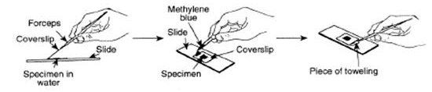
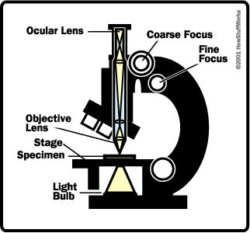
GCSE Required Practical – Biology 1 – Using a light microscope
What’s the point of the practical?
To find out what cells look like and see how big they are and see how they work.
Example Apparatus
Use a stain to make things
visble (cell wall, nucleus).
Get the specimen as flat and
thin as possible.
Start on the smallest lens,
focus, then move up a lens.
a ruler, or eyepiece scale can
be used to measure size
Use the equation:
Magnification = ___image size____
actual object size
What may they ask us about?
Make sure you can use and rearrange the equation
Make sure you know the units:
  1mm = 1000um
  1um = 1000nm
  You may need a ruler to measure the size of images and work out their real size.
  Explain why we can see the nucleus and cell wall but not the mitochondria (they’re far too small and not stained)
  How can we see smaller parts of cells? (An electron microscope has much more resolution and magnification)

Slide 2
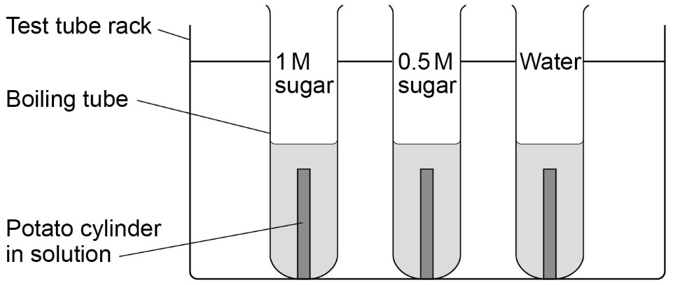
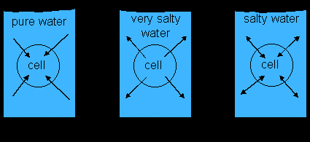
GCSE Required Practical – Biology 1 – Investigating Osmosis
Osmosis: the movement of water from an area with high concentration OF WATER, to an area with lower concentration OF WATER.
Solute: something that dissolves in water
Example Apparatus
Different concentrations of sugar (or salt)
Measure the length (or mass) of the potato cylinders before and after.
What’s the point of the practical?
To find out what happens to cells when you put them in different concentrations of sugar or salt solutions. (to see how the water moves in or out of the plant tissue)
Results
- High concentration of sugar in solution = water moves out of potato cells into the solution. Potato gets smaller.
Low concentration of sugar in solution = water moves into the potato cells from the solution. Potato gets bigger.
If no water goes in or out of the potato overall and it doesn’t change mass, then the solution is exactly the same concentration as inside the potato
What may they ask us about?
Control variables
Accuracy of measurements – why should you remove excess water with paper towel before weighing
Use a graph of results to find the concentration inside the potato cells
Why can the water, but not the sugar/salt move through the membrane?

Slide 3
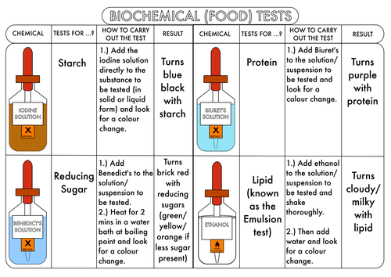
GCSE Required Practical – Biology 1 – Food Tests
What’s the point of the practical?
To find out if sugars, starch and/or proteins are in certain foods.
What may they ask us about?
Qualitative test (tell you just yes/no) vs Quantitative (tells you how much) tests.
Sources of error – how could you make mistakes?
Why is it hard to judge colour change accurately?
Resolution of measurements, repeatability, reproducibility etc.
Example Apparatus and results

Slide 4
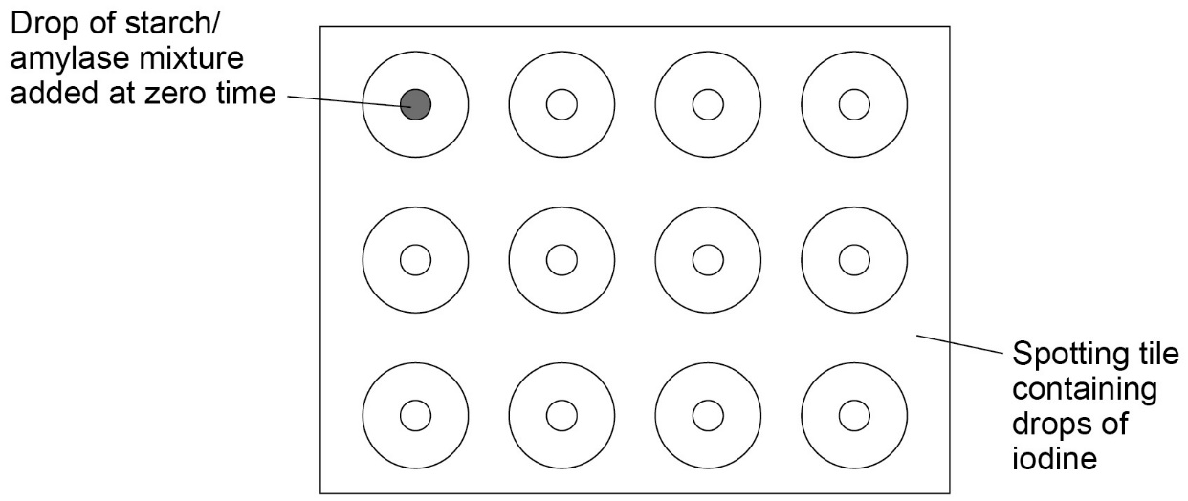
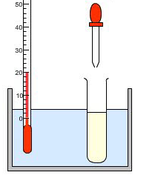
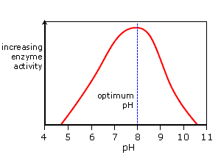
GCSE Required Practical – Biology 1 – Investigating amylase enzyme
Enzyme: a biological catalyst. Speeds up reactions in the body by
lowering the activation energy.
pH: how acidic or alkali a substance is (1 = strong acid, 7=neutral,
14 = strong alkali)
Amylase: an enzyme that breaks down starch into sugar
Example Apparatus
Starch reacts with amylase in a water bath
Take samples from the mixture every 30 seconds and add it to iodine
Iodine goes black = starch present
Iodine stays brown = no starch present (it’s reacted)
What’s the point of the practical?
To find out what happens to the rate of enzyme activity when the pH changes.
Results
- At low pH and high pH,
the iodine keeps turning
black because the enzyme
has been denatured.
- After just a few minutes
at pH 7-9, the iodine stays
brown – the starch has all
broken down into sugar.
What may they ask us about?
Why do you need a water bath? (To maintain the correct temperature, because temperature affects reaction rate)
If you test at pH 3,4,5,6,7,8,9 and 10, Why don’t we know the exact optimum pH? (because although two answers may both show quick reactions (e.g. pH7 and pH8), the actual optimum could be between those number (e.g. pH 7.6) so you need to test different pH’s to find out the exact optimum.
Sources of error and weaknesses – e.g. in measuring, starting and stopping timers etc

Slide 5
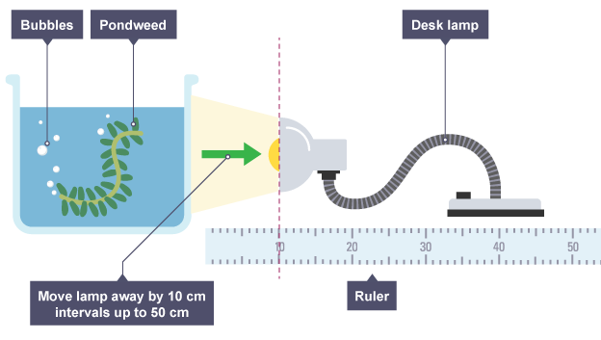
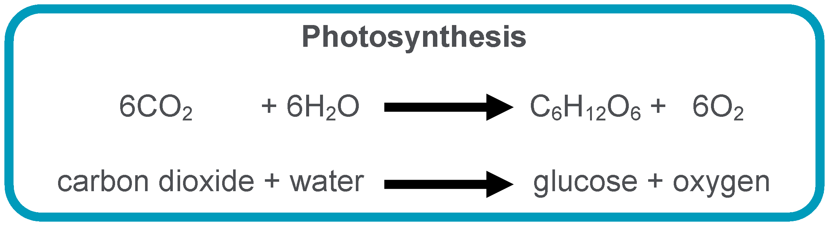
GCSE Required Practical – Biology 1 – Light and Photosynthesis
Photosynthesis: when plants use carbon dioxide and water to make glucose (and oxygen). Happens in the chloroplast and needs light to happen.
Example Apparatus
What’s the point of the practical?
To find out what happens to the rate of photosynthesis when we change the light intensity
Results
- The closer the lamp, the quicker the bubbles are produced (so higher rate of photosynthesis)
What may they ask us about?
Why results may be inaccurate (difficult to count very small bubbles, each bubble counts as ‘1’ no matter how big it is)
Why should you leave the plant for a few minutes before starting to count bubbles (as it takes time for the plant to adjust to the light/temperature and for photosynthesis to reach the correct rate).
Heat from the lamp is a source of error, how could you avoid this? (Place a glass screen in front of the beaker so that light gets through but heat doesn’t)
What are the other limiting factors apart from light? Why will rate of photosynthesis level off, even with maximum light? (The plant also needs enough temperature and CO₂)

