Slide 1
The Structure of the Atom
Learning Objectives:
Describe the structure of the atom and name the sub atomic particles making it up.
Use the periodic table to find the combinations of particles making up different atoms.
Explain the term isotope.
Key Words:
Atom, Electron, Proton, Neutron, Nucleus, Sub-atomic particle, Isotopes

Slide 2
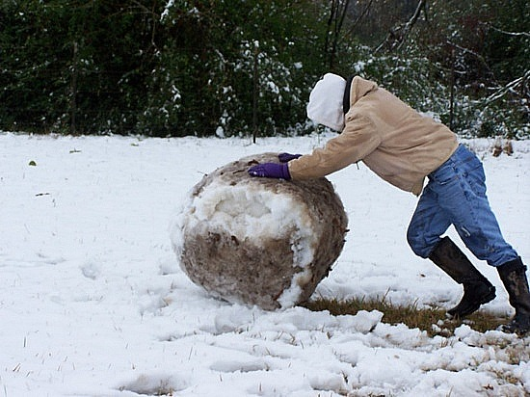
Starter Snowball
What do you know about atoms?
Start the snowball – on your own
- Think about what you know about atoms.
Grow the snowball – in pairs
- Pick out the best ideas you have had between the two of you.
Still growing! – pair your pairs
- join another pair. In fours pick the two best ideas you have come up with between the four you.

Slide 3
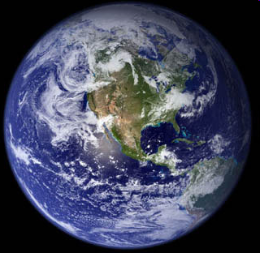
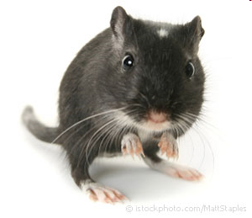
Atoms: very small
If an atom was the size of a full stop, then the average gerbil would be the size of the Earth.

Slide 4
Atomic Structure
-
-
+
+
Particle | Mass | Charge
Electron | Negligible | -1
Proton | 1 | +1
Neutron | 1 | none
-
+
+
-
+
+
-
-

Slide 5
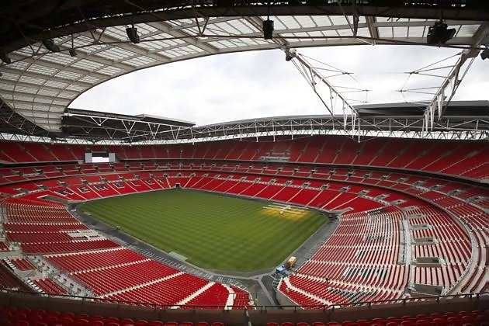
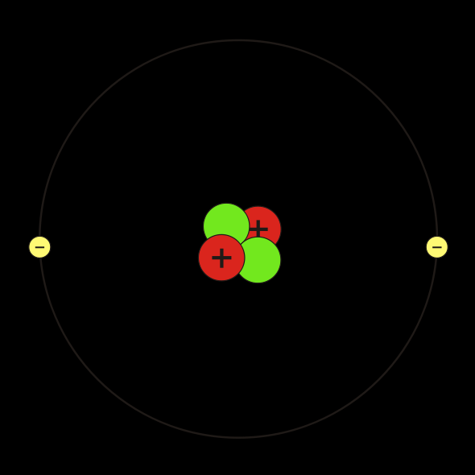
Most of the atom is empty space!
If you imagine an atom being the size of Wembley stadium, the nucleus would be about the size of a football on the centre spot.
The electrons would be two peas flying around the whole stadium. The rest of it: emptiness.

Slide 6
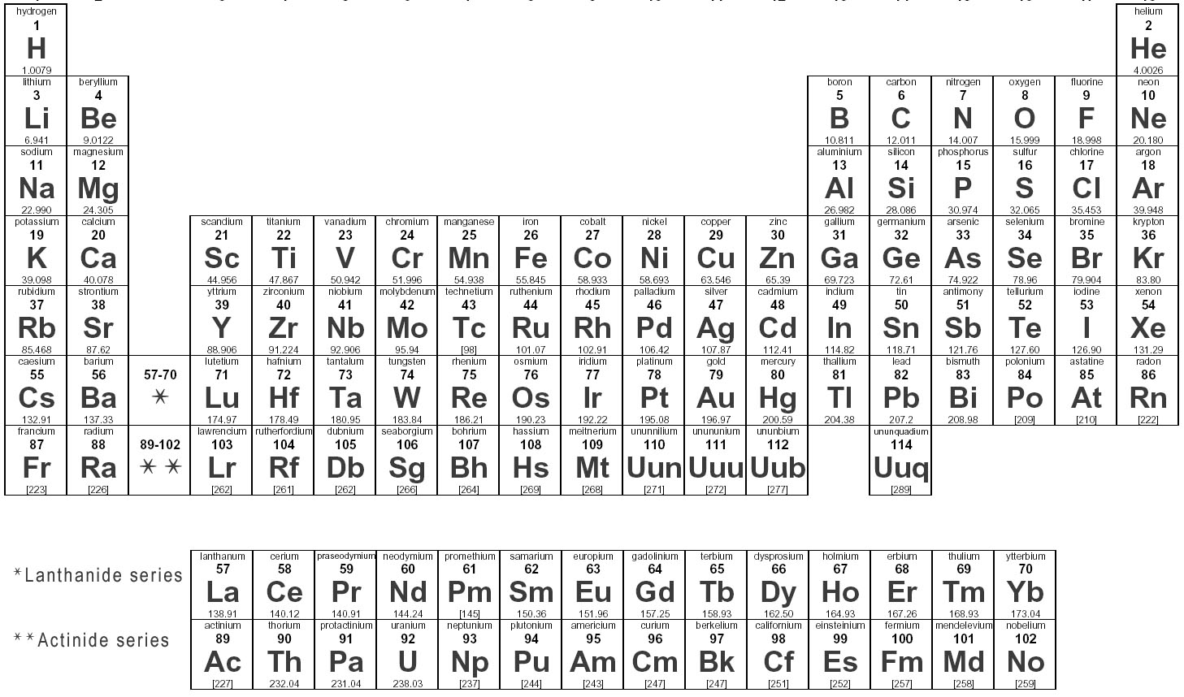
The Periodic Table

Slide 7
Lithium
No. of protons + neutrons
Mass number
Number of protons
Number of electrons
=
Li
7
Lithium
Electrons | 3
Protons | 3
Neutrons | 4
3
Atomic number does not always equal the number of neutrons.
Atomic number or proton number
(No. of protons)

Slide 8
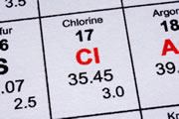
Isotopes
Why is the mass number of chlorine not a whole number?

Slide 9
Isotopes
An isotope is an atom with the same number of protons but a different number of neutrons:
Notice that the mass number is different. How many neutrons does each isotope have?
16
17
18
O
O
O
8
8
8
Each isotope has a different number of neutrons but still 8 protons – if it didn’t then it just wouldn’t be oxygen any more.

Slide 10
TASKS
Answer the following questions
1) What three particles is an atom made of?
2) Which particle is: a) positively b) negatively c) neutrally charged?
3) Lithium is represented by the symbol: how many: a) protons b) neutrons c) electrons are there?
4) Lithium also has the isotopes: what do you notice about the atomic/proton number

