Slide 1
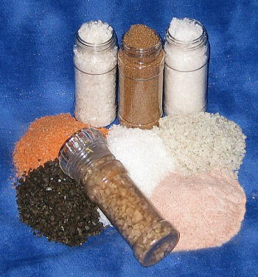
Salts
Learning Objectives:
State that a salt is produced when the H⁺ ion of an acid is replaced by a metal ion or NH₄⁺
Describe the reactions of a acid with carbonates, bases and alkalis, to form a salt.
Understand that a base readily accepts H⁺ ions from an acid.
Key Words:
Acid, base, anion, cation, salt, metal ions,

Slide 2
Salts
Salt: an ionic compound formed from an acid when the H⁺ ion has been replaced by a metal ion or other positive ion e.g. NH₄⁺
A salt is an ionic compound with the following features:
The positive cation in a salt is usually a metal ion or an ammonium ion, NH₄⁺
The negative anion in a salt is derived from the acid.
The formula of a salt is the same as the parent acid, except the H+ ion is replaced by the positive ion
Sulphuric acid → Sulphate salts
H₂SO₄ → K₂SO₄ - Potassium sulphate
Hydrochloric acid → Chloride salts
HCl → NaCl -Sodium Chloride
Nitric Acid →Nitrate salts
HNO₃ → Ca(NO₃)₂ - Calcium nitrate

Slide 3
Formation of Salts
Salts can be produced by neutralising the following types of chemicals with acids
Carbonates, Bases, Alkalis
Salts from Carbonates –
Acid + carbonate → salt + carbon dioxide + water
HCl(aq) + CaCO₃(s) → CaCl₂(aq) + CO₂(g) + H₂O(l)
Salts from Bases –
Acid + base → salt +water
HCl(aq) + CaO(s) → CaCl₂(aq) + H₂O(l)
Salts from Alkalis
Acid + alkali → salt + water
HCl(aq) + NaOH(aq) → NaCl(aq) + H₂0(l)

Slide 4
Ammonium Salts as Fertilisers
Ammonium salts can be used as artificial fertilisers
Ammonium salts are formed when acids are neutralised by ammonia;
NH₃(aq) + HNO₃(aq) → NH₄NO₃(aq)
Farmers and gardeners use these fertilisers to add soluble forms on nitrogen to the soil to help plants grow.
The amount of fertiliser needed needs to be carefully calculated to get the best amount of nitrogen into the soil for good growth but not overload and poison it.
So you can calculate the amount of N by percentage mass in a particular type of fertiliser compound.

Slide 5
Questions
Write a balanced equation for the following reactions;
a) Hydrochloric acid with potassium hydroxide.
b) Nitric acid with calcium hydroxide.
c) Sulphuric acid with sodium hydroxide.
d) Nitric acid with magnesium carbonate.
e) Phosphoric acid, H₃PO₄, with sodium carbonate.
2) a) Write balanced equations for formation of ammonium salts from ammonia and:
i) hydrochloric acid
ii) sulphuric acid
iii) phosphoric acid
b) Each of the ammonium salts above can be used as fertiliser. Calculate the percentage of N by mass in each.

Slide 6
Water of Crystallisation
Learning Objectives:
Explain the terms anhydrous, hydrated and water of crystallisation
Calculate the formula of a hydrated salt using percentage composition, mass composition or experimental data.
Key Words:
Salt, hydrated, anhydrous, water of crystallisation

Slide 7
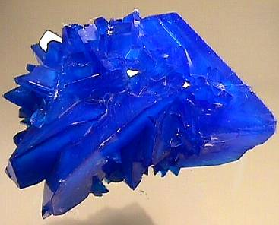
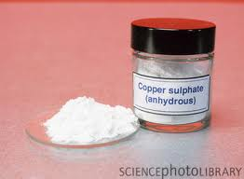
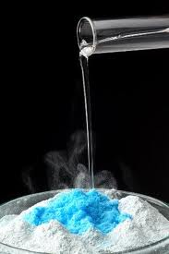
Hydrated Crystals
Hydrated copper sulphate
CuSO₄.5H₂O
Copper sulphate (anhydrous)
CuSO₄ (no water)
Hydrated: a compound that contains water molecules
Anhydrous: a substance that contains no water molecules

Slide 8
Water of Crystallisation
If a solid material has been made from an aqueous solution the product will frequently contain water.
This is called the water of crystallisation.
The hydrated form of a compound is written in a special way;
The empirical formula of the compound is separated from the water of crystallisation by a dot.
The number of water molecules in the formula is sown after the dot.
Hydrated copper sulphate has 5 water molecules for each formula unit: CuSO₄.5H₂O

Slide 9
Water of Crystallisation
Other examples:
Copper sulphate pentahydrate - CuSO₄.5H₂O
Cobalt chloride hexahydrate - CoCl₂. 6H₂O
Sodium Sulphate decahydtrate – Na₂SO₄.10H₂O

Slide 10
Working out the formula for a Hydrated Salt
This is the same as the method for empirical formula.
There is an additional final step to find the number of water molecules.
The secret is to use the number of H atoms to work out the number of water molecules of crystallisation.
Don’t rely on the number of O as some of these are included in other ions e.g. SO₄²⁻.
Salt | Empirical Formula | Dot Formula
Hydrated magnesium chloride | MgCl₂H₁₀O₅ | MgCl₂.5H₂O
Hydrated sodium carbonate | Na₂CH₂₀O₁₃ | Na₂CO₃.10H₂O
Hydrated calcium nitrate | CaN₂H₈O₁₀ | Ca(NO₃)₂.4H₂O

Slide 11
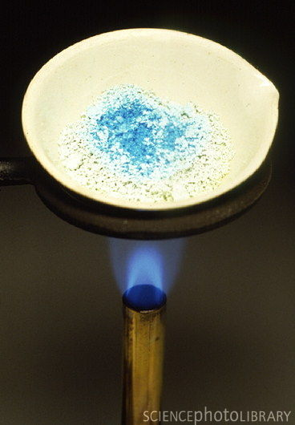
Calculating the formula of a Hydrated Salt
If you heat a hydrated salt the water will be removed by evaporation.
If you find out:
The mass of the hydrated salt.
The mass of the anhydrous salt.
The difference in mass (the mass of water).
E.g.
Mass of MgSO₄.xH₂O = 4.312 g
Mass of MgSO₄ = 2.107 g
Mass of water = 2.205 g
n(MgSO₄) = 2.107/120.4 = 0.0175 mol
n(H₂O) = 2.205/18 = 0.1228 mol
Ratio MgSO₄:H₂O = 1:7
Therefore the formula;
MgSO₄.7H₂O

Slide 12
Water of Crystallisation
Questions:
You are supplied with three empirical formulae. Write down the dot formula of each salt to show the water of crystallisation.
a) BaCl₂H₄O₂ b)ZnSH₁₄O₁₁ c) FeN₃H₁₂O₁₅
2) From the data below work out the formula of the hydrated salt.
Mass of CaCl₂.xH₂O = 6.573 g
Mass of CaCl₂ = 3.333 g
x = 6

