Slide 1
Key Word | Definition
Complex Ion | Metal ion surrounded by co-ordinately bonded ligands
Coordinate Bond | A covalent bond in which both electrons in the shared pair come from the same atom
Coordination Number | The number of coordinate bonds to ligands that surround a transition metal ion
Ligand | An ion or molecule that forms a coordinate bond with a transition metal
Unidentate | Ligand that can only form one coordinate bond
Bidentate | Ligand that can form two coordinate bonds
Multidentate | Ligands that can form more than one coordinate bond
-

Slide 2

COMPLEXES
Complexes are formed when transition metals or their ions form co-ordinate (dative) bonds with ligands
A complex ion is an ion comprising of one or more ligands attached to a central metal cation by means of a dative covalent bond
Cations are
positive
(“pussy-tive) ions

Slide 3
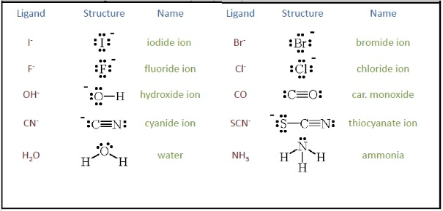
LIGANDS
A ligand is a species which can use its lone pair of electrons on one of its atoms to form a dative covalent bond with a transition metal
Examples of ligands are:
  H₂O
  NH₃
  Cl⁻
  OH⁻
  CN⁻

Slide 4
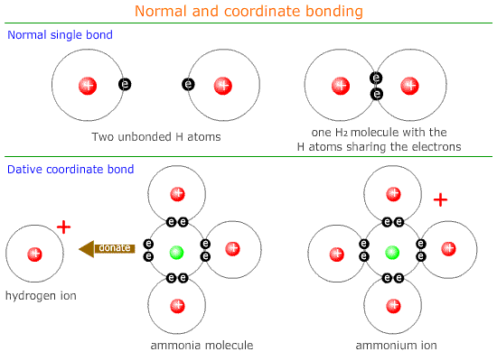
CO-ORDINATE BOND
A co-ordinate bond (dative covalent bond) is a covalent bond in which both electrons come from the same atom
In the case of
complex ions, the
co-ordinate bonds
are formed by the
overlap of an orbital
containing a lone
pair of electrons
with a vacant orbital
on the transition
metal

Slide 5
CO-ORDINATION NUMBER
The number of lone pairs of electrons which a cation can accept is known as the coordination number of the cation
It depends on the size and electronic configuration of that cation, and also on the size and charge of the ligand
Coordination number 6 is the most common, although 4 and 2 are also known

Slide 6
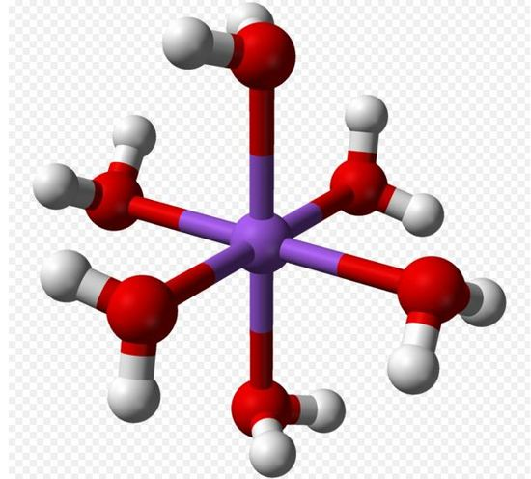
EXAMPLE
An example of a complex ion is:
[Cu(H₂O)₆]²⁺
Note that the formula of
the ion is always written
inside square brackets
The overall charge is written
outside the brackets
H₂O
H₂O
OH₂
Cu²⁺
H₂O
OH₂
OH₂

Slide 7
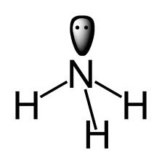
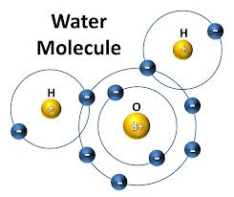
UNIDENTATE LIGANDS
Meaning ‘single toothed’ → form 1 co-ordinate bond
Common unidentate ligands are H₂O, Cl⁻, NH₃ and CN⁻
Can be negatively charged ions or neutral molecules
Ammonia only has 1 pair of electrons to donate
Water has 2 lone pairs. BUT they are so close together it can only form one coordinate bond at a time!

Slide 8
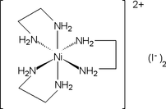
  BIDENTATE LIGANDS
  Ligands that can form two co-ordinate bonds since they donate two lone pairs of electrons (from two donor atoms)
  Examples:
    Ethane-1,2-diamine
    (NH₂CH₂CH₂NH₂)
Each ethane-1,2-diamine molecule forms 2 coordinate bonds with the metal ion
2 amine groups. Each has a lone
pair of electrons to donate

Slide 9
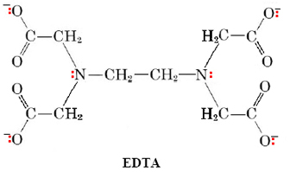
  MULTIDENTATE LIGANDS
  Can form three or more co-ordinate bonds by donating at least three lone pairs of electrons to the metal ion
  Extremely stable since the reaction results in an increase in entropy
  EDTA is a common
  example
  How many coordinate
  bonds can it form?
Ethylenediaminetetracetate

Slide 10
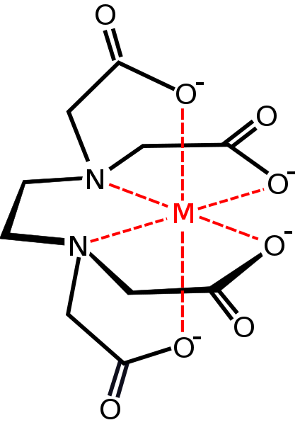
EDTA⁴⁻ has six lone pairs (two on nitrogen atoms and 4 on oxygen atoms)
It can form six coordinate bonds with a metal ion
Complex ions with multidentate ligands are called chelates (‘key-lates) from the Greek word for claw

Slide 11
MULTIDENTATE LIGANDS
[Cu(H₂O)₆]²⁺ + EDTA ➔ [Cu(EDTA)]²⁻ + 6H₂O
They can be used to remove metal ions from solution
The six water ligands are replaced by one EDTA ligand
This results in an increase in the number of particles in solution
Hence an increase in entropy

Slide 12
TYPES OF LIGAND
The charge on the ligand and the oxidation state of the metal determines the overall charge of the complex
Neutral ligands result in positively charged complexes, where the overall charge of the complex equals the oxidation state of the metal ion
Negatively charged ligands result in a negatively charged complex

Slide 13
OXIDATION STATES
Overall charge on a complex ion is its total oxidation state
It’s put outside the brackets
You can work out the oxidation state of the metal ion by:
Oxidation state of metal ion
Total oxidation state of complex
Sum of oxidation states of ligands
=
-

Slide 14
OXIDATION STATES
Back to this example:
[Cu(H₂O)₆]²⁺
Overall = 2+
H₂O ligands → 12 H’s = +12
→ 6 O’s = -12
Cu²⁺ ion has an
oxidation state of +2
Cu²⁺ ion has a co-ordination
number of 6
H₂O
H₂O
OH₂
Cu²⁺
H₂O
OH₂
OH₂

Slide 15
QUESTIONS
Work out the oxidation states (OS) and co-ordination numbers (CN) of the following complexes:
[Cu(H₂O)₆]²⁺ OS: +2 CN:6
[Ag(NH₃)₂]⁺ OS: +1 CN:2
[Cu(NH₃)₄]²⁺ OS: +2 CN:4
[Cu(Cl)₄]²⁻ OS: +2 CN:4
[Fe(CN)₆]³⁻ OS: +3 CN:6
CN OS = -1

Slide 16
SHAPES OF COMPLEXES
The co-ordination number dictates the shape of the complex
This is the number of coordinate bonds formed with the central metal ion
  2 co-ordinate = linear
  4 co-ordinate = tetrahedral
  6 co-ordinate = octahedral

Slide 17
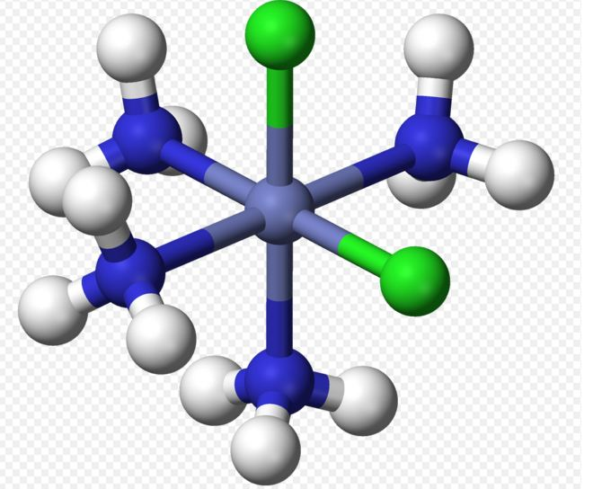
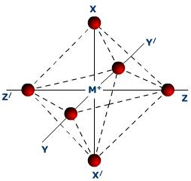
SIX COORDINATE BONDS
Octahedral shape
6 points BUT 8 faces
Use the molymods to create each complex molecule & draw it in your notes
Make the one below and then try [Co(NH₃)₆]³⁺

Slide 18
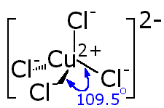
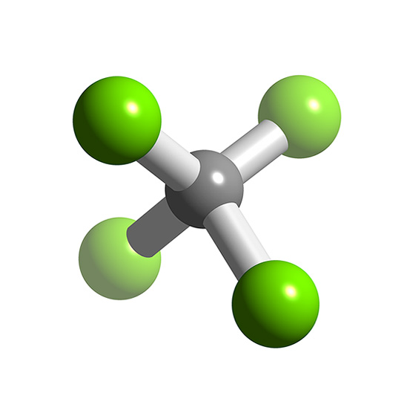
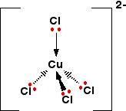
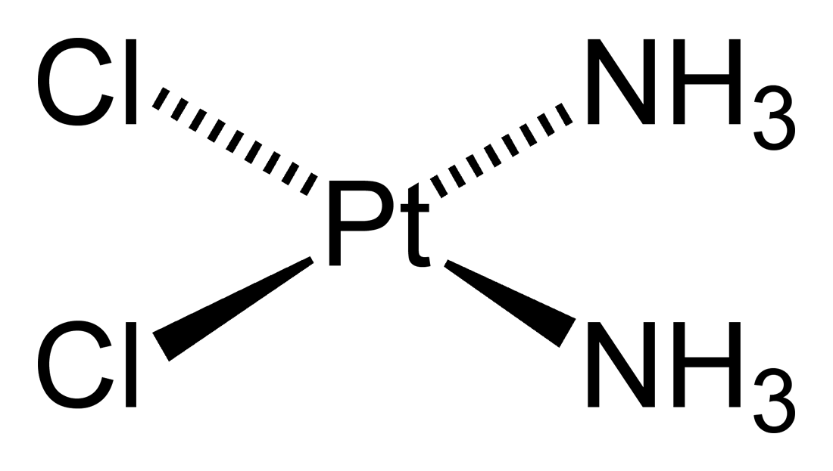
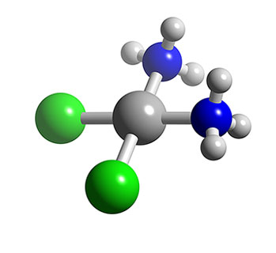
FOUR COORDINATE BONDS
Usually have a tetrahedral shape
A few complexes have a square planar shape
Cisplatin (Pt(NH₃)₂Cl₂) is an example

Slide 19
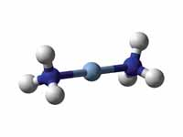
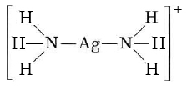
TWO COORDINATE BONDS
Most have a linear shape
E.g. [Ag(NH₃)₂]⁺
A solution of this is called Tollens’ reagent which is used to tell aldehydes from ketones. Aldehydes reduce it to silver, while ketones do not

Slide 20
USEFUL APPLICATIONS OF EDTA
EDTA has many uses, for example:
  An antidote in metal poisoning. It removes poisonous metal ions (e.g. mercury and lead) from the bloodstream
  It is an anticoagulant, so is used in blood transfusions to remove calcium ions which cause blood clotting, and in the storage and analysis of blood in forensic science
  To remove calcium ions from hard water. For this reason many cleaning products contain it, such as shampoos, shower gel etc

Slide 21
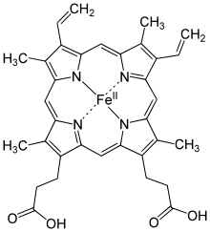
HAEMOGLOBIN
Blood naturally contains a multidentate ligand called haemoglobin
The haemoglobin molecule contains
4 nitrogen atoms that are
co-ordinately bonded to iron
Two more co-ordinate bonds
are formed to the iron, one
from the nitrogen atom in the
protein globin and the other
from the oxygen in a molecule
of oxygen (oxyhaemoglobin) or
from a water molecule
(deoxyhaemoglobin)

Slide 22
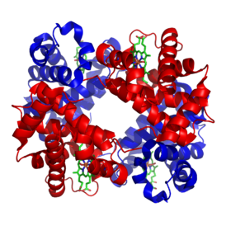
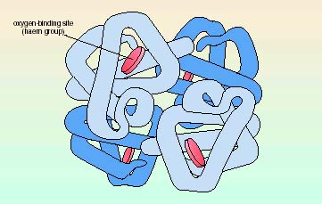
HAEMOGLOBIN
This complex transports the oxygen in our blood around our bodies, due to the weak co-ordinate bonds formed in the iron complex
Carbon monoxide can also form co-ordinate bonds with the complex and the bond is more stable than the bond formed with oxygen. Therefore if carbon monoxide is breathed in and concentration is high enough, it can cause oxygen starvation to the body and is life threatening

Slide 23

CISPLATIN
One of the most-successful anti-caner drugs developed in recent years is cisplatin
It is believed to work by bonding to DNA so that it prevents the replication of cancerous cells
Its isomer transplatin has no anti-cancer properties

Slide 24
HOW IT WORKS
Bonds between guanine on separate strands of DNA are coordinate ones with nitrogen
These displace the two ammonia molecules from cisplatin
the platinum atom is now binded to DNA bases
This prevents DNA from unravelling – which it needs to do in order for replication (cancer is uncontrollable cell replication
The damaged DNA elicits DNA repair mechanisms, which in turn activate apoptosis (cell death) when repair proves impossible.

Slide 25
I CAN… | I AM…
Define the terms ligand, co-ordinate bond and co-ordination number | C
Explain what unidentate, bidentate and multidentate ligands are | B
Calculate co-ordination numbers and oxidation states and shapes of complex ions | A
Give examples of each type of ligand and analyse some of their applications | A*

Slide 26
NAMING COMPOUNDS
The name contains:
  The ligand
  The number of ligands
  The oxidation state of the transition metal ion
Ligand | Name in Complex | Formula | Charge
Water | aqua | H₂O | 0
Chloride | chloro | Cl⁻ | -1
Ammonia | amine | NH₃ | 0
Cyanide | cyano | CN⁻ | -1
Hydroxide | Hydroxo | OH⁻ | -1

Slide 27
NAMING COMPLEXES
The number of ligands has a prefix
If more than one ligand is present, they are named alphabetically – ignoring the prefix
Number of ligands | Prefix
2 | di
4 | tetra
6 | hexa

Slide 28
NAMING COMPLEXES
When a complex is cationic the name of the metal is as you would expect it
When a complex is an
anionic, the metal name
ends in “ate”
The oxidation state of
the metal is given in
roman numerals.
Metal | Name in anionic
Cobalt | Cobaltate
Chromium | Chromate
Vanadium | Vanadate
Copper | Cuprate
Iron | Ferrate

Slide 29
Questions
Work out the name of the following complexes:
[Cu(H₂O)₆]²⁺ hexaaquacopper (II)
[Co(Cl)₄]²⁻ tetrachlorocobaltate(II)
[Cr(NH₃)₆]²⁺ hexaaminechromium(II)
[Ag(NH₃)₂]⁺ diaminesilver(I)
[Co(H₂O)₆]²⁺ hexaaquacobalt(II)
[Cu(Cl)₄]²⁻ tetrachlorocuprate(II)
[Ag(Cl)₂]⁻ dichloroargentate(I)

