Slide 1
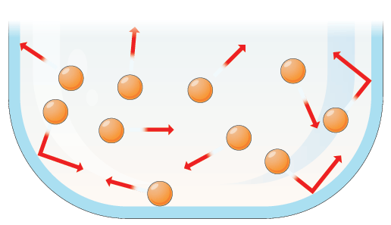
Moles and Gasses
Learning Objectives:
Know the molar volume of gasses at room temperature and pressure
Calculate the amount of substance, in moles, using gas volumes.
Key Words:
Gas, volume, moles.

Slide 2
The Molar Gas Volume
One mole of any gas contains the same number of particles,
How many?
6.022 x 10²³ - Avogadro’s number.
Due to this and the size of individual gas particles, ONE MOLE OF ANY GAS OCCUPIES THE SAME VOLUME at the same temperature and pressure.
The volume occupied by 1 mole of a gas is called the MOLAR GAS VOLUME.
This is Avogadro’s Law

Slide 3
Avogadro’s Law
Amedo Avogadro 1776-1856
At room temperature (25ºC or 298K) and normal atmospheric pressure (101kPa), the molar volume, M_{v}, is 24dm³ (or 24,000 cm³)
This is very useful as it is very difficult to weigh gasses!
Why must the pressure and temperature be kept the same?
I does not matter which type of gas is being measured. By using the volume we can indirectly measure the number of moles and therefore molecules of that gas!

Slide 4
Gas Calculations
Calculations
Providing that we know the temperature and volume, we can easily calculate the number of moles of any gas from a given volume using:
Number of moles (n) = Volume given
Molar Gas Volume
(24dm³)
You must be careful to make sure that the units of volume are the same on the top and bottom of your calculation.
Both the volume given and the molar gas volume must be in either dm³ or cm³.
If in doubt convert every thing to dm³

Slide 5
Gas Calculations
Example 1
What amount, in mol, of gas is in 72 cm³ of any gas at R.T.P (room temp & pressure) ?
Number of moles (n) = Volume given = 72/24000 = 0.0030 mol
Molar Gas Volume
(24dm³)
Both values have been converted into cm³

Slide 6
Gas Calculations
Example 2
What is the volume in cm³, of 2.10 x 10⁻³ mol of any gas at R.T.P (room temp & pressure) ?
Number of moles (n) = Volume given
Molar Gas Volume
(24000 cm³)
Hence, V = n x 24000 = 2.10 x 10⁻³ x 24000 = 51.12 cm³
Both values have been converted into cm³

Slide 7
Gas Calculations
Use these ideas (and your previous work on moles) to complete the following tables:
Calculate the volume and then the mass of the following amounts of gas.
All measurements made at room temperature and pressure where 1 mole of gas occupies 24dm³.
Gas | Moles of gas | Formula | Mass
48 dm³ of oxygen
12 dm³ of ammonia
240 cm³ of bromine
96 cm³ of neon
2.4 dm³ of hydrogen

Slide 8
Gas Calculations
Questions:
(a) What amount, in moles, of gas are in the following gas volumes at R.T.P.
i) 36 dm³ ii) 1080 dm³ iii) 4.0 dm³
(b) What is the volume of the following at R.T.P.
i) 6 mol SO₂(g) ii) 0.25 mol O₂(g) iii) 20.7 g NO₂(g)
2) What is the mass of the following at R.T.P?
(a) 0.6 dm³ N₂ (b) 1920 cm³ C₃H₈(g) (c) 84 cm³ N₂O(g)
3) What is the volume of the following at R.T.P?
(a) 1.282 g SO₂(g) (b) 1.485 g HCN(g) (c) 1.26 g C₃H₆(g)

