Slide 1
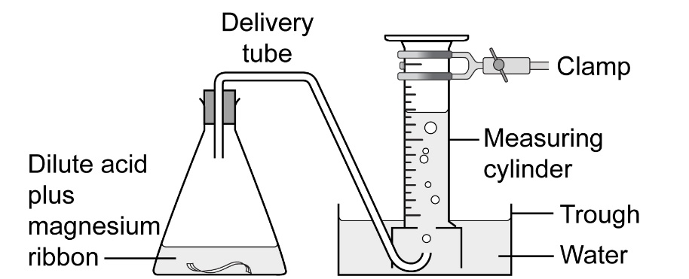
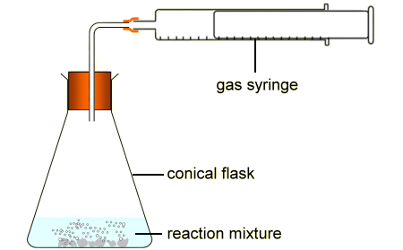
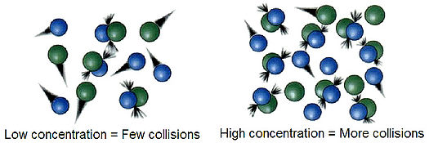
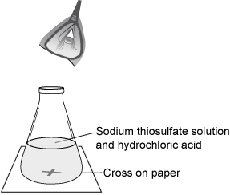
GCSE Required Practical –Chemistry 2 – How does concentration affect rate of reaction
Concentration: the amount of substance in a certain space
What’s the point of the practical?
To find out how changes in concentration affect the rate of reaction.
Example Apparatus
Measuring cylinder
- used to measure gas
Production over time
Gas syringe - used to measure
gas production over time
‘Disappearing’ cross – used to
measure how quickly the colour
changes
Results
The higher the concentration, the faster the reaction rate
What may they ask us about?
What are the sources of errors that could lead to anomalous results? (not getting the bung in quickly enough, starting the timer exactly on time etc)
Resolution and accuracy of measurements
Control variables – just change the concentration – everything else has to stay the same (e.g. why must temperature be controlled)

Slide 2
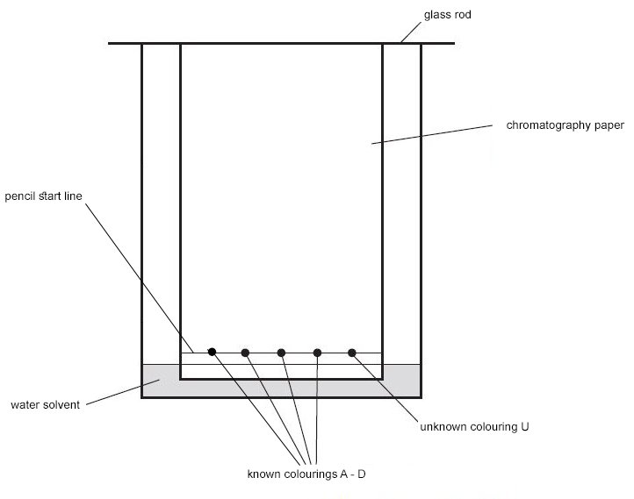
GCSE Required Practical –Chemistry 2 –Identifying substances using chromatography
Chromatography: the process where a dissolved substance is separated by running a solvent along a material (e.g paper)
What’s the point of the practical?
To separate substances and identify what they’re made of
Example Apparatus
Results
The substance moves up the paper (stationary phase). It is carried by the solvent (mobile phase). Each substance goes a certain distance
R_{f} = distance moved by substance
distance moved by solvent
What may they ask us about?
Why must the start line be drawn in pencil? (because pencil does not smudge/run in the solvent whereas pen would)
Why does there need to be a lid? (to stop the solvent from evaporating)
Measure the R_{f} value – be accurate. Compare different substances with different R_{f} values. See what substances are contained in certain mixtures
Sources of error, resolution or measurements etc

Slide 3
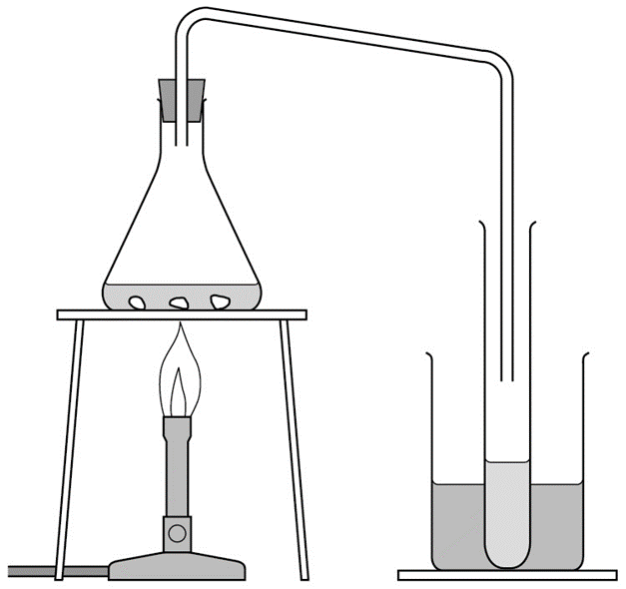
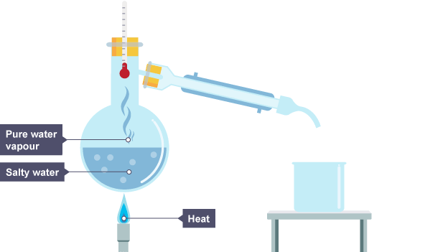
GCSE Required Practical –Chemistry 2 –Purifying and testing water
Potable water = drinkable water
What’s the point of the practical?
To analyse and purify water from different sources
Example Apparatus
Or..
Results
Pure water boils at exactly 100°C and it’s pH is 7
Salt water contains sodium chloride
Distillation = Heat the solution, the water evaporates, the salt stays in the container.
What may they ask us about?
Explain how distillation works (water evaporates at lower temperature as it has a lower boiling point than the dissolved solids, then it condenses back into liquid as it cools down)
Why is it not economical to do this on a large scale to make drinking water? (it costs too much to heat the water)
Why may you not get all the water from the solution? (some does not evaporate, some liquid stays in the tube)

