Slide 1
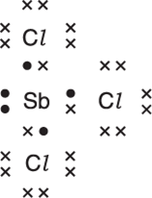
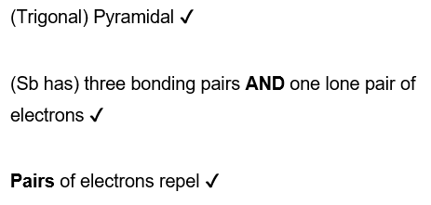
Antimony chloride, SbCl₃, exists as a simple covalent molecule.
A ‘dot-and-cross’ diagram of SbCl₃ is shown.
Predict and draw the shape of a molecule of SbCl₃.
Explain your answer and give the bond angle

Slide 2
Draw a ‘dot-and-cross’ diagram to show the bonding in CO₂.
Show outer electrons only.

Slide 3
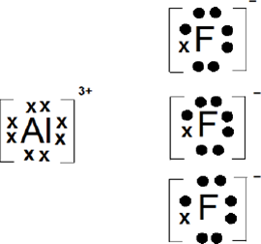
Solid aluminium fluoride has a giant ionic lattice structure.
Describe what is meant by the term ionic lattice, in terms of the type and arrangement of particles present. [2]
Draw a ‘dot-and-cross’ diagram
for aluminium fluoride.
Show outer electrons only. [2]
Repeating pattern ✔
of oppositely charged ions ✔

Slide 4
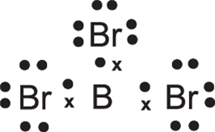
Solid boron tribromide has a simple molecular structure. The atoms are held together by covalent bonds.
What is meant by the term covalent bond? [1]
Draw a ‘dot-and-cross’ diagram to show the bonding in a boron tribromide molecule. Show outer electrons only. [1]
A shared pair of electrons

Slide 5
State whether the following substances conduct electricity when solid or molten, and explain your answers in terms of the particles involved: • aluminium [5]
• aluminium fluoride
• boron tribromide
Aluminium conducts in solid and molten states ✔
Aluminium has delocalised electrons✔
AlF₃ conducts in molten states ✔
AlF₃ because it has mobile ions✔
Aluminium fluoride does not conduct when solid
Solid aluminium fluoride has ions which are fixed (in position) OR ions are held (in position) OR ions are not mobile in an (ionic) lattice
Boron tribromide does not conduct in solid and molten states AND
Boron tribromide has no mobile electrons OR no (mobile) ions OR no mobile charge carriers OR no mobile charged particles ✔

Slide 6
Carbon monoxide contains a triple bond, and includes a dative covalent bond.
Construct a ‘dot-and-cross’ diagram to show the outer electron pairs in a molecule of carbon monoxide.

Slide 7
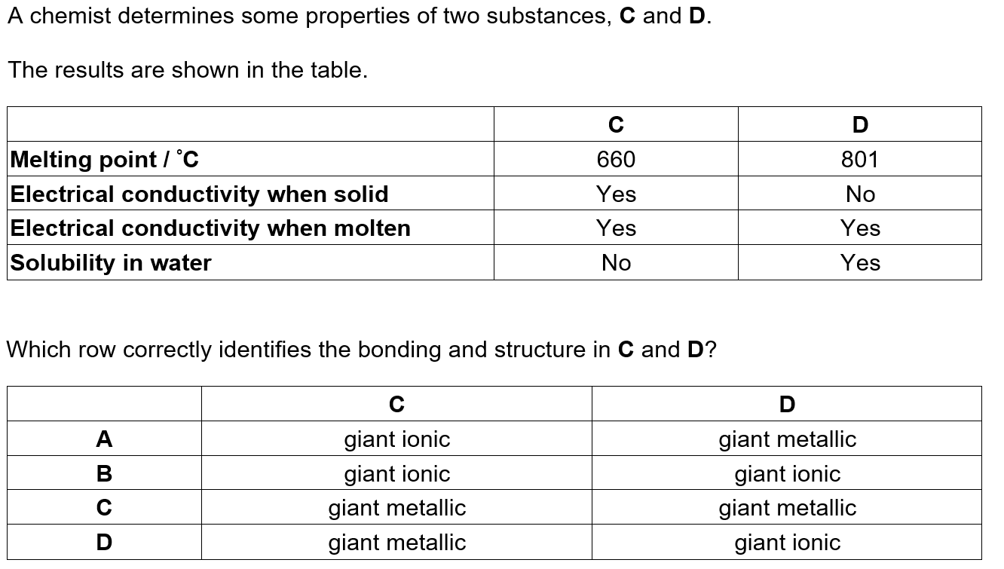

Slide 8
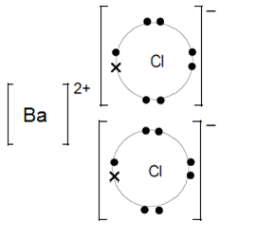
Solid barium chloride has a high melting point. Barium chloride dissolves in water to form a solution that can be used to test for sulfate ions.
Draw a ‘dot-and-cross’ diagram to show the bonding in solid barium chloride.
Show outer electrons only. [2]
A solution of barium chloride can be made in the laboratory using dilute hydrochloric acid.
Suggest a compound that can be reacted with hydrochloric acid to make barium chloride. [1]
Barium hydroxide OR barium oxide OR barium carbonate

Slide 9
Draw a ‘dot-and-cross’ diagram to show the bonding in a nitrogen molecule.
Show outer electrons only. [1]

