Slide 1
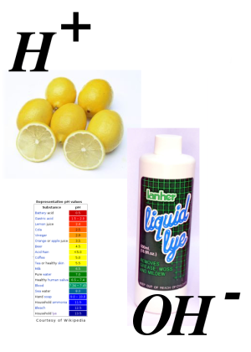
Acids and Bases
Learning Objectives:
Know the formulae of common acids and bases.
State that an acid releases H⁺ ions in aqueous solution.
State that common bases are metal oxides, metal hydroxides and ammonia.
State that an alkali is a soluble base that releases OH– ions in aqueous solution.
Key Words:
Acid, base, alkali, pH, neutral,

Slide 2
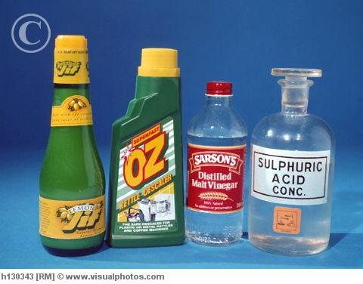
Acids
Acid: A species that is a proton (H⁺ ion) donor
The word Acid comes from the Latin ‘acidus’ – meaning sour.
In water acids give a pH of less than 7.0
The 3 common acids in AS chemistry are
Sulphuric acid –
Hydrochloric acid -
Nitric acid –
You need to know the name and formula for these
H₂SO₄
HCl
HNO₃

Slide 3
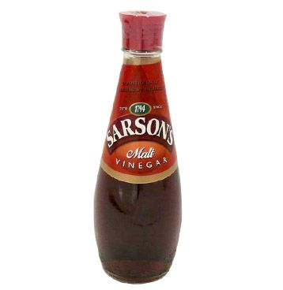
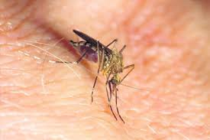
Acids
Some other common acids are naturally occurring ad weaker than lab acids
Ethanoic (acetic) acid – CH₃COOH – in vinegar
Methanoic (formic) acid – HCOOH – in insect bites
Citric acid – C₆H₈O₇ – in citrus fruits

Slide 4
Acids
If you look at the formulae of all acids you will notice that they all contain hydrogen;
H₂SO₄
HCl
HNO₃
When an acid is added to water the acid splits into it’s component ions and releases H⁺ ions.
HCl + aq → H⁺ + Cl⁻
H₂SO₄ + aq →2H⁺ + SO4²⁻
The H⁺ ion (proton) if the active ingredient in acids.
All acids are proton donors

Slide 5
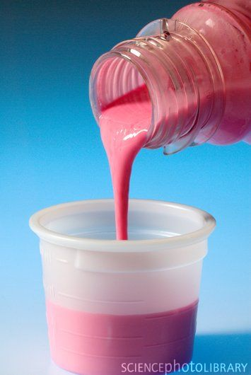
Bases
Base: A species that is a proton (H⁺ ion) acceptor
Common bases are metal oxides and hydroxides:
Metal Oxides – MgO, CuO Metal Hydroxides – NaOH, Mg(OH)₂
Ammonia – NH₃ is also a base as are all amines e.g. CH₃NH₂
We can use bases in every day life:
For acid indigestion MgO is in milk of magnesia
Ca(OH)₂ is used to treat acid soils

Slide 6
Alkalis
Alkali: a type of base that dissolves in water to form hydroxide (OH⁻) ions.
A chemical that gives a solution with a pH greater than 7.0 when dissolved in water.
Common alkalis are:
Sodium Hydroxide – NaOH
Potassium hydroxide – KOH
Ammonia – NH₃
Alkalis are very corrosive and sometimes more dangerous than acids!
An alkali is a certain type of base that dissolves in water to give aqueous hydroxide ions – OH⁻(aq)
E.g. NaOH + aq → Na⁺(aq) + OH⁻(aq)

Slide 7
Neutralisation
When the protons (H⁺) from acids and the hydroxide ions (OH⁻) from bases meet in solution. This is called a neutralisation reaction. Water is formed:
H⁺(aq) + OH⁻(aq) →H₂O(l)
E.g. HCl + NaOH → NaCl + H₂O
Acid + Base → Salt + Water

Slide 8
Ammonia as a Weak Base
Ammonia – NH₃ is a gas that dissolves in water to form a weak alkaline solution. It reacts with the water;
NH₃(aq) + H₂O(l) $⇋$ NH4⁺(aq) + OH⁻(aq)
Ammonia is a weak base because only a small proportion of the dissolved NH₃ actually reacts with the water.
As indicated by the equilibrium sign $⇋$

Slide 9
Questions
Write down the formulae of the following;
Sulphuric acid
Nitric acid
Ethanoic acid
Potassium hydroxide
Calcium hydroxide
Ammonia
2) Define the following terms;
a) acid
b) base
c) alkali

Slide 10
Questions
Calculate the unknown concentration of hydrochloric acid if 25 cm³ of 0.125 mol dm⁻³ aqueous sodium hydroxide is titrated with 22.75 cm³ of the acid.
Calculate the molar mass of the acid H₂X from the following information.
A student dissolved 1.571 g of the acid in water and made the solution up to 250 cm³. She titrated 25.0 cm³ of this solution against 0.125 mol dm⁻³ sodium hydroxide solution. 21.30 cm³ of this solution was needed to reach the end point.
The equation for this reaction is;
2NaOH(aq) + H₂X(aq) → Na₂X(aq) + 2H₂0(l)

