Slide 1
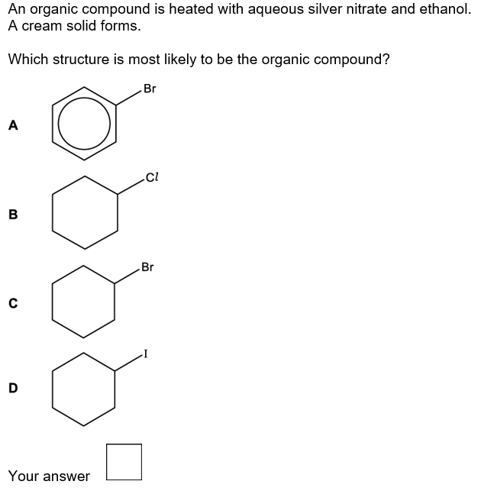
Silver Bromide – But aromatic compounds
are not very reactive
C

Slide 2
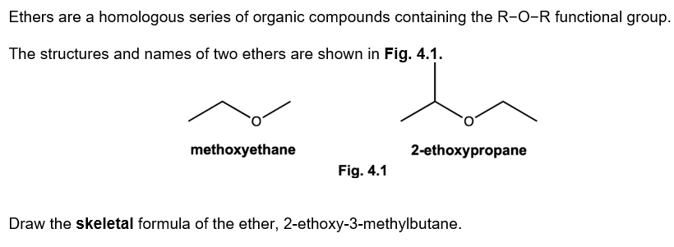

Slide 3
Ethers can be prepared by nucleophilic substitution of haloalkanes with alkoxide ions, RO⁻.
i. Alkoxide ions can be prepared by reacting sodium with an alcohol. A gas is also formed.
Write an equation for the formation of methoxide ions from sodium and an alcohol.
2Na + 2CH₃OH → 2Na⁺ + 2CH₃O⁻ + H₂ ✔

Slide 4
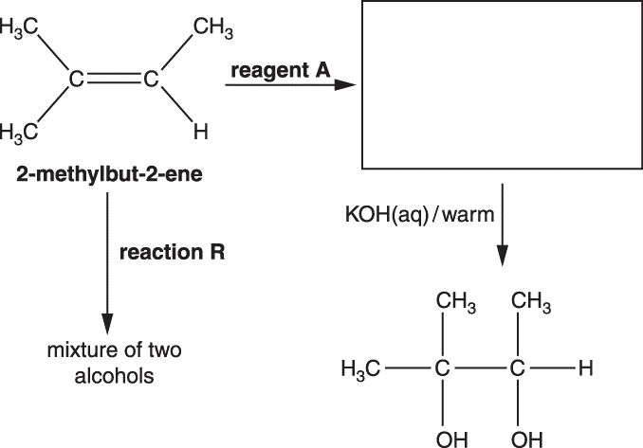
Steam AND acid catalyst ✔
(compounds or molecules) having the same molecular formula but different structural formulae ✔
In the flowchart, reaction R forms a mixture of two alcohols that are structural isomers of C₅H₁₂O.
i. State the reagents and conditions needed for reaction R. [1]
ii. What is meant by the term structural isomers? [1]
iii. Draw the two structural isomers of C₅H₁₂O formed in reaction R.
[2]
iv. Suggest why 2-methylbut-2-ene is less soluble in water than either of the structural isomers formed.
[2]

Slide 5
Reaction mechanisms use curly arrows and can involve electrophiles and nucleophiles.
i. What does a curly arrow represent in mechanisms?
ii. What is meant by the term nucleophile?
Movement of an electron pair ✔
Electron pair donor ✔

Slide 6
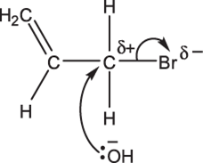
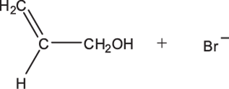
Allyl bromide, CH₂=CHCH₂Br, reacts with aqueous sodium hydroxide.
Outline the mechanism of this reaction. Include curly arrows, relevant dipoles and final product(s).
[3]
Name the type of mechanism.
Nucleophilic substitution ✔

Slide 7
Alcohols are used in organic synthesis.
Pentan-2-ol can be prepared by the alkaline hydrolysis of 2-iodopentane.
CH₃CH(I)CH₂CH₂CH₃ + NaOH → CH₃CH(OH)CH₂CH₂CH₃ + NaI
The reaction mixture is boiled for 20 minutes.
i. State the most appropriate technique that could be used to boil the reaction mixture for 20 minutes. [1]
ii. Describe the mechanism for the alkaline hydrolysis of 2-iodopentane.
In your answer, include the name of the mechanism, curly arrows and relevant dipoles.
And name of mechanism:
Reflux
Nucleophilic substitution (1)
Mechanism
Curly arrow from lone pair on OH− to δ+ carbon atom (1)
Curly arrow and dipole on C–I bond (1)

Slide 8
Bromine Water Br₂(aq)
Identify reagent A.

Slide 9
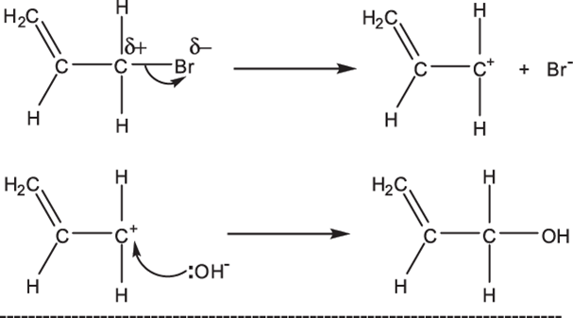
Allyl bromide, CH₂=CHCH₂Br, reacts with aqueous sodium hydroxide.
i. Outline the mechanism of this reaction.
Include curly arrows, relevant dipoles and final product(s).
ii. Name the type of mechanism.
Nucleophilic substitution ✔

Slide 10
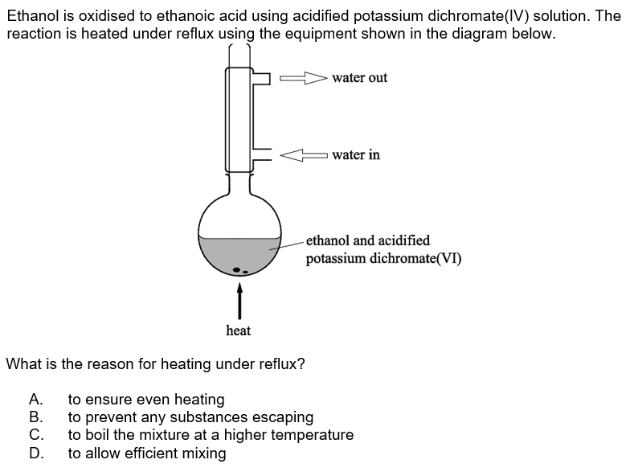
B

Slide 11
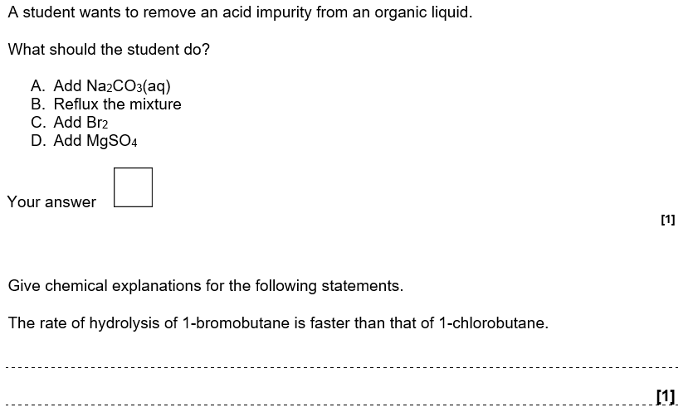
A
 | The C−Br bond is weaker (than the C−Cl bond)

Slide 12
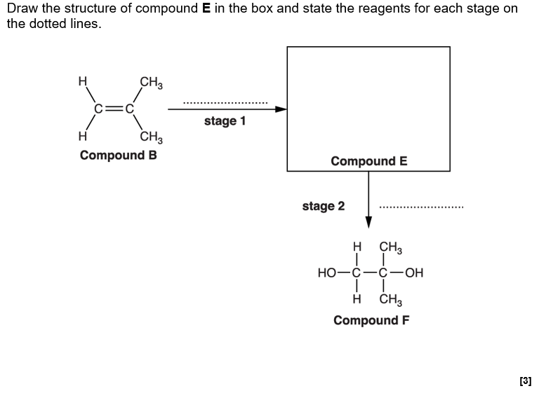
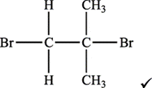
Stage 1: | Compound E: Bromine/Br₂ ✓
Stage 2: | NaOH/KOH OR OH⁻ ✓

