Slide 1
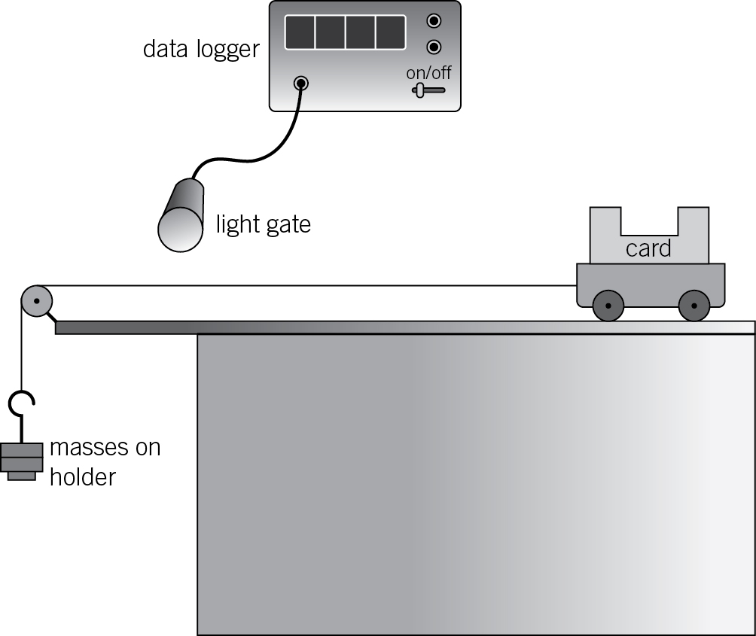
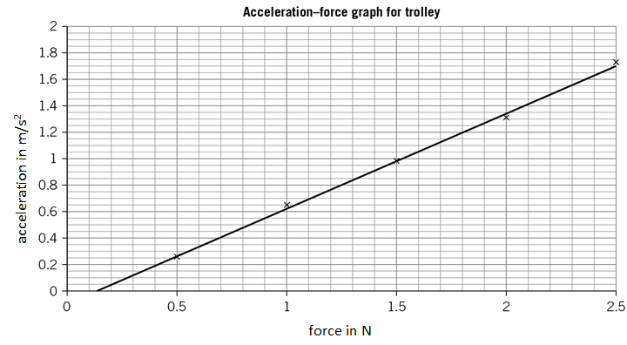
GCSE Required Practical – Physics 2 – Force and acceleration
What’s the point of the practical?
To find out what happens to the acceleration when we change the mass.
And to find out what happens to the acceleration when we change the force.
Example Apparatus
Data logger and light gate -
Measures velocity or
acceleration
Masses – make the trolley
(car) move
Force (N) = mass (kg) x acceleration (m/s²)
Acceleration (m/s²) = change in velocity (m/s)
time (s)
Results:
The more force, the more acceleration.
The more mass, the less acceleration.
What may they ask us about?
They may get you to work out acceleration from force and mass (easy) or give you the change in velocity and time so you need to use both equations above.
State one possible source of error (friction slows the trolley down, the trolley doesn’t go in an exact straight line, the masses hit the floor and stop pulling on the string)
What is the IV, DV and control variables for each part of the experiment?
(remember, if you’re changing the mass, the force should stay the same, if you’re
changing force, the mass should stay the same – only one thing changes)
Interpret graphs of results and use them to calculate or make predictions:

Slide 2
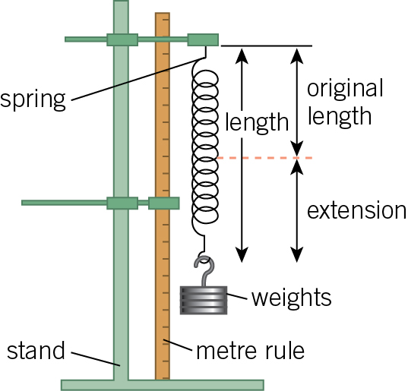
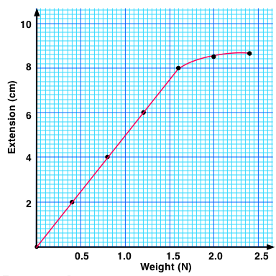
GCSE Required Practical – Physics 2 – Force and extension of a spring
Extension = how much the length has increased from it’s original length
What’s the point of the practical?
To find out the relationship between force and extension.
Example Apparatus
Weights – provide a force (N)
Spring - stretches
Metre rule – measures the length
of the spring (before and after)
Results:
Hooke’s Law:
extension is directly
proportional to the
force applied, as
long as the limit of
proportionality is
not exceeded
Limit of proportionality
What may they ask us about?
Describe the relationship (directly propotional). Label the limit of proportionality (where it’s no longer a straight line)
What error could cause the extension to NOT start at zero (if you measured, the length and not the extension. The extension should be zero with no weights, but the length of the spring will be a few cm)
What is the IV (force), what is the DV (extension), comment on repeatability, resolution, etc

Slide 3
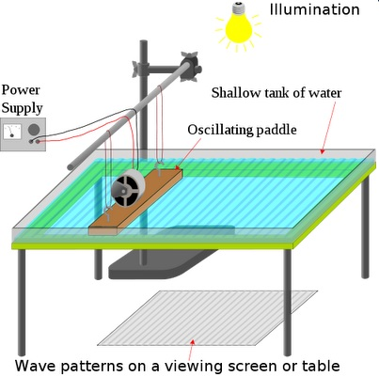
GCSE Required Practical – Physics 2 – Waves in a tank (water)
Wave speed (m/s) = frequency (Hz) x wavelength (m)
What’s the point of the practical?
To find out how wavelength, frequency and wave speed are related.
Example Apparatus
Oscillating paddle –
moves up and down
to produce waves
Results:
Speed = frequency x wavelength.
If you double the double the frequency, the wavelength is halved and vice versa.
Wave speed stays the same because it’s always the same material (string)
What may they ask us about?
- Explain why the wave speeds you calculate are all about the same but not identical. (Wave speed is the same in water but it’s hard to be 100% accurate with measurements each time because it’s hard to see where exactly the waves are, the waves keep moving, some waves are reflected)
How could you improve the accuracy of measurements? (add insulation to stop reflected waves, use a bigger pool, brighter light, sharper paddle to get nice clean waves)
Comment on repeatability, reproducibility, range, uncertainty and calculate means

Slide 4
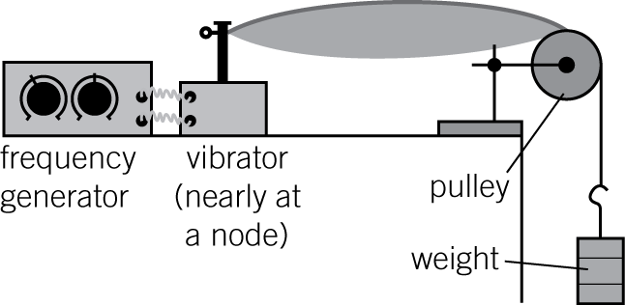
GCSE Required Practical – Physics 2 – Waves in a solid (string)
Wave speed (m/s) = frequency (Hz) x wavelength (m)
What’s the point of the practical?
To find out how wavelength, frequency and wave speed are related.
Example Apparatus
Weight – hold the
String tight (taut)
Frequency generator and vibrator (oscillator) – make the string vibrate to produce waves.
Results:
Speed = frequency x wavelength.
If you double the double the frequency, the wavelength is halved and vice versa.
Wave speed stays the same because it’s always the same material (string)
What may they ask us about?
How could you measure the waves more accurately? (use a different colour or width string to make it easier to see the waves)
Comment on repeatability, reproducibility, uncertainty and calculate means

Slide 5
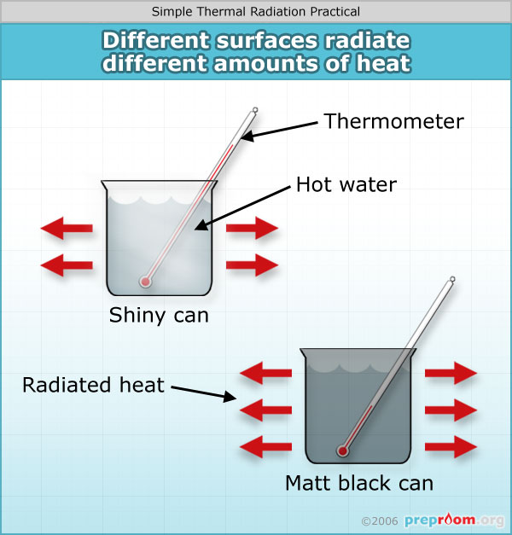
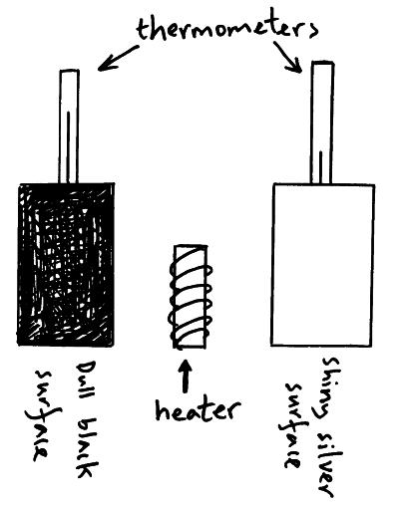
GCSE Required Practical – Physics 2 – Surfaces and radiation
Infrared Radiation: electromagnetic waves that heat things up. Emit: when something gives off something
Absorb: when something takes in or soaks up something (don’t say attract!)
What’s the point of the practical?
To find out how the colour and texture of the surface affects how much heat (radiation) is absorbed or emitted
Example Apparatus
Heated from the outside Heated from the inside
Results:
Matt black surfaces absorb and emit much more radiation than shiny smooth surfaces.
What may they ask us about?
Independent, dependent and control variables (same sizes, same volumes, same thickness, starting temp etc)
Why should you put lids on each container (to reduce heat loss through convection)
Resolution of measurements (1°C?), repeatability, reproducibility, calculating means etc
Why won’t you get exactly the same measurements if you repeat the experiment? What are the sources of error? (hard to read the temp at exactly the right time, slightly different volumes, slightly different starting temperatures, can may be warm already)

