Slide 1
Mole calculations
The largest nugget of gold ever found was in Australia in 1892 measuring 290kg. How many moles is this?
What is the mass of 5 moles of CH₃CH₂OH?
The density of H₂O is 1000g dm⁻³. On average I drink 2.5dm³ of H₂O a day. How many moles is this?
How much volume does 4.5moles of NH₃ occupy?
On average, a large cow produces 280dm³ of methane a day. How many moles is this?
What is the mass of methane produced by this cow?
How many grams of NaOH are there in 500cm³ of 2mol dm⁻³?
What is the concentration in mol dm⁻³ of a solution of 2.4g of NaOH dissolved in 250cm³ of water?
A = 1472moles
A = 230g
A = 139mol
A = 108dm³
A = 11.7mol
A = 187.2g
A = 40g
A = 0.24mol dm⁻³

Slide 2
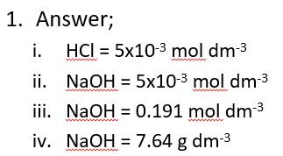
1) Titration calculations
25cm³ of 0.2mol dm⁻³ hydrochloric acid was used to neutralise 26.12cm³ of the sodium hydroxide solution.
  Calculate the number of moles of HCl used
  Calculate the number of moles of NaOH used
  Calculate the concentration of NaOH in mol dm⁻³
Calculate the concentration of NaOH in g dm⁻³

Slide 3
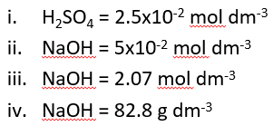
2) Titration calculations
25cm³ of 1.0mol dm⁻³ sulphuric acid was used to neutralise 24.16cm³ of the sodium hydroxide solution.
  Calculate the number of moles of H₂SO₄ used
  Calculate the number of moles of NaOH used
  Calculate the concentration of NaOH in mol dm⁻³
Calculate the concentration of NaOH in g dm⁻³

Slide 4
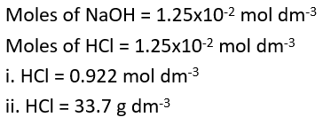
3) Titration calculations
25cm³ of 0.5mol dm⁻³ sodium hydroxide was used to neutralise 13.56cm³ of the hydrochloric acid solution. Calculate the concentration of HCl in mol dm⁻³
Calculate the concentration of HCl in g dm⁻³

Slide 5
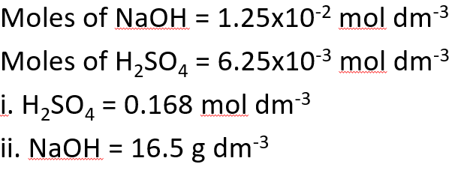
4) Titration calculations
25cm³ of 0.5mol dm⁻³ sodium hydroxide was used to neutralise 37.18cm³ of the sulphuric acid solution. Calculate the concentration of H₂SO₄ in mol dm⁻³
B. Calculate the concentration of H₂SO₄ in g dm⁻³

Slide 6
Titration calculations
Calculate the concentration of sodium hydroxide solution in mol dm⁻³ if 25cm³ of 0.2 mol dm⁻³ hydrochloric acid was used to neutralise 26.12cm³ of the sodium hydroxide solution. Calculate the concentration of sodium hydroxide in g dm⁻³
Calculate the concentration of hydrochloric acid solution in mol dm⁻³ if 25cm³ of 0.5 mol dm⁻³ sodium hydroxide was used to neutralise 13.56cm³ of the hydrochloric acid solution. Calculate the concentration of hydrochloric acid in g dm⁻³
Calculate the concentration of sodium hydroxide solution in mol dm⁻³ if 25cm³ of 1.0 mol dm⁻³ sulphuric acid was used to neutralise 24.16cm³ of the sodium hydroxide solution. Calculate the concentration of sodium hydroxide in g dm⁻³
Calculate the concentration of sulphuric acid solution in mol dm⁻³ if 25cm³ of 0.5 mol dm⁻³ sodium hydroxide was used to neutralise 37.18cm³ of the sulphuric solution. Calculate the concentration of sulphuric acid in g dm⁻³
Calculate the concentration of citric acid solution in mol dm⁻³ if 25cm³ of 1.0 mol dm⁻³ sodium hydroxide was used to neutralise 12.56cm³ of the citric acid solution. (Hint 3 moles of sodium hydroxide react with 1 mole of citric acid). Calculate the concentration of citric acid in g dm⁻³ (Hint: the relative formula mass of citric acid is 192)
Calculate the concentration of ethylenediaminetetraacetic acid solution in mol dm⁻³ if 25cm³ of 0.1 mol dm⁻³ sodium hydroxide was used to neutralise 11.56cm³ of the ethylenediaminetetraacetic acid solution. (Hint: Use your intuition to work out how many moles of sodium hydroxide react with ethylenediaminetetraacetic acid!). Calculate the concentration of ethylenediaminetetraacetic acid in g dm⁻³ (Hint: the relative formula mass of ethylenediaminetetraacetic acid is 292)

Slide 7
Titration calculation answers
(0.2 x 0.025) / 0.02612 = 0.1914mol dm⁻³ and 7.66g dm⁻³
(0.5 x 0.025) / 0.01356 = 0.9218mol dm⁻³ and 33.65g dm⁻³
(1.0 x 0.025 x 2) / 0.02416 = 2.070mol dm⁻³ and 82.78g dm⁻³
(0.5 x 0.025) / (0.03718 x 2) = 0.1681mol dm⁻³ and 16.47g dm⁻³
(1.0 x 0.025) / (0.01256 x 3) = 0.6634mol dm⁻³ and 127.4g dm⁻³
(0.1 x 0.025) / (0.01156 x 4) = 0.0541mol dm⁻³ and 15.77g dm⁻³

