Slide 1
Which alcohol will not react with potassium dichromate(VI) in sulfuric acid?
A. CH₃CH₂CH(OH)CH₂CH₃
B. CH₃CH₂CH(CH₃)CH₂OH
C. (CH₃)₂CHCH(CH₃)OH
D. (CH₃CH₂)₂C(CH₃)OH
D – TERTIARY ALCHOLS
CANNOT BE OXIDISED

Slide 2
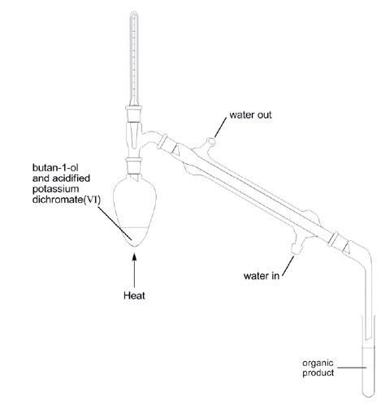
Butan-1-ol is reacted with acidified potassium dichromate(VI) using the apparatus shown below.
What is the organic product of this reaction?
A. But-1-ene
B. Butanone
C. Butanal
D. Butanoic acid
C – PRIMARY ALCHOLS
GIVE ALDEHYDES WITH
[O] + DISTILLATION

Slide 3
Which molecule is the most soluble in water?
D

Slide 4
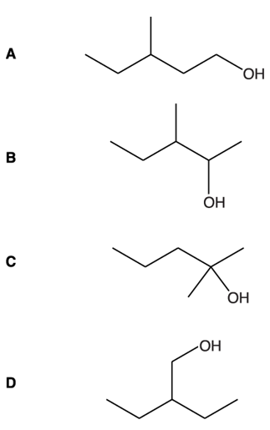
Which alcohol can be oxidised by K₂Cr₂O₇ and H₂SO₄ to form a ketone?
B – SECONDARY ALCHOLS
GIVE KETONES WITH [O]

Slide 5
Describe the oxidation reactions of propan-1-ol when using a suitable oxidising agent.
Indicate how the use of different reaction conditions can control which organic product forms. Include reagents, observations and equations in your answer.
In your equations, use structural formulae and use [O] to represent the oxidising agent. [6]
Reagents: Acid / H⁺ and (potassium or sodium) dichromate / Cr₂O₇²⁻ ✔
Observations: Orange to Green OR Orange to Blue✔
Distillation / Distil produces aldehyde / CH₃CH₂CHO: ✔
CH₃CH₂CH₂OH + [O] → CH₃CH₂CHO + H₂O ✔
Reflux (of propan-1-ol) produces carboxylic acid / CH3CH2COOH✔
CH₃CH₂CH₂OH + 2[O] → CH₃CH₂COOH + H₂O ✔

Slide 6
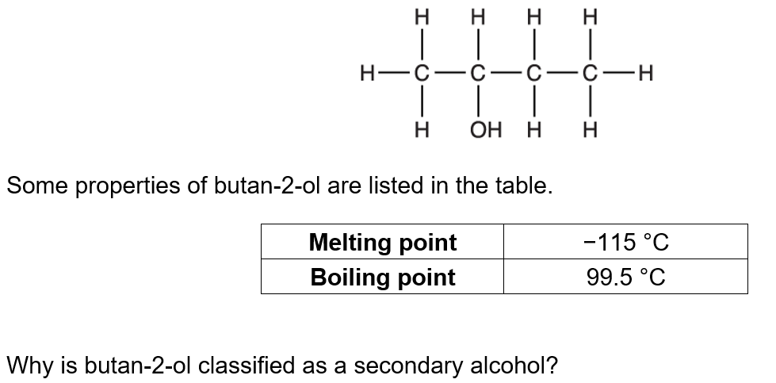
The –OH group is attached to a carbon that is attached to one hydrogen atom OR The –OH group is attached to a carbon that is attached to two C atoms / alkyl groups/R groups ✓

Slide 7
Butan-2-ol can be oxidised by heating with an oxidising agent.
i. Write an equation for the reaction.
Use [O] to represent the oxidising agent and show the structure of the organic product.
Equation CH₃CH(OH)CH₂CH₃ + [O] → CH₃COCH₂CH₃ + H₂O ✓ Structure of product could be allowed from equation CH₃COCH₂CH₃ ✓

Slide 8
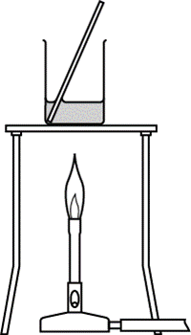
Butan-2-ol can be oxidised by heating with an oxidising agent.
ii. A student plans to carry out this oxidation using the apparatus shown in the diagram. Give one reason why the apparatus is not suitable and describe a more suitable way of carrying out this oxidation.
Butan-2-ol/butanone is flammable OR Butan-2-ol / butanone is volatile / low boiling point OR
Butan-2-ol / butanone will evaporate / boil away ✓

