Slide 1

Exam Technique

Slide 2
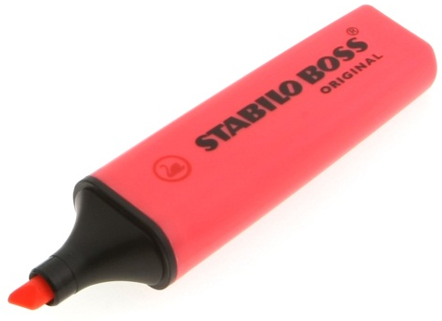
Read the Question
Always read the question carefully – don’t rush in and answer the question straight away.
Think about what the question is asking and what information it is looking for.
Use the marks as a hint of how detailed it needs to be.
Practical Tip
Highlight the key words of a question during the exam.

Slide 3
Read the Question
What does that word mean?
Explain
Write a detailed answer that covers how and why a thing happens. Talk about mechanisms and reasons. (Hint: don’t confuse with “describe”).
Describe
Write a detailed answer that covers what happens, when it happens, and where it happens. Talk about facts and characteristics. (Hint: don’t confuse with “explain”).
Calculate
Work out a number. You can use your calculator to help you. You may need to use an equation.
Evaluate
You will be given some facts, data, or other kind of information. Write about the data or facts and provide your own conclusion or opinion on them.
Compare
Write about the similarities and differences between two things.
Justify
Give some evidence or write down an explanation to tell the examiner why you gave an answer.
Suggest
Think about what you’ve learnt and apply it to a new situation or context. Use what you have learnt to suggest sensible answers to the question.
Predict
Look at some data and suggest a realistic value or outcome. You may use a calculator to help. Don’t guess – look at trends in the data and use your knowledge of science. (Hint: don’t confuse with “calculate” or “estimate”).

Slide 4
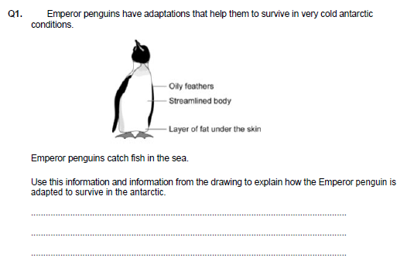
Read the Question
Example
This information is given to HELP you answer the question.
ALWAYS read information before the question.
More information – the question is 3 marks and there are 3 points. HINT!!!!
A layer of fat helps insulate the penguin.
A streamlined body helps reduce water resistance so the penguin can swim faster.
Oily feathers prevent cold reaching the skin.

Slide 5
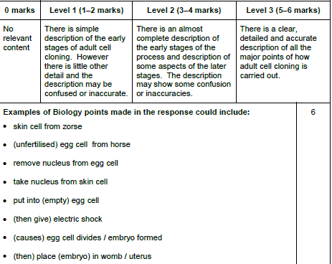
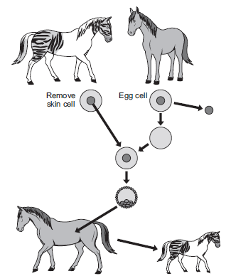
Zorses are not able to breed.
Scientists could produce more zorses from this zorse by adult cell cloning. The diagram shows how the scientists might clone a zorse.
Use information from the diagram and your own knowledge to describe how adult cell cloning could be used to clone a zorse.
Read the Question
Example
HINT - this is what the question is about, cloning.
Use this to your advantage – everything you need is here.
.

Slide 6


Show Calculations
Some questions in the exam might ask you to calculate a percentage (e.g. energy efficiency).
ALWAYS show your working.
Then… even if you get the answer wrong and your working correct, you will still get a mark!

Slide 7
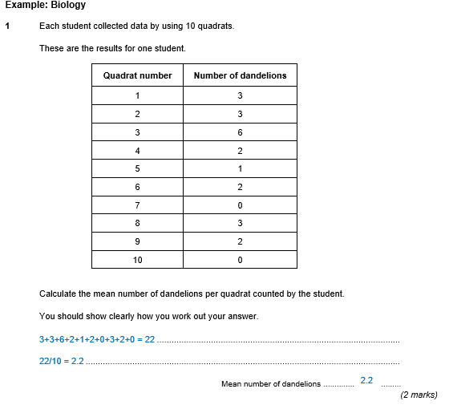
Show Calculations

Slide 8
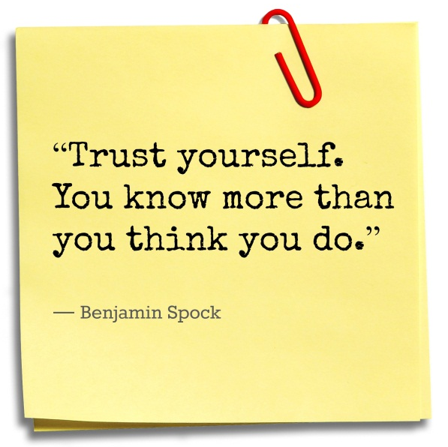
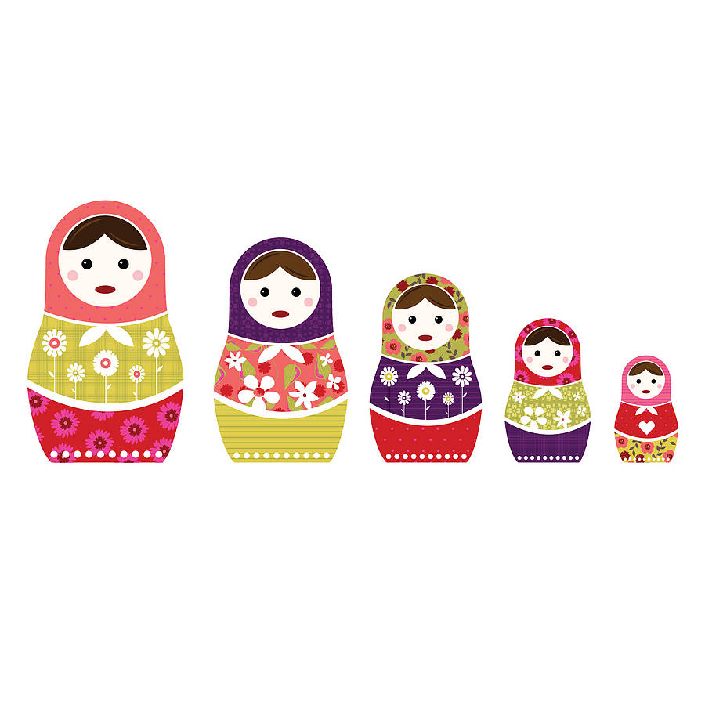
Be Flexible
Change the order.
Answers the questions in any order you like – you don’t need to go start to finish.
Answers easy questions first to secure marks and build your confidence.
Come back to hard questions last – you have at least secured a decent grade and know how much time you have left.

Slide 9
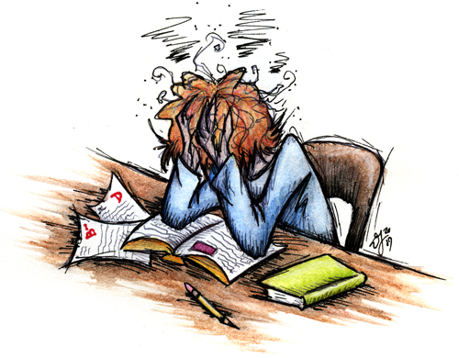
Be Flexible
If you’re stuck…. Move on!
The worse thing you can do is stay on a question you are stuck on!!
Don’t get frustrated.
Don’t be afraid to leave a question to come back to.
MOVE ON and secure yourself some more marks on questions you can answer.

Slide 10


Use the Marks
Every question is worth a certain amount of marks.
Use the amount of marks to determine the amount of detail needed in a question.
Think of it – for every 1 mark given, you need to make one clear and concise statement.

Slide 11
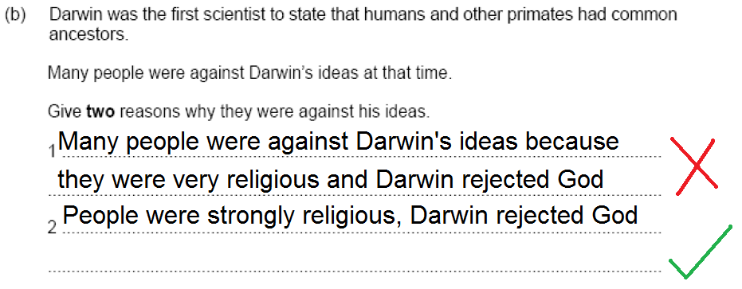
Don’t waste time and space re-writing the question
Use the Marks
Looking at papers where candidates ended up with a grade D, about 25% of candidates ran out of time!

Slide 12
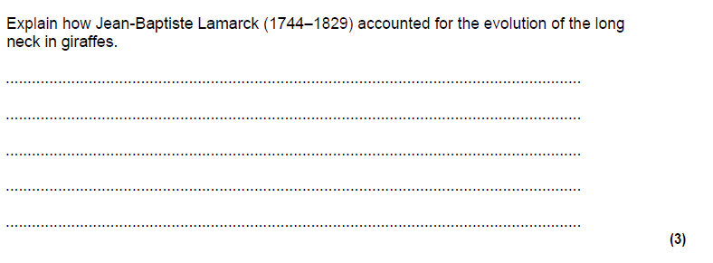
Use the Marks
Medium example – 3/4 marks.
Explain = detailed answer that explain why.
Bullet point if you need to clearly see the points you make.
.
Reaching for food led to more use of the neck.
More use led to an increased length of the neck (characteristic)
This characteristic was passed on to offspring
3 marks on a written question = 3 written statements / points.

Slide 13
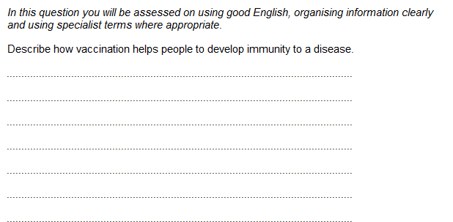
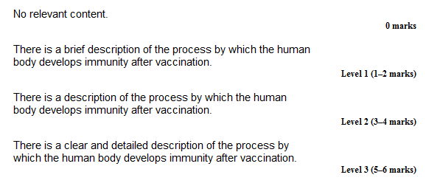
Use the Marks
Challenging example – 6 mark question.
Quality of written communication is the only question that needs full sentences and correct grammar.
.
Describe = write a detailed answer of the steps in a vaccination.

Slide 14
Use the Marks
At the risk of labouring the point. Use the number of marks available as a guide to how much to write.
Describe the changes on the diagram.
For two marks………….
The creature has less hair ✔
The creature gets taller ✔
The creature has less hair ✔
The creature gets taller ✔
The creature gets more upright ✔
It changes from ape to a human being ✔
For four marks………….

Slide 15
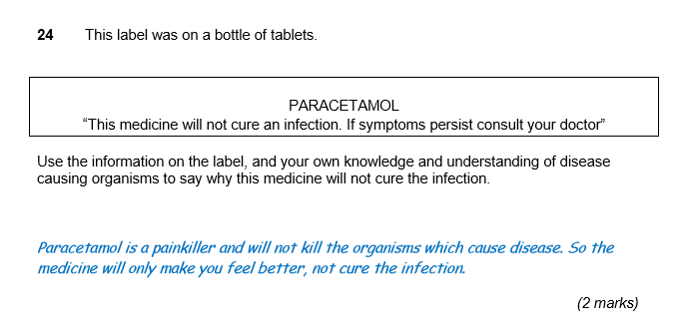
Use the information in the passage/diagram/graph/table to…

Slide 16
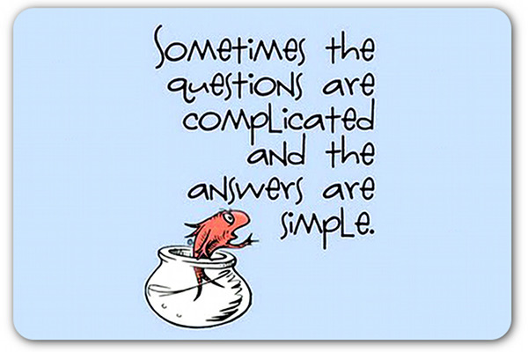

Question Wording
Exams can word questions in complicated ways – it is testing your ability to understand what they are asking.
Complicated question often have simple answers – go with your first answer, if you keep going back and forth, you will start doubting yourself.

Slide 17
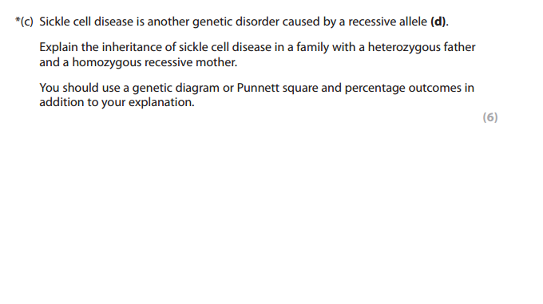
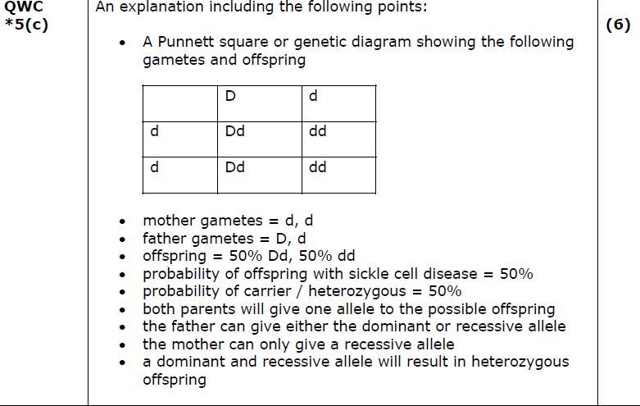
Question Wording

Slide 18
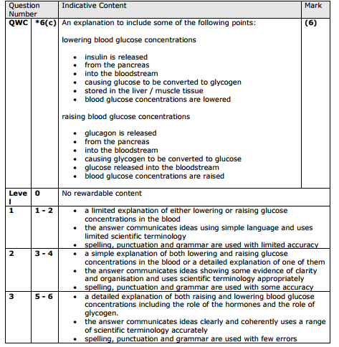
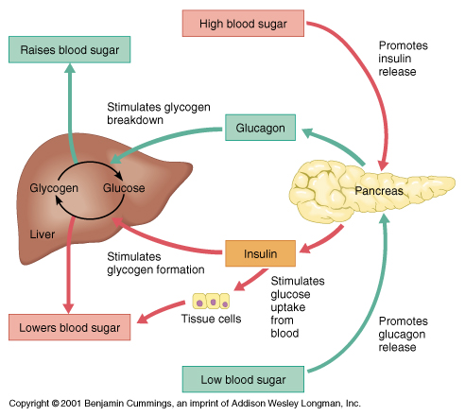
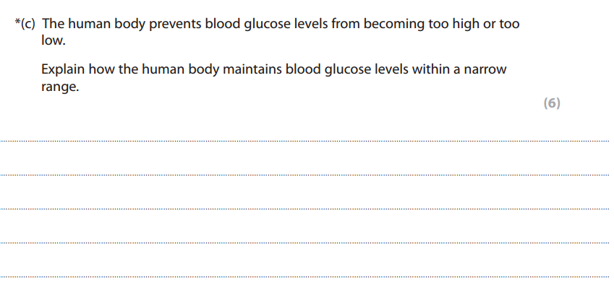
Question Wording

Slide 19
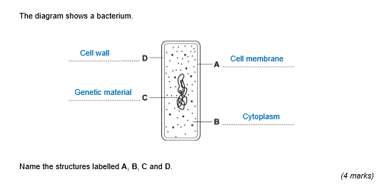
State, name, give, write down

Slide 20
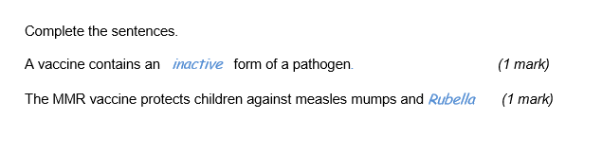
Complete

Slide 21
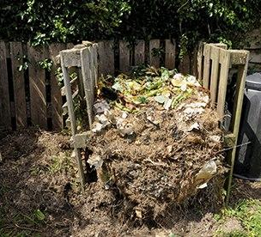
Describe
Describe conditions microbes require …..
Oxygen ✔
Moisture ✔
Warmth
How would an able student, with poor exam technique, waste their time when answering this question?
Explain the conditions microbes require…….
Reason 1: More oxygen leads to more respiration of microbes. This allows them to grow and reproduce faster.✔
Reason 2: Microbes need water to be healthy. Moist conditions lead to faster growth and reproduction.✔
Reason 3: If microbes have the correct temperature they can respire faster so they grow and reproduce quicker.

Slide 22
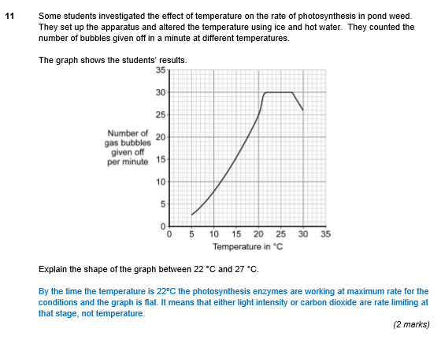
Explain

Slide 23
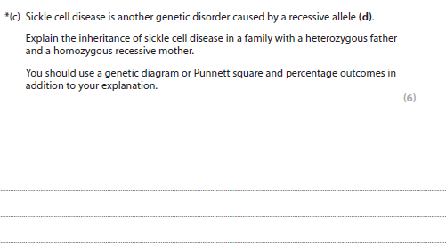
Explain
Nov 2012
Genetic Disorders
Q5

Slide 24
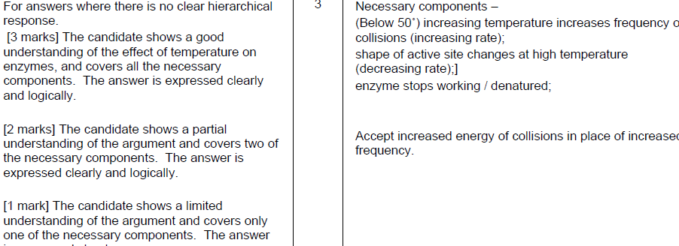
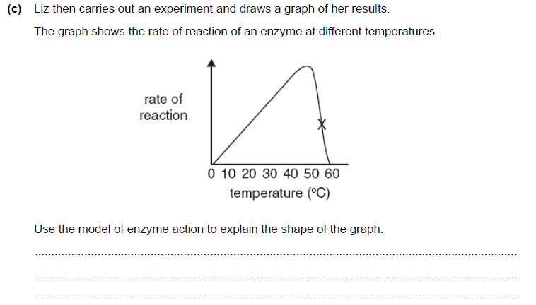
Explain

Slide 25
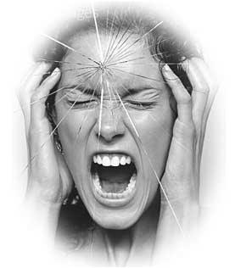
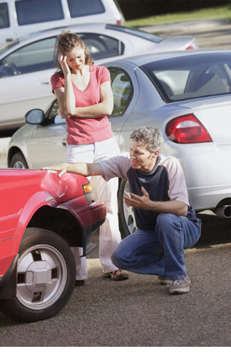
Evaluate
Evaluate is one of the most difficult command words, it is often used in English exams
Expect to give an extended answer
You will be expected to give an opinion
Expect to “weigh up” the pros and cons or the strengths and weaknesses of the information which has been provided.
Use phrases like ……..
In my opinion …
I think this because….
On the other hand, you could argue that ……
The most important thing that influenced me was ….

Slide 26
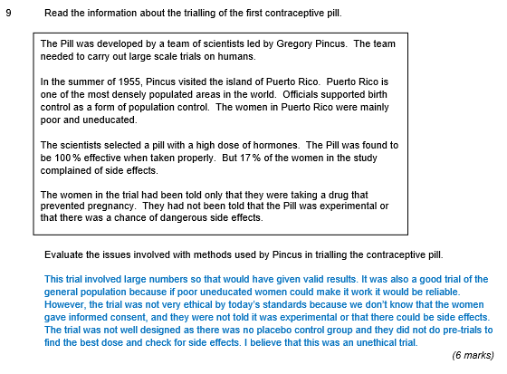
Evaluate

Slide 27
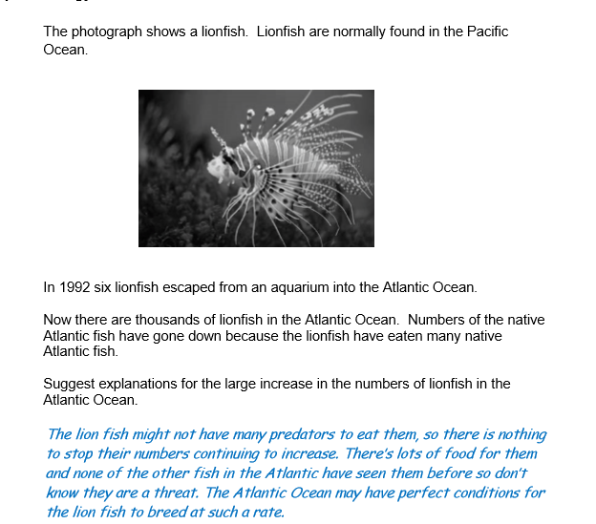
Suggest

Slide 28


General Tips
Always use key words where appropriate.
Short and simple answers are much better than long waffling answers.
Unless it is a quality of written communication answer (QWC), use bullet points for your answers.

Slide 29


Check Your Work
Re - read your answers when you have finished.
Never leave a question blank – it is always worth taking a guess if you don’t know.
A final look through your exam is the perfect time to check for any errors or add any extra information you may have remembered.

Slide 30
Averages or Mean
The average is the same as the mean. We use it when we have more than one result.
Usain runs 100 metres in London, Stockholm and Zurich. His times are 9.60 seconds, 9.84 seconds and 9.78 seconds. What is his average time?
Average = Total number / Number of results
= (9.60 + 9.84 + 9.78) / 3
= 9.74 seconds

Slide 31
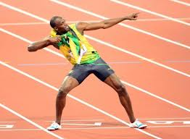
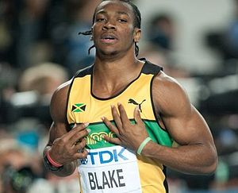
Averages
Comparing averages can tell us information....
 | London | Stockholm | Zurich | Average
Usain | 9.60 | 9.84 | 9.78 | 9.74
Yohan | 9.72 | 9.72 | 9.90
Who is the fastest runner? How do we know this?
(1 marks)

Slide 32
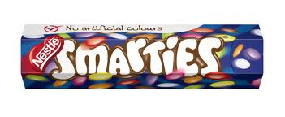
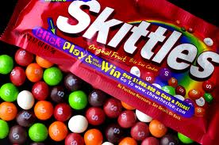
Averages
 | Amount of sugar in sweets (grams)
 | Sample 1 | Sample 2 | Sample 3 | Sample 4 | Average
Skittles | 6.5 | 6.5 | 10.5 | 8.0
Smarties | 7.1 | 7.8 | 8.1 | 10.9
Explain which sweet is better for your teeth?
(3 marks)

Slide 33
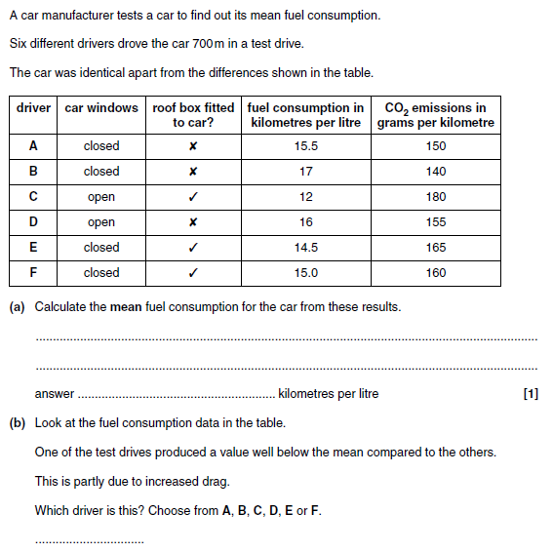
Averages or Mean

Slide 34
Ranges
To calculate the range of a group of numbers, you subtract the smallest number from the biggest number.
Range is used to show the spread of results. A big range means a big spread.
What is the range of 7, 6, 12, 3, 7, 4?
Range = 12 -3 = 9

Slide 35
Ranges
 | Amount of sugar in sweets (grams)
 | Sample 1 | Sample 2 | Sample 3 | Sample 4
Skittles | 6.5 | 6.5 | 10.5 | 8.0
Smarties | 7.1 | 7.8 | 8.1 | 10.9
Four samples of Skittles were taken and four samples of Smarties. The amount of sugar was measured in each sample.
Show which sweet has a bigger range of the amount of sugar in them

Slide 36
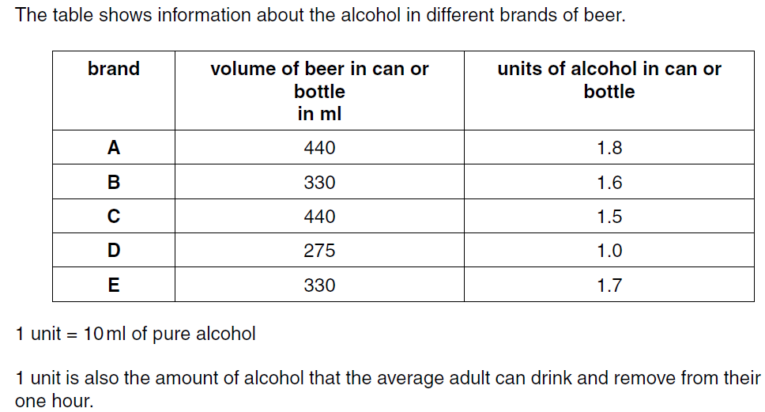
How many ml of alcohol are there in a can of brand A? ______ ml
If an average adult drinks one can of brand C, how many minutes will it take to remove all the alcohol from the blood? ____ minutes

Slide 37
Using data in tables
Other questions show scientific data (often from an experiment) in a table and ask you to draw a conclusion.
Behaviour of mothers during pregnancy | % of babies born normal weight or above | % of babies born underweight
Smokes 0 cigarettes | 99% | 1%
Smokes more than 20 cigarettes a day | 92% | 8%
Explain what we can conclude about how smoking affects the weight of a baby (2 marks)

Slide 38
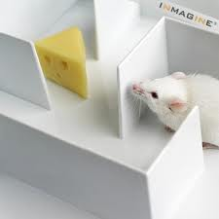
A mouse scientist wants to know the effect of caffeine on how quickly a mouse can get through a maze.
6 mice are used – 3 with caffeine and 3 without
What has mouse been given | Time taken to get around maze (seconds)
 | Attempt 1 | Attempt 2 | Attempt 3
Mouse has drunk 5ml of water | 42 | 55 | 59
Mouse has drunk 5ml of coffee | 48 | 32 | 30
Explain what we can conclude about how caffeine affects how quickly a mouse can get through a maze (2 marks)
Suggest how could the scientist could improve his experiment. (1 mark)

Slide 39
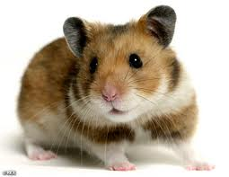
The same experiment was then done with 6 hamsters
in the same maze.
What has hamster been given | Time taken to get around maze (seconds)
 | Attempt 1 | Attempt 2 | Attempt 3
Hamster has drunk 5ml of water | 68 | 70 | 72
Hamster has drunk 5ml of coffee | 67 | 67 | 76
Explain what we can conclude about how caffeine affects how quickly a hamster can get through a maze (2 marks)

Slide 40
Percentage increases
The population of lions in a wildlife reserve was 500. It has now increased by 40%.
What is the new population of lions in 2012?
Population of lions = 500 x 1.4
= 700

Slide 41
Percentage increases
The population of buffalo in a wildlife reserve was 2000. It has now increased by 35%.
What is the new population of buffalo in 2012?
Population of buffalo = 2000 x 1.35
= 2700

Slide 42
Percentage decreases
The population of cheetahs in a wildlife reserve was 300. It has now decreased by 70%.
What is the new population of cheetahs?
Population of cheetahs = 300 x 0.3
= 90

Slide 43
Rodent | Population
 | October 2011 | October 2012
Mouse | 30 | 35
Rat | 64
The population of rats in a barn has decreased by 20% from 2011 to 2012.
What is the population of rats in 2012?

Slide 44
Calculating percentages
You may be asked to calculate how much something is as a percentage of the total amount.
 | Mars | Snickers
John | 12 | 8
What is the percentage of the chocolate bars John eats are Mars bars?
Percentage = Number of Mars bars x 100%
Total number of bars eaten
= 12 x 100% = 60%
20

Slide 45
Calculating percentages
You may be asked to calculate how much something is as a percentage of the total amount.
 | Mars | Snickers
John | 12 | 8
Paul | 3 | 7
George | 21 | 4
What is the percentage of the chocolate bars eaten by George are Snickers?

