Slide 1
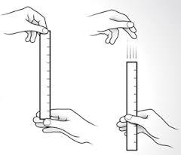
GCSE Required Practical – Biology 1 – Investigating reaction time
Reaction time – the time it takes for you to react. You need to detect the stimulus (eyes) and send an impulse to the brain (sensory neurone) and down to the hand (motor neurone)
Example Apparatus
Dropping a metre stick
Or using an online reaction
test to measure reaction time
(reaction distance with metre
stick).
Many IV’s could be tested
e.g. the effect of listening to music, drinking alcohol, drinking caffeine, taking drugs or medicines, gender, age, amount of practice
What’s the point of the practical?
To find out how a certain variable affects reaction time.
Results
People react quicker with practice and if they are concentrating.
They react slower if distracted in any way.
What may they ask us about?
Control variables – what had to be kept the same and how did you do it?
Why is it important to repeat? Calculate means etc
Range of results, resolution of measurements, uncertainty of results
Ethical considerations
Use of control groups to compare to

Slide 2
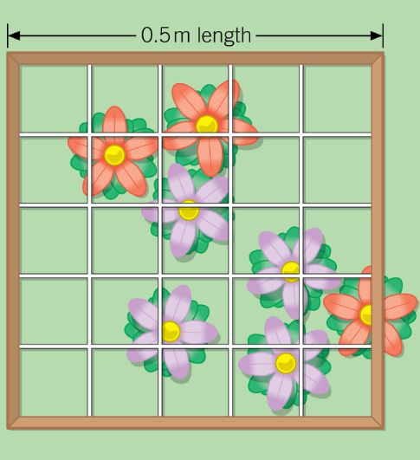

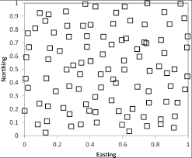
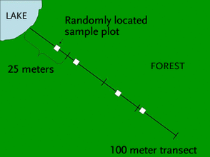
GCSE Required Practical – Biology 1 – Measuring population size
Population: all the individuals of a species in a particular area. Abiotic factors: non-living factors biotic factors: living factors
Distribution: how the individuals are ‘spread out’ across a certain area
What’s the point of the practical?
To find out how different factors affect how species are distributed
Example Apparatus
Quadrat – frame of a certain size used to isolate a particular area so you can see what’s in that certain space
Results
Random sampling – used when you want to know how the organisms are spread out across an area.
Line transect – used when you want to see how one particular feature (e.g. a river/road/building) affects an area. You take samples in a line (called a transect) and repeat to compare the difference near and far from the feature.
What may they ask us about?
Accuracy of measurements – is it 100% accurate?
Reproducibility and validity of data – is it completely fair?
Calculate means and work out the total number in a certain area.
How could you improve the sample to make it more representative?

