Slide 1
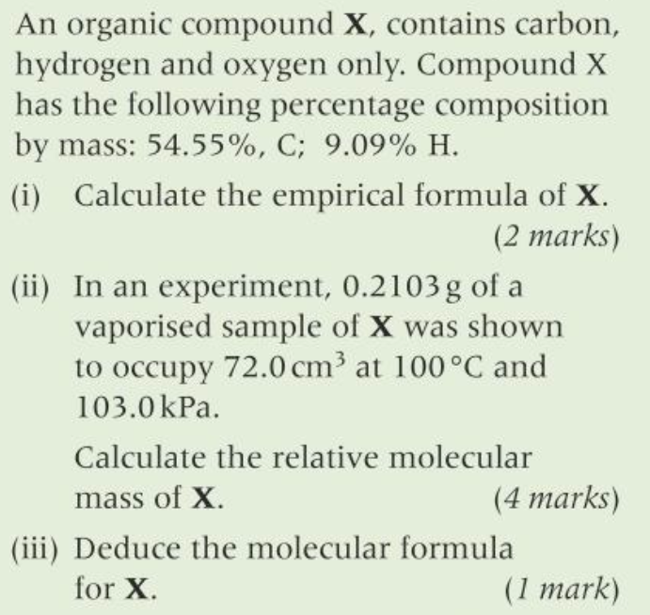
C | H | O
12 | 1 | 16
54.5 | 9.09 | 36.4
2 | 4 | 1
C₂H₄O (mass=44)
PV=nRT
n=PV/RT
n=103.0x0.072/8.314x373)
n=2.39x10⁻³
Mr = 0.2103/2.39x10⁻³
= 88 gmol⁻¹
88/44=2
Mol. formula C₄H₈O₂

Slide 2
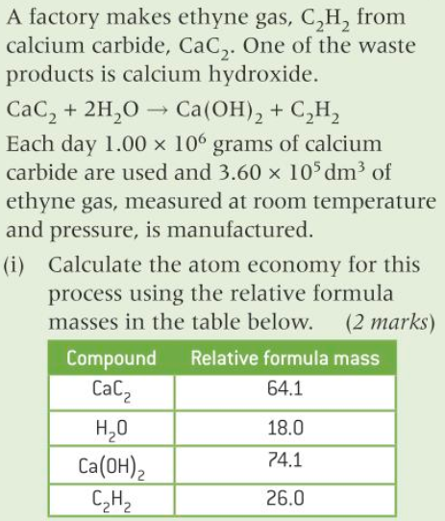
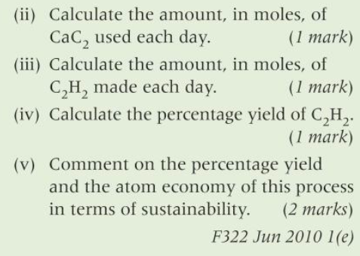
Economy 26.0 x 100/(64.1 + 2x18) = 26%
1x10⁶/64.1 = 15600 mols
15600 x 0.26=4056 moles
Yield 3.6 x 10⁵ / 24 = 15000
15000 x 100/15600 = 96.2%
Excellent yield but very poor atom economy
(But Ca(OH)₂ can be used…..)

