Slide 1
Ions and Relative Atomic Mass
Learning Objectives:
Deduce the atomic structure in atoms and ions.
State why Carbon-12 is used at the standard measurement of relative masses
Calculate RAM, RMM (Relative molecular mass) and RFM (Relative formula mass).
Key Words:
Ion, electron, mass, relative.

Slide 2
What is an Ion?
An atom (or group of atoms) that has lost or gained electrons to become positively or negatively charged.
The loss/gain causes an imbalance in the number of +:- charges in the atom and gives an overall charge that is not zero.
For Example: Sodium looses one electron to become an ion – Na⁺ it 11 protons and 10 electrons – therefore an overall charge of +1

Slide 3
Negative
Neutral
Positive
Sign of charge = -
Sign of charge = 0
Sign of charge = +
More electrons than protons
Same No. of electrons as protons
Less electrons than protons
O²⁻
8 Protons
10 Electrons
8 Neutrons
Overall Charge -2
Ar
18 Protons
18 Electrons
22 Neutrons
Overall Charge 0
Al³⁺
13 Protons
10 Electrons
14 Neutrons
Overall Charge +3

Slide 4
Questions
How many protons neutrons and electrons are in the following ions?
K⁺ (b) F⁻ (c) Ca²⁺ (d) S²⁻
2) Write down the symbols for the following ions.
The ion with 16 protons, 18 neutrons and 13 electrons.
The ion with 26 protons, 30 neutrons and 23 electrons.

Slide 5
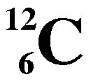
Atomic Masses
How can we weigh something that we cannot see?
Like Atoms.
Rather than weighing atoms, the masses of different elements are compared – This is where the term Relative Atomic Mass comes from.
The carbon-12 isotope is the international standard all elemental masses are measured against
Atomic masses are measured using the unified atomic mass unit, u
1 u = 1.660538782 x 10⁻²⁷ kg
The mass id one C-12 atom is 12 u.
So the mass of one twelfth of a C-12 atom is 1 u.

Slide 6
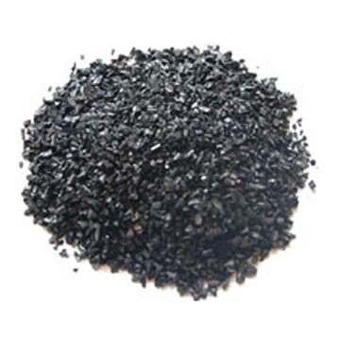
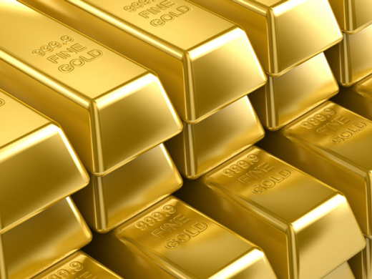
Relative Isotopic Mass
All the atoms in a sample of a single isotope are identical so have the same mass.
Relative Isotopic Mass is the same as the mass number for an isotope.
Oxygen-16 has a relative isotopic mass of 16
Sodium-23 has a relative isotopic mass of 23
Chlorine-35 has a relative isotopic mass of 35
(note how the mass no. of Cl on the periodic table is not exactly 35)

Slide 7
Relative Atomic Mass - A_{r}
Most elements are a mixture of naturally occurring isotopes in varying proportions.
The mass number on the periodic table is a weighted mean accounting for the different proportions if each isotope in nature.
The overall mass number of an element depends on;
The percentage abundance of the different isotopes.
The relative isotopic masses of the isotopes.

Slide 9
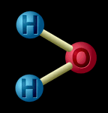
Relative Molecular Mass - M_{r}
Many materials are made up of simple molecules.
e.g. the gasses in the air – N₂ O₂ and CO₂
Relative Molecular Mass is found by adding together the Relative Atomic Masses of the atoms in the molecule
e.g. H₂O = (1.0 x 2) + 16 = 18

Slide 10

Relative Formula Mass
Materials with giant structures don’t exist as simple molecules.
For example – NaCl (common salt) or SiO₂ (sand)
So a different term is used (as they are no molecules)
Relative Formula Mass
Relative Formula Mass is found by adding together the Relative Atomic Masses of the atoms in the formula unit
e.g. SiO₂ = 28 + (16 x 2) = 60

Slide 11
Calculate the relative formula mass of the following compounds (showing your working!):
(a) Carbon monoxide CO
(b) Carbon dioxide
(c) Sulphur dioxide SO₂
(d) Calcium carbonate CaCO₃
(e) Sodium hydroxide NaOH
(f) Sulphuric acid H₂SO₄
(g) Hydrochloric acid HCl
(h) Copper sulphate CuSO₄
(i) Magnesium chloride MgCl₂
(j) Sodium carbonate Na₂CO₃
(k) Lead nitrate Pb(NO₃)₂
(l) Calcium hydroxide Ca(OH)₂

