Slide 1
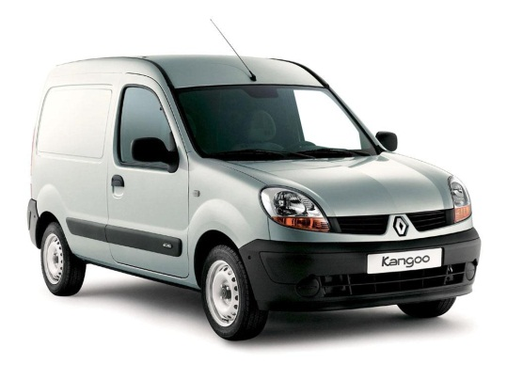
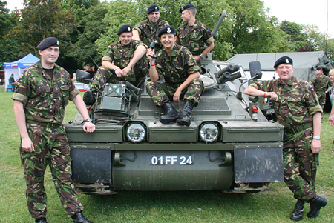
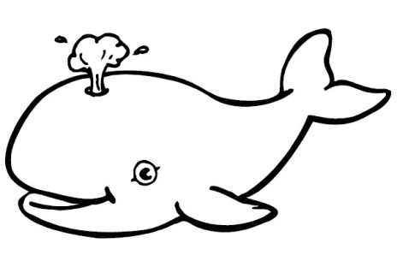
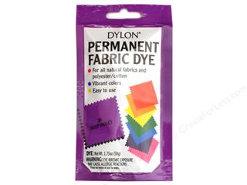
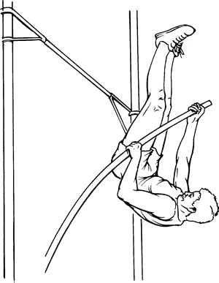
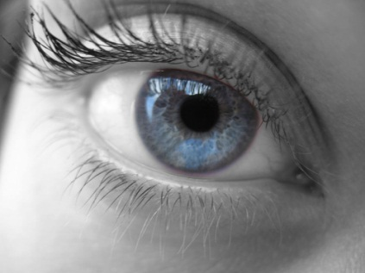
Keyword Dingbats (not elements)
1
2
3
s

Slide 2
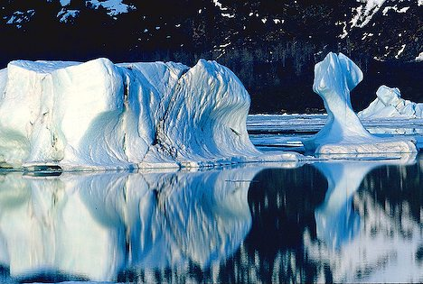
Why do icebergs float?

Slide 3
Starter Questions
Describe how van der Waals’ forces arise.
2.The boiling point of the group 7 elements are shown below. The all exist as diatomic molecules.
F₂ = -188$℃$; Cl₂ ₌ -35 $℃$; Br₂ ₌ 59 $℃$; I₂ ₌ 184 $℃$;
Explain this trend in terms of molecular forces.

Slide 4
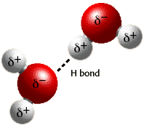
Hydrogen Bonding
Learning Objectives:
Describe hydrogen bonding between molecules containing –OH and –NH groups.
Describe and explain the anomalous properties of water resulting from hydrogen bonding.
Key Words: Hydrogen bond, permanent dipole-dipole force, electronegativity, hydrogen, oxygen.

Slide 5
Hydrogen Bonding
Hydrogen bond: is a strong dipole-dipole attraction between:
An electron-deficient hydrogen atom on one molecule (O-H^{δ+} or N-H ^{δ+}) and;
A lone-pair of electrons on a highly electronegative atom on a different molecule. (H-O^{δ-} or H-N^{δ-})
Draw out a few water molecules, assign their dipoles and predict what kind of intermolecular forces there are between them.

Slide 6
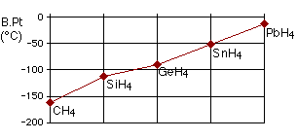
The boiling point of compounds of hydrogen and group 4 elements. Why does it increase?

Slide 7
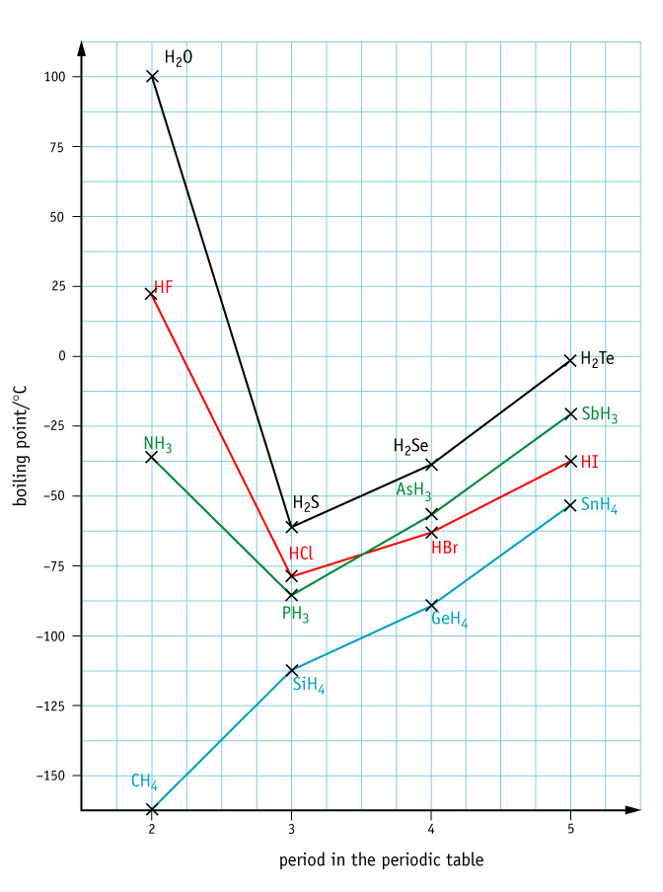
How hydrogen bonding affects boiling points
Look at the the boiling points of compounds of hydrogen and group 5,6 and 7 elements.
What is unusual?

Slide 8
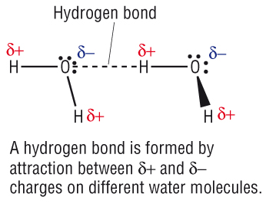
Occurs in O-H and N-H bonds ( and H-F)

Slide 9
Why do hydrogen bonds only form between O-H and N-H (and F-H)?
It might help to sketch the shape and dipoles of the molecules containing these atoms (such as H₂O)

Slide 10
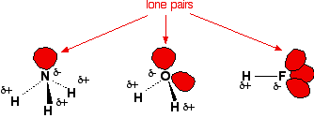

Slide 11
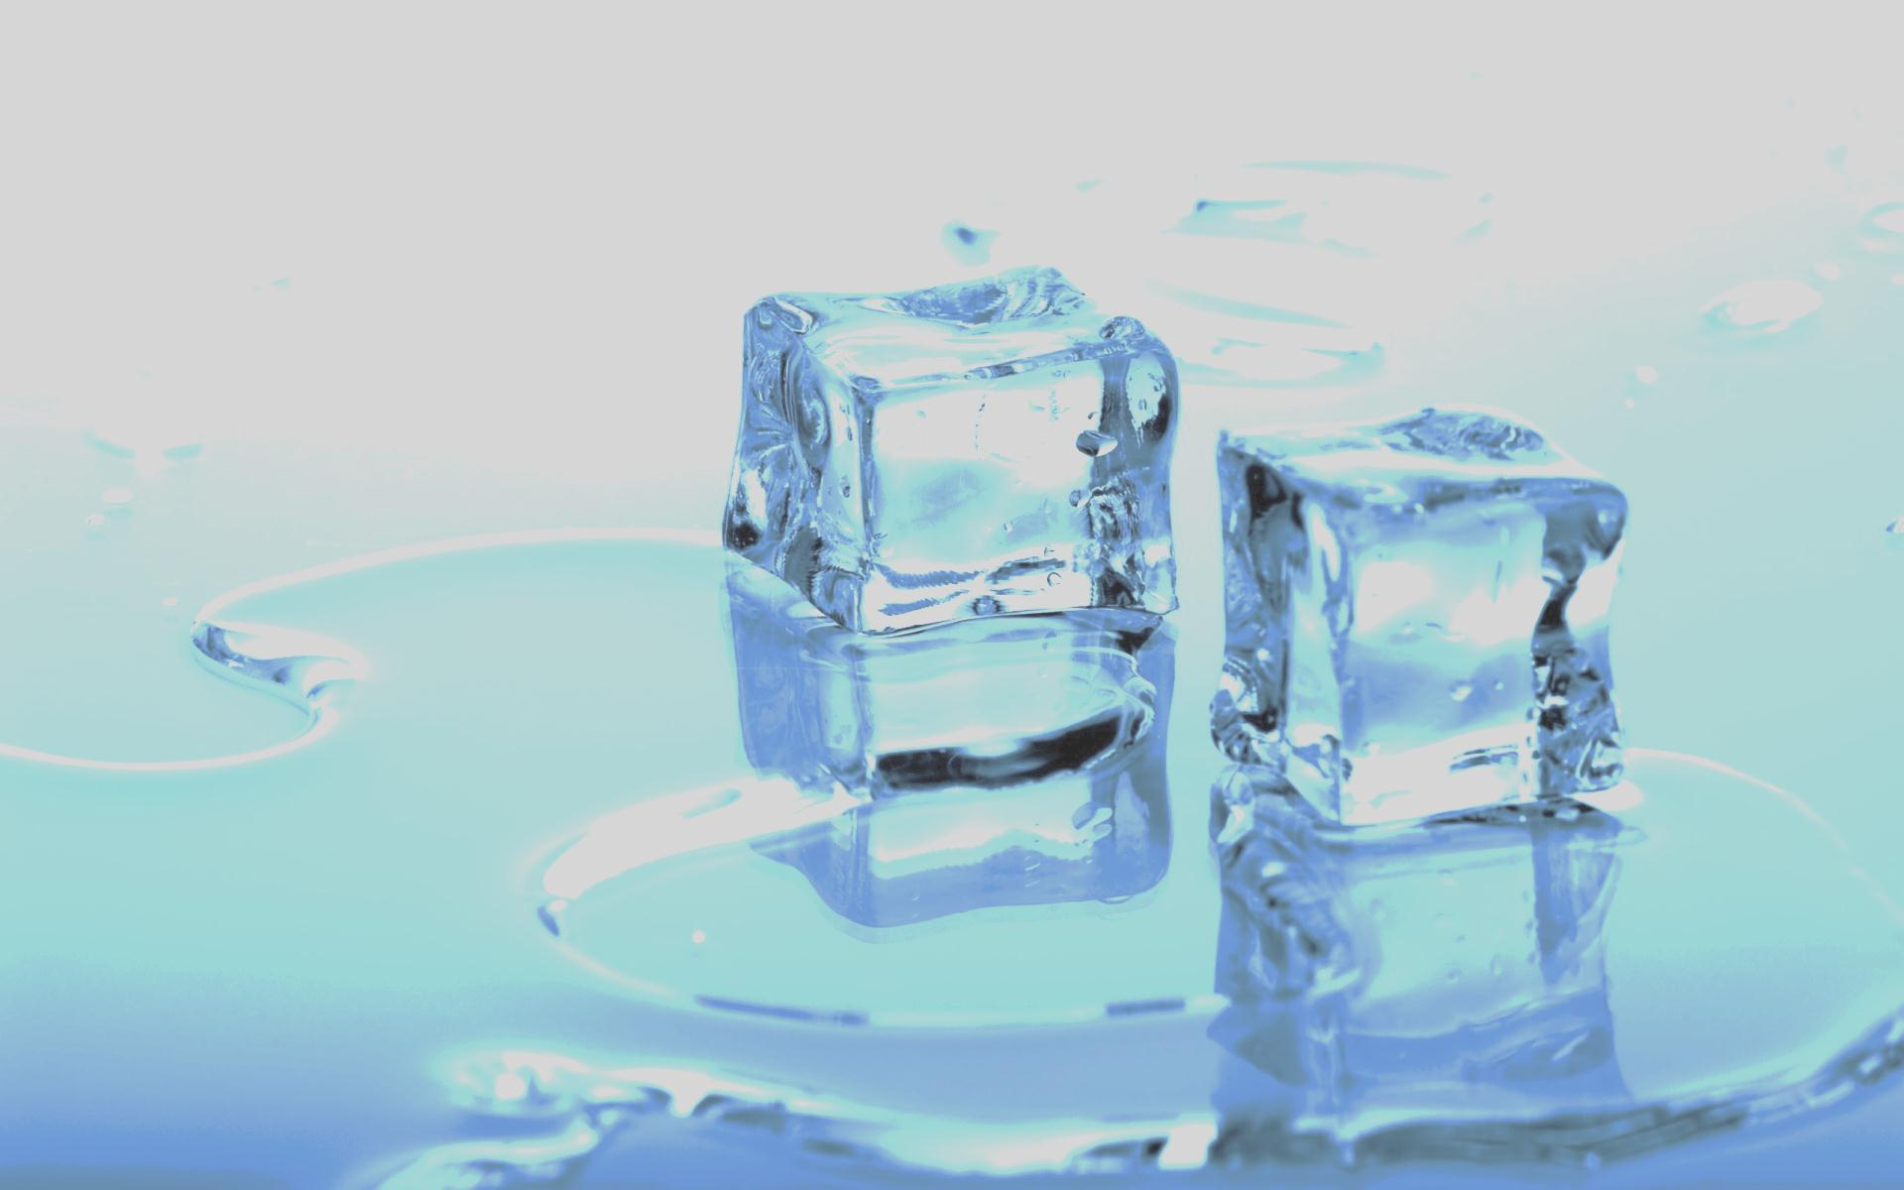
Hydrogen Bonds
What happens to the volume of water when it freezes?
How does this differ from other liquids?
What causes this?

Slide 12
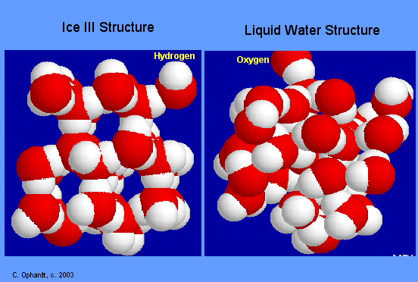
Ice has open lattice, H-bonds hold water molecules apart.
When ice melts, H₂O molecules move closer together.

Slide 13
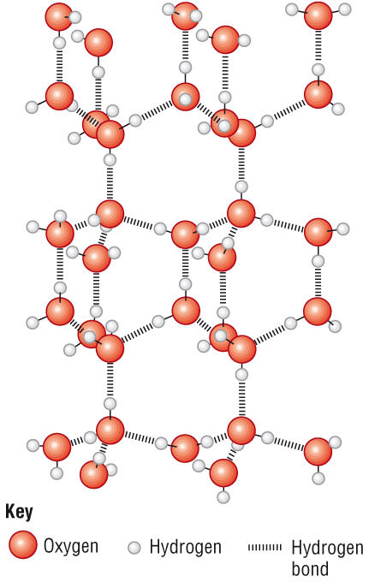

Slide 14
How much does volume increase?
1) Calculate the volume in a 100 g ice cube with a density of 0.92 g per mL.
2) What is the exact change in volume of the water when it freezes as ice?
Comparison of:
Liquid water | Ice
Mass = 100 g | Mass = 100 g
Volume = 100 mL | Volume = ? mL
Density = 1.0 g/mL | Density = 0.92 g/mL

Slide 15
Many simple molecular structures are gases at room temperature but H₂O is a liquid – why?

Slide 16
Other molecules are held together by van der Waals’ forces.
However, water molecules are held together by hydrogen bonds which are stronger and harder to overcome.

Slide 17
Bond type | Relative strength
Ionic and covalent bonds | 1000
Hydrogen bonds | 50
Dipole-dipole forces | 10
Van der Waals’ forces | 1

Slide 18
Other
H-bonds also give water relatively high surface tension and viscosity.
H-bonds are important in organic compounds containing O-H and N-H bonds (alcohols, carboxylic acids etc)
They are responsible for shape of proteins and even DNA.

Slide 19
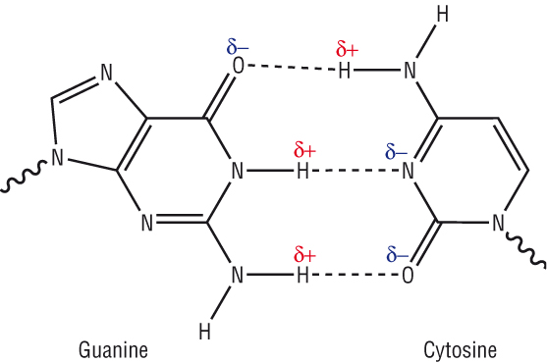
DNA

Slide 20
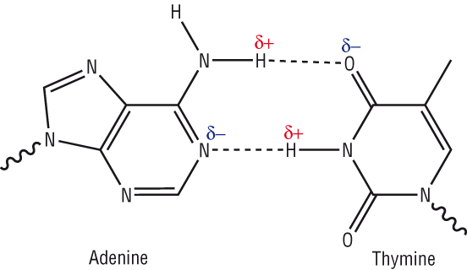
DNA

Slide 21
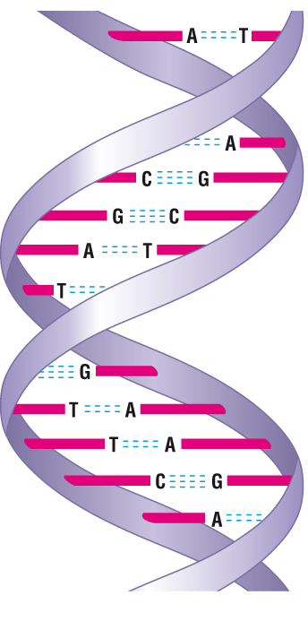
DNA Double Helix

Slide 22
Key Point
Remember when ice melts or boils, hydrogen bonds break – but the covalent bonds do not.

Slide 23
Why do icebergs float?

Slide 24
Questions
Which of the following molecules have hydrogen bonding?
H₂S b) CH₄ c) CH₃OH d) PH₃ e) NO₂ f) CH₃NH₂
2) Draw diagrams showing H-bonds between:
2 molecules of water
2 molecules of ammonia
2 molecules of ethanol
1 molecule of water and 1 molecule of ethanol

Slide 25
Homework
Create a revision guide for module 1 & 2 for another Chemistry student.
Due Next Friday – 25th Nov
These will actually be given to other students to use!

