Slide 1
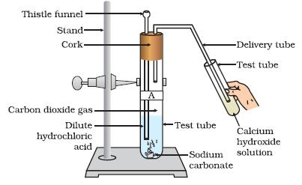
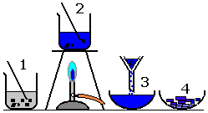
GCSE Required Practical –Chemistry 1 – Making a salt from a carbonate or oxide
Salt: an ionic substance soluble: something that dissolves in water insoluble: something that doesn’t dissolve in water
Acid + metal carbonate → metal salt + water + carbon dioxide Acid + metal oxide → metal salt + water
What’s the point of the practical?
To find out how to make a pure, dry sample of a soluble salt from an insoluble carbonate or oxide.
Example Apparatus
Acid + Carbonate
Limewater (calcium
hydroxide can be used
To show Co_{z} is produced
Acid + Metal Oxide
Excess of metal oxide added
Need to heat the solution
to ensure as acid fully reacts
with available metal oxide
particles
Then filter to remove
Excess metal oxide
Results
Hydrochloric Acid makes Metal Chlorides
Sulfuric Acid makes Metal Sulfates
Nitric Acid makes Metal Nitrates
What may they ask us about?
How do you get solid crystals from the salt solution (crystallize, evaporate the water)
Why do we heat the solution
What are the risks and safety precautions
Why do we filter the solution
How could we test the pH of the salt solution?
Name the salt produced.

Slide 2
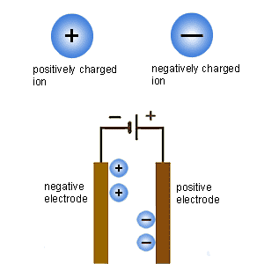
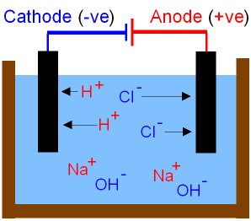
GCSE Required Practical – Chemistry 1 – Electrolysis
Electrolysis: when a salt solution is separated using electricity
Example Apparatus
Molten compounds or less
reactive salt solutions
Positive ions to negative
electrode. Negative ions to
positive electrode. Easy.
More reactive metal solutions
e.g. Sodium Chloride solution
(Brine)
If the metal is more reactive
than Hydrogen
Hydrogen is produced at the
Negative electrode (instead of
the metal).
Metal hydroxide is produced
In the solution.
What’s the point of the practical?
To find out how different solutions behave when electrolysed
What may they ask us about?
How could you test the gas that is produced (hydrogen = pop, chlorine = bleaches damp litmus paper).
What happens when the …….. Ions get to the ……. Electrode? (positive ions are reduced – gain electrons. Negative ions are oxidised – lose electrons).
What would happen if you added universal indicator to the solution? (turns purple – hydroxide is produced – alkali).

Slide 3
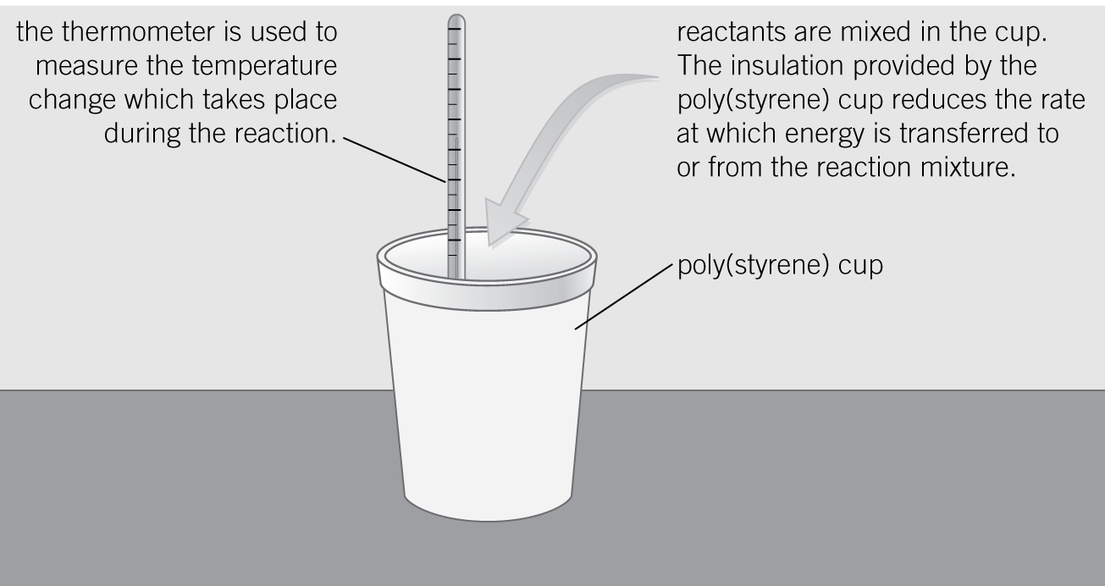
GCSE Required Practical –Chemistry 1 – Temperature changes in solutions
Exothermic reaction: releases energy (heat exits) Endothermic reaction: absorbs energy (gets cold)
What’s the point of the practical?
To find out how different variables affect energy changes in solutions.
Example Apparatus
- Displacement (e.g. Copper Sulfate + Iron → Iron Sulfate + Copper)
Neutralisation
(e.g. Hydrochloric Acid + Sodium Hydroxide → Sodium Chloride + Water)
Results
Displacement reactions are exothermic
Neutralisation reactions are exothermic
What may they ask us about?
Why do you use a polystyrene cup / lid? (to reduce temperature loss to the surroundings - makes results more accurate)
Resolution and accuracy of measurements.
Repeatability, calculating mean results, uncertainty etc

