Slide 2
[5]
Conductivity of Na mark
M1: Sodium conducts in the solid and molten states ✔
Reason for conductivity of Na mark
M2: Sodium has delocalised electrons (in both solid and liquid state) ✔
Conductivity of Na₂O mark
M3: Na₂O conducts when molten and not when solid ✔
Reason for conductivity of Na₂O marks
M4: Molten Na₂O has ions which are mobile ✔
M5: Solid Na₂O has ions which are fixed (in position) OR ions are held (in position) OR ions are not mobile AND in an (ionic) lattice OR structure ✔

Slide 3
[3]
M1 Trend AND nuclear charge mark (from Li to F) atomic radius decreases AND nuclear charge increases or number of protons increases ✔ M2 same shell / shielding mark (outer) electrons are in same shell OR (outer) electrons experience similar or same shielding ✔ OR same number of shells M3 nuclear attraction mark Greater nuclear attraction on (outer) electrons or shells OR (Outer) electrons or shells are attracted more strongly to the nucleus ✔

Slide 4
Al²⁺(g) → Al³⁺(g) + e⁻✔

Slide 5
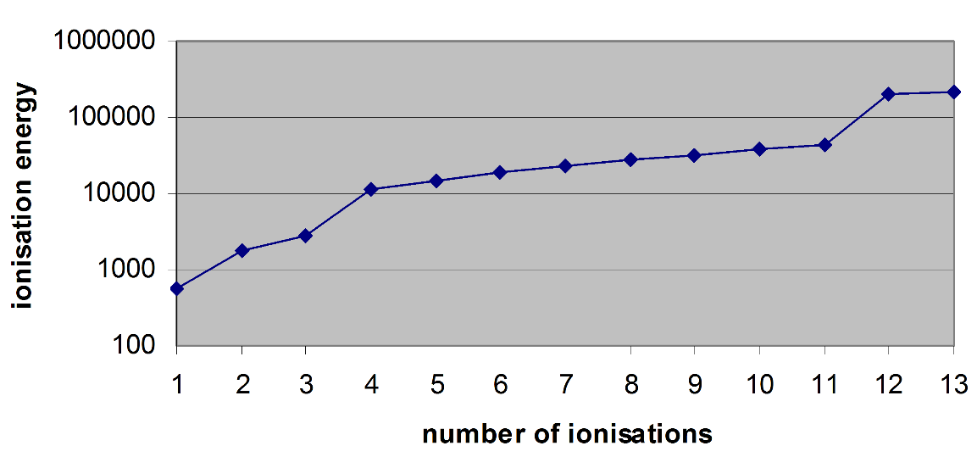
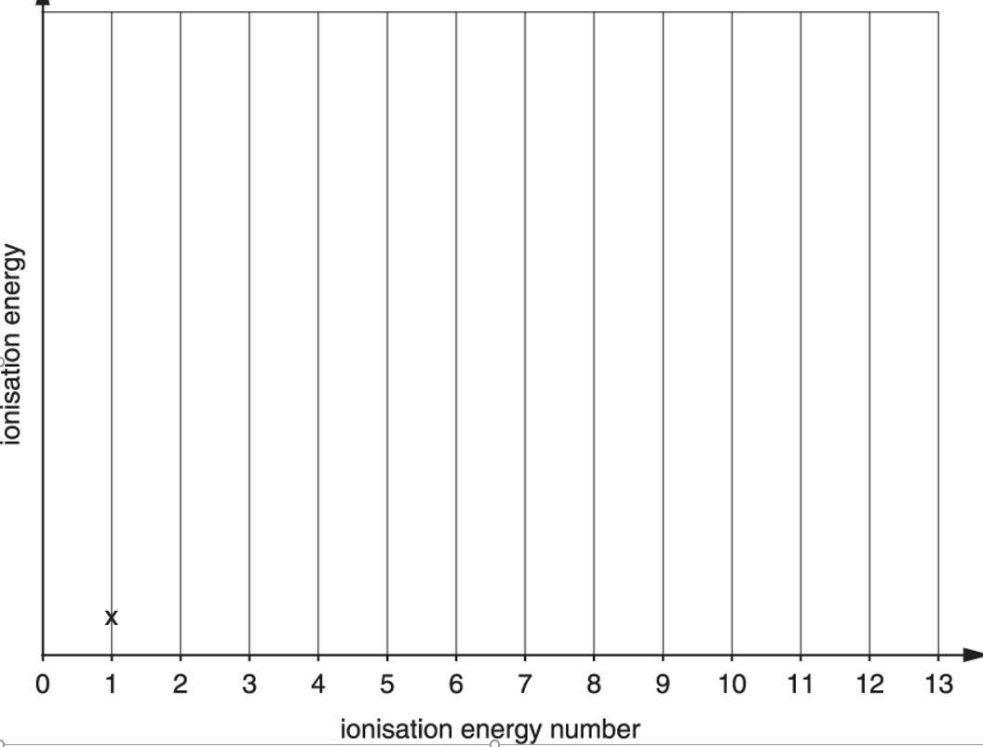
All (thirteen) ionisation energies show an increase ✔ The two largest increases are between the third and fourth AND the eleventh and twelfth ionisation energies ✔

Slide 6
The attraction (between nuclei and outermost electrons) increases (across the period)
AND The nuclear charge increases
OR The number of protons increase ✔
(Outer) electrons are in the same shell
OR (Outer) electrons experience similar shielding
OR Same number of shells
OR Atomic radius decreases ✔

Slide 7
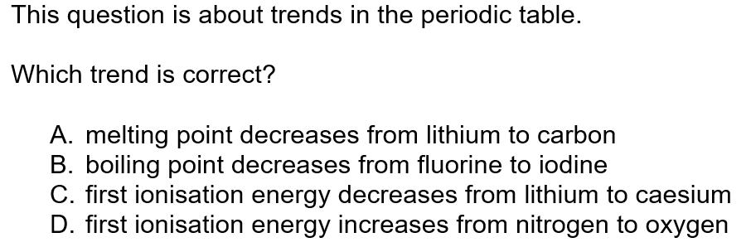
✔

Slide 8
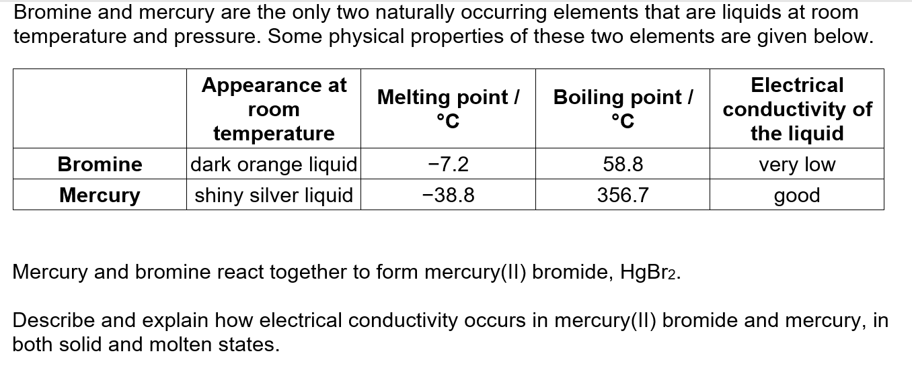
HgBr₂ conducts when molten but not when solid (1) … because ions are mobile in molten HgBr₂ (1) … but are fixed in a lattice in solid HgBr₂ (1) Mercury conducts in both the solid and molten states … (1) … because delocalised electrons move (in both solid and liquid state) (1)

Slide 9
✔

Slide 10
✔

Slide 11
✔

Slide 12
Group: 2 (1)
Large increase between 2nd and 3rd ionisation energy values. (1)

Slide 13
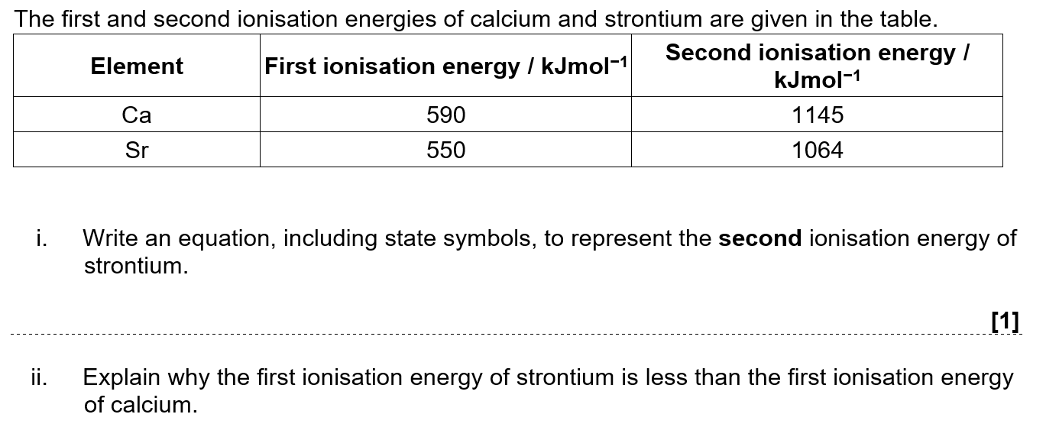
Sr⁺(g) → Sr²⁺(g) + e⁻ ✓
Atomic radius: larger atomic radius OR more shells ✓ Effect of nuclear charge / shielding Increased nuclear charge outweighed by increased distance / shielding OR more / increased shielding ✓ Nuclear attraction: less nuclear attraction OR less attraction on electrons ✓

Slide 14
Phosphorus has more electrons ✓
Stronger London forces OR Stronger induced dipole(-dipole) interactions ✓
More energy required to break the intermolecular forces / bonds OR London forces ✓

Slide 15
Magnesium metallic (bonds) ✓
cations/positive ions/Mg²⁺ AND delocalised electrons ✓
Silicon covalent ✓
between atoms ✓

Slide 16
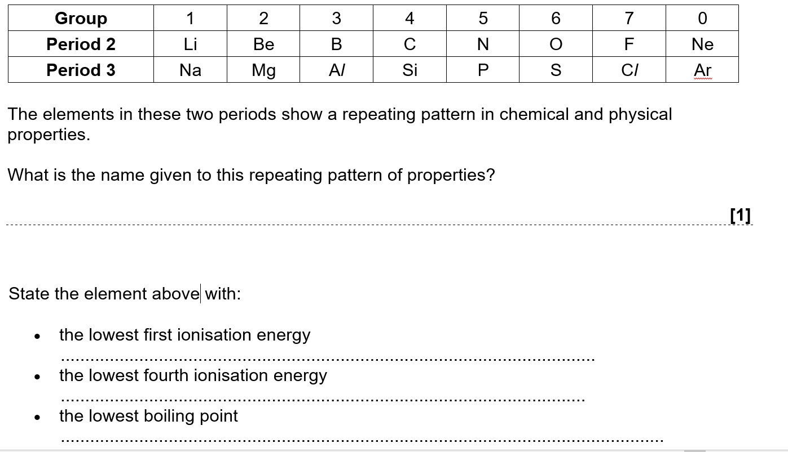
 | Periodicity ✓
 | Sodium OR Na ✓ Silicon OR Si ✓ Neon OR Ne ✓

Slide 17
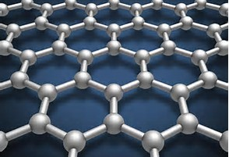
✔

Slide 18
✔

Slide 19



