Slide 1
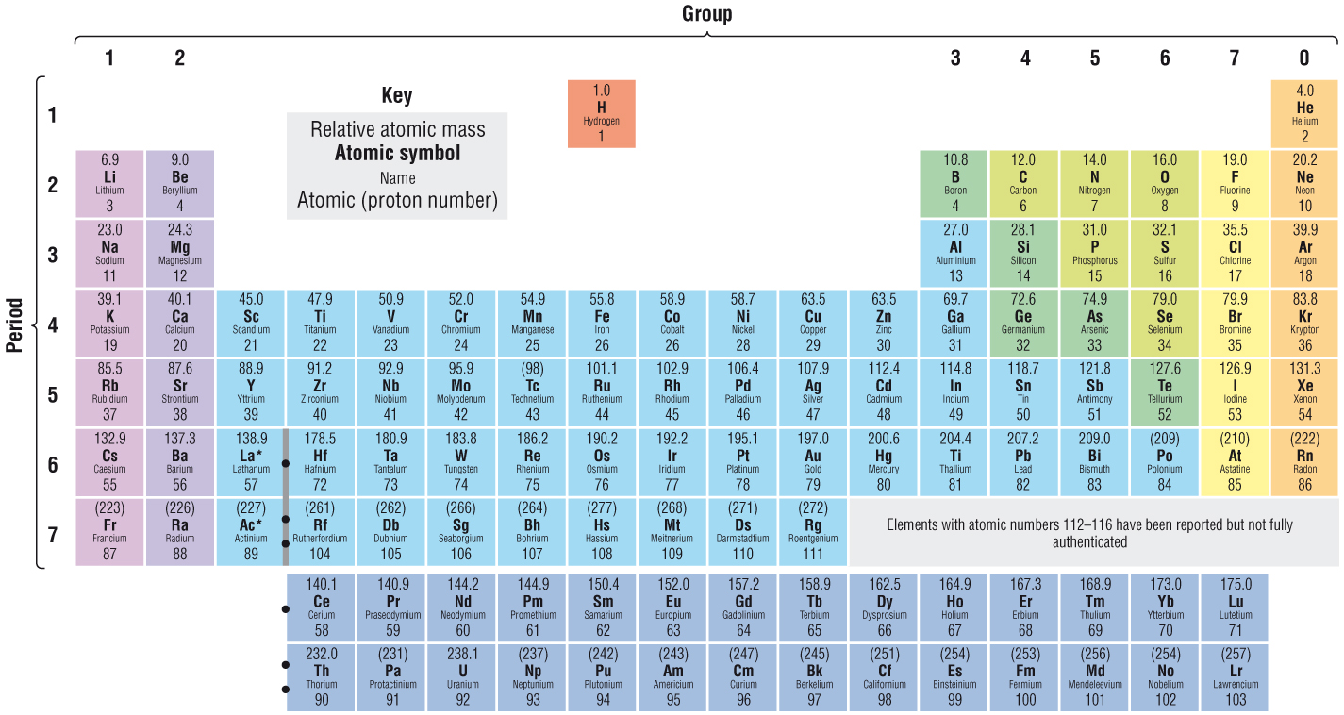

Slide 2
The Periodic Table
Lesson Objectives:
• Describe the Periodic Table in terms of the arrangement of elements by increasing atomic number, in periods and in groups.
• Explain how periodicity is a repeating pattern across different periods.
• Explain how atoms of elements in a group have similar outer-shell electron structures, resulting in similar properties.
• Describe the variation in electron structures across Periods 2 and 3.
Key Words: Group, period, periodicity, trends, patterns.

Slide 3
The Periodic Table
Group: vertical columns in the periodic table. Elements in a group have similar chemical properties and their atoms have the same number of outer shell electrons
Period: horizontal row of elements in the periodic table. Elements show changing trends across a period.

Slide 4
Periodicity: IE’s and Atomic Radii and boiling points
Lesson Objectives:
• Explain that ionisation energy depends upon: atomic radius; electron shielding; and nuclear charge.
• Describe the variation of the first ionisation energies and atomic radii of elements across a period and down a group.
Describe the variation in both melting and boiling points for the elements of Periods 2 and 3.
Key Words: periodicity, ionisation energy, atomic radius, electron shielding,

Slide 5
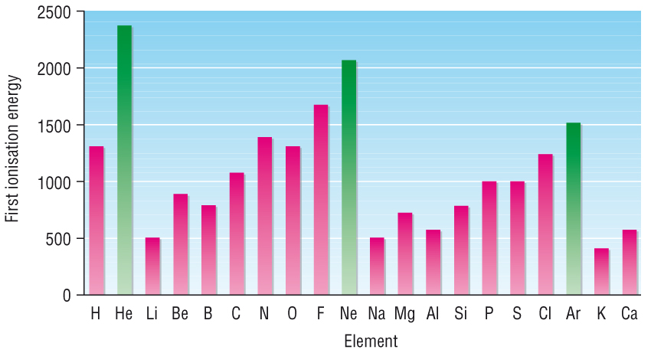
Variation in 1st IE’s and Atomic Radii
Three factors affect the value of ionisation energies.
Nuclear charge
Distance from the nucleus
Electron shielding.
First ionisation energies of the first 20 elements

Slide 6
First ionisation energies of the first 20 elements
What trends can you notice from the graph?
Try to explain the general trend in terms of atomic structure.
Now explain the anomalies in the general trend

Slide 7
Across a Period
P1
Period 2
Period 3
There is a general increase across the period
The number of protons increases, so there is more attraction acting on the electrons
Electrons are added to the same shell, so the outer shell is drawn inwards slightly. Same no. of shells = same level of shielding, but more nuclear charge.

Slide 8
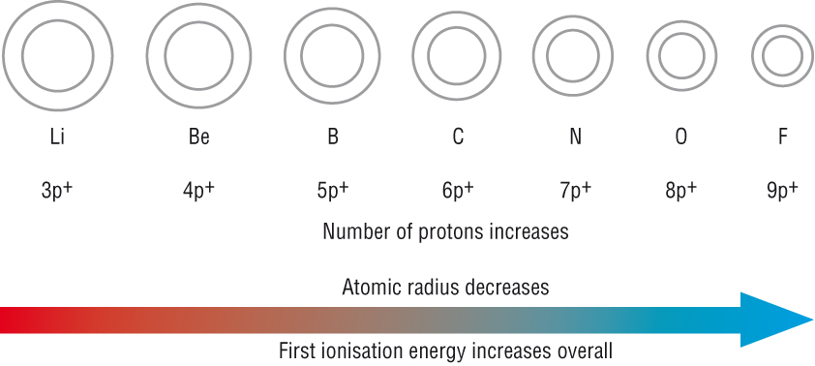
Across a Period
General trend in first ionisation energy and atomic radius across a period

Slide 9
Across a Period
There is a sharp decrease in 1st IE between the end of one period and the start of the next.
This reflects the addition of a new shell.
Increased distance from the outer shell to the nucleus
Increased electron shielding of the outer electrons by the inner shells.

Slide 10
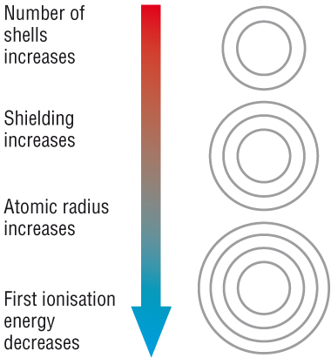
Down a Group
1st IE’s decrease
The number of shells increases, so t he distance between the nucleus and the outer electrons – weaker attractive force.
More inner shells, so the shielding increases – less attraction.

Slide 11
Down a Group
Ionic radius increases
More shells of electrons
Also less attraction means electrons are pulled in less by the nucleus

Slide 12
Questions
Explain the trends in IE and atomic radius across a period
In the answer, use ideas about nuclear charge, distance and shielding
2. Explain the trends in IE and atomic radius down a group.
In the answer, use ideas about nuclear charge, distance and shielding

Slide 13
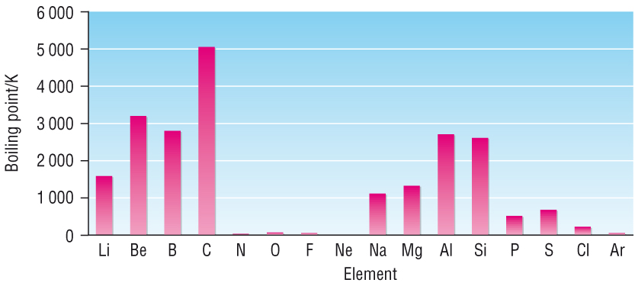
Boiling Points
Melting and boiling points tell us about the structure of materials.
Boiling points of Period 2 and Period 3 elements

Slide 14
Boiling Points
Trend in BP across each period:
Group 1 – 4 | Group 4 – 5 | Group 5 – 0
Li → C | C → N | N → Ne
Na → Si | Si → P | P → Ar
General increase in Boiling point | Sharp decrease in boiling point | Comparatively low boiling points
Distinct change between group 4 and 5 in structure and forces
From giant structures to simple molecular
From strong to weak forces.
Trend in melting point is similar – sharp decrease between group 4 and 5 marking the change from giant to simple molecular.

Slide 15
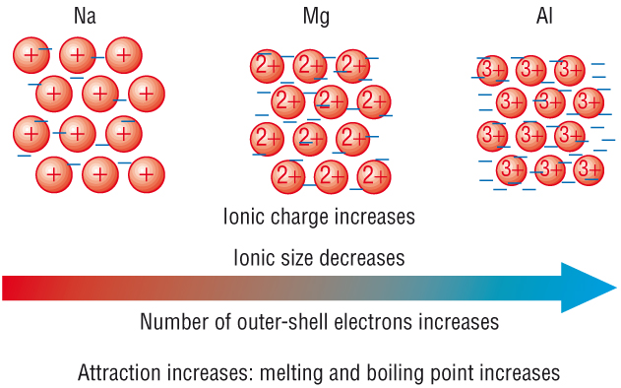
Boiling Points of Metals
MP and BP of the metals Na, Mg and Al in P3 increase as you move across

Slide 16
Questions
Why is the b.p of carbon much higher that of nitrogen?
2. Why is the m.p. of aluminium higher than that of magnesium?

Slide 17
Group 2 Elements: Redox Reactions
Lesson Objectives:
• Describe the redox reactions of the Group 2 elements
Mg → Ba with oxygen and with water.
• Explain the trend in reactivity of Group 2 elements down the group.
Key Words: periodicity, redox reactions, reacitvity.

Slide 18
Starter – using the white boards
What do you know about the elements in group 2?
2. Write the chemical equation for magnesium with
Water b) oxygen
c) Assign oxidation numbers to all species in the above equations.

Slide 19
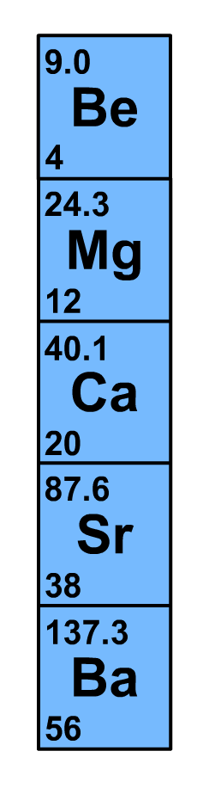
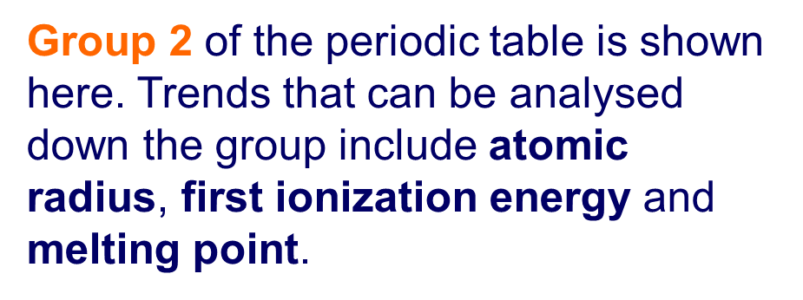
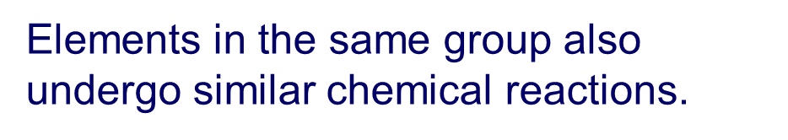
Group 2 Elements: Physical Properties
High melting point
Light metals with low densities
They form colourless compounds

Slide 20
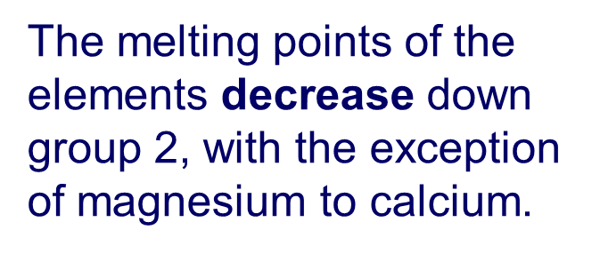
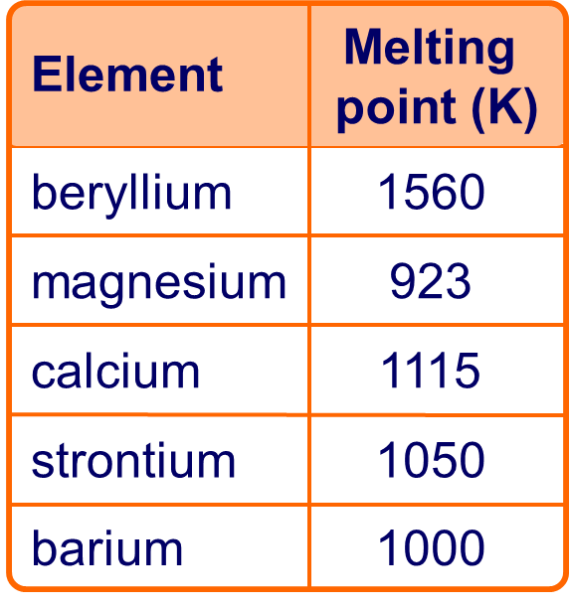
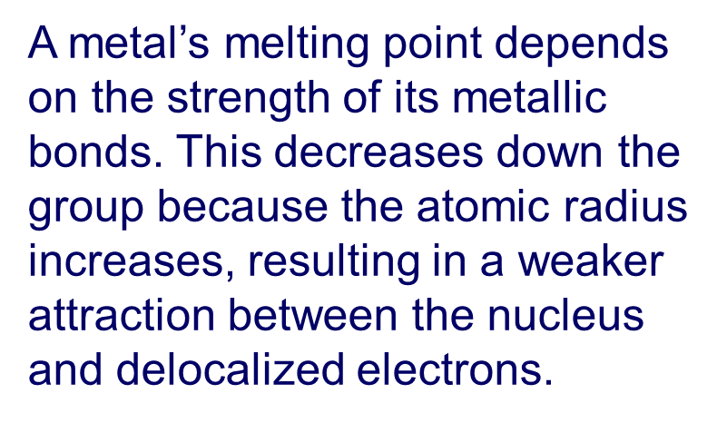
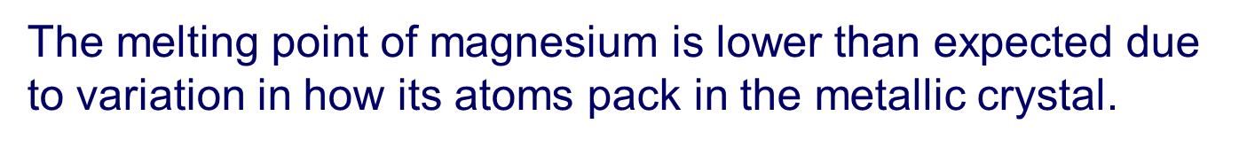
Group 2 Elements: Melting Points

Slide 21
Group 2 Elements: Electron Configuration
Element | Electron Configuration | 1st I.E. /kJ mol⁻¹
Be | [He]2s² | 900
Mg | [Ne]3s² | 736
Ca | [Ar]4s² | 590
Sr | [Kr]5s² | 548
Ba | [Xe]6s² | 502
Ra | [Rn]7s² | 509
Highest energy electrons in an s sub-shell
Each element has two more electrons than the preceding noble gas
two electrons in the outer shell. (form 2+ ions)

Slide 22
Group 2 Elements: Reactivity
Reactive metals that are strong reducing agents.
They are oxidised in reactions – loose 2 electrons
M → M²⁺ + 2e⁻ (+2 oxidation state)
Reactivity increases down the group
Reactivity increases because of the same factors that cause 1st I.E. to decrease.

Slide 23
Group 2 Elements:
Reaction with Oxygen
Group 2 metals react vigorously with oxygen
It is a redox reaction
Produces an ionic oxide with general formula MO
e.g. 2Ca(s) + O₂(g) → 2CaO(s)
0 0 +2 -2
Oxidation Numbers –
Ca – Oxidised
O – Reduced

Slide 24
Group 2 Elements:
Reaction with Water
Group 2 metals react with water to form hydroxides – M(OH)₂
Hydrogen gas is also formed
e.g. Ca(s) + 2H₂O(l) → Ca(OH)₂(aq) + H₂(g)
0 +1 -2 +2 -2 +1 0
Oxidation Numbers –
Ca – Oxidised
H – Reduced
Only one H atom in each water has been reduced – The other doesn’t change
Mg reacts slowly with water – on descending the groups reactions get more vigorous.

Slide 25
Questions
Mg + 2HCl → MgCl₂ + H₂ is a redox reaction
Identify the changes in oxidation number
Which species are being oxidised and which are being reduced?
c)Which species are the oxidising and reducing agents?
2. a) Write the equations for these reactions;
i) Barium with water
ii) Strontium with oxygen
b) Using oxidations numbers, identify what has been oxidised and reduced

Slide 26
Group 2 Compounds: Reactions
Lesson Objectives:
• Describe the effect of water on Group 2 oxides.
• Describe the thermal decomposition of Group 2 carbonates.
• Interpret and make predictions from the chemical and physical properties of Group 2 elements/compounds.
• Explain the uses of Group 2 hydroxides.
Key Words: thermal decomposition,

Slide 27
Group 2 Compounds:
Oxides and Hydroxides
Oxides and Hydroxides of group 2 metals are bases
They are neutralised by acids to form salt and water.
e.g. MgO(s) + 2HCl(aq) → MgCl₂(aq) + H₂O(l)
or Ca(OH)₂(s) + 2HCl(aq) → CaCl₂(aq) + 2H₂O(l)
As the products of these reactions are soluble you will see the solid oxides or hydroxides dissolve

Slide 28
Group 2 Compounds:
Oxides
Oxides react with water to form a solution of the metal hydroxide.
MgO(s) + 2H₂O(l) → Mg(OH)₂(aq)
Typical pH is about 10-12

Slide 29
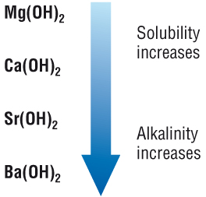
Group 2 Compounds:
Hydroxides
Oxides dissolve in water to form alkaline solutions.
Mg(OH)₂ + aq→ Mg²⁺ + 2OH⁻(aq)
Typical pH is about 10-12
Solubility increases on descending the group
The resulting solutions are also more alkaline
Mg(OH)₂ is only slightly soluble in water
Ba(OH)₂ much more soluble, therefore more OH- goes into solution = more alkaline.

Slide 30
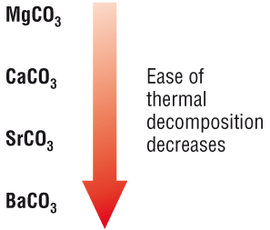
Group 2 Compounds:
Carbonates
Carbonates are decomposed by heat → metal oxide and carbon dioxide gas
MgCO₃(s) → MgO(s) + CO₂(g)
This is called thermal decomposition
The carbonates are more difficult to decompose on descending the group.

Slide 31
Group 2: Properties of elements and compounds
Elements become more reactive down the group.
Carbonates decompose at higher temperatures down the group
Hydroxides become more soluble in water and the resulting solutions become more alkaline down the group.

Slide 32
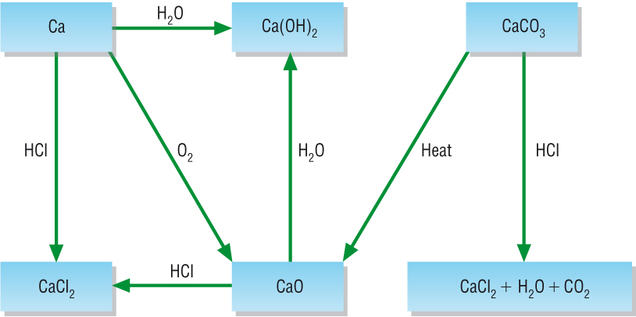
Group 2: Reactions and Compounds

Slide 33
Group 2: Uses of Hydroxides
Because the hydroxides of group 2 metals are very alkaline – they can be used to combat acidity.
The most common examples are ;
Calcium hydroxide, Ca(OH)₂ is used by farmers to neutralise acidic soils
Magnesium Hydroxide , Mg(OH)₂ is used in indigestion remedies to neutralise excess stomach acid.

Slide 34
Questions
1. Write the equations for the following reactions;
Barium oxide with hydrochloric acid
Radium carbonate with nitric acid
Strontium with water
The thermal decomposition of magnesium carbonate
Calcium oxide with nitric acid

Slide 35
Summary Activity
Summarise the properties and reaction of group 2 elements and their compounds.
Things to include;
Reaction of metals with water and oxygen
Reactions of the oxides and hydroxides
Trend in reactivity
Behaviour of the carbonates.
Solubility
Uses of the metal hydroxides.

Slide 36
Starter
Write down everything you know about the elements in group 7.

Slide 37
Group 7 Elements: Redox Reactions
Lesson Objectives:
• Explain the trend in boiling points of Cl₂, Br₂ and I₂.
• Explain the trend in reactivity for the Group 7 elements.
• Describe the redox reactions of the Group 7 elements with other halide ions.
• Describe and interpret, using oxidation numbers, the reaction of chlorine with water and aqueous sodium hydroxide.
Key Words: reactivity, displacement reaction, disproportionation, precipitation reaction

Slide 38
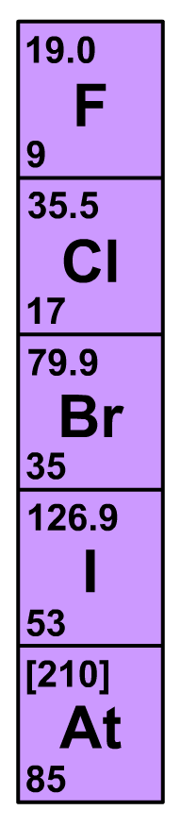
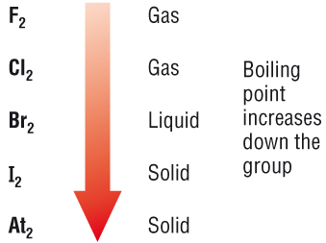
Group 7 Elements: The Halogens
Physical Properties:
Low melting and boiling points
Exist as diatomic molecules
On descending the group, no. of electrons increases → increasing van der Waals’ forces between molecules.
Boiling points increase on descending the group.
The physical states of the halogens at room temperature;
Gas → Liquid → Solid
On descending the group

Slide 39
Group 7 Elements: Electron Configuration
Element | Electron Configuration
F | [He]2s²2p⁵
Cl | [Ne]3s²3p⁵
Br | [Ar]4s²4p⁵
I | [Kr]5s²5p⁵
At | [Xe]6s²6p⁵
7 electrons in the outer shell, highest energy electrons in a p sub-shell
Each element has two fewer electrons than the next noble gas
Outer p sub-shell containing 5 electrons (needs 1 more to form a ⁻1 ion

Slide 40
The Halogens: Oxidising Agents
The halogens are the most reactive non-metals in the periodic table
Strong oxidising agents (they gain electrons)
Oxidising power decreases down the group. Therefore less reactive down the group
½ Cl₂(g) + e⁻ → Cl⁻(g) (⁻1 oxidation state)
Reactivity decreases down the group because;
Atomic radius decreases
Electron shielding increases
Ability to gain an electron decreases

Slide 41
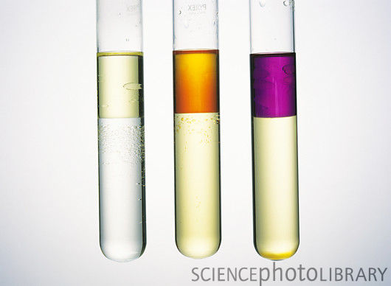
The Halogens: Recognising them
The halogens form solutions with different colours. A colour change will show if a reaction has taken place.
Halogen | Water | cyclohexane
Cl₂ | Pale-green | Pale-green
Br₂ | Orange | Orange
I₂ | Brown | violet
If you shake the reaction mixture with an organic solvent it can help distinguish between halogens that have reacted

Slide 42
Group 7 Elements: Uses and Halide Tests
Lesson Objectives:
• Interpret and make predictions from the chemical and physical properties of the Group 7 elements/compounds.
• Contrast the benefits and risks of chlorine’s use as a water treatment.
• Describe the precipitation reactions of aqueous anions Cl–, Br– and I– with aqueous silver ions, followed by aqueous ammonia.
• Recognise the use of these precipitation reactions as a test for different halide ions.
Key Words: reactivity, displacement reaction, disproportionation, precipitation reaction

