Slide 1
Use the following results from the experiment to determine the value of x in FeSO₄ •xH₂O (3 marks).
mass of crucible= 20.23g
mass of FeSO•xH₂O = 28.91 g
mass of FeS0₄ formed= 24.98g
(Mr FeSO₄ = 151.9)
b. In the experiment, how could you make sure that the measurement of the mass of the anhydrous solid was reliable?
Mass of FeSO₄ = 24.98 – 20.23 = 4.75g mass of H₂O in the crystals = 28.91 – 24.98 = 3.93g
The amounts in mol are FeSO₄:
4.75/151.9 = 0.0313 mol
and H₂O:
3.93/18 = 0.218 mol (1)
Therefore for every 1 mol of FeSO₄ there are 0.218/0.0313 = 6.98 or 7 mol of H₂O
So x = 7 (1)
Heat the crystals to constant mass

Slide 2
A student prepares a solution of sodium carbonate in a volumetric flask by dissolving some crystals in distilled water. However, instead of filling the flask correctly, the student uses too small a volume of water. Samples of this solution are then used in a titration with sulfuric acid.
Explain what effect this has on the calculated concentration of the sulfuric acid obtained from the titration. [3]
The solution of sodium carbonate will be more concentrated than it should be. (1)
This means more sulfuric acid will be required for the end-point of the titration. (1)
Therefore it will appear to be more dilute than it really is.

Slide 3
25.0 cm³ of a 0.25 mol dm⁻³ solution of sodium carbonate is titrated against hydrochloric acid.18.5cm³ of the acid is required to reach the end-point.
Write a balanced equation for the reaction that takes place. [1]
Calculate:
i. the amount in mol in 25.0cm³ of the sodium carbonate solution [1]
ii. the amount i n mol of hydrochloric acid that reacts with the sodium carbonate [1]
iii. the concentration of the hydrochloric acid in mol dm⁻³ [1]
Na₂CO₃ + 2HCl  2NaCl + CO₂ + H₂O
The amount in mol of sodium carbonate = 0.25 × (25/1000) = 0.00625 mol (n = cV)
From the equation, 1 mol of Na₂CO₃ reacts with 2 mol of HCl Therefore 0.00625 mol of Na₂CO₃ reacts with 2 × 0.00625 = 0.0125 mol of HCl
The 0.0125 mol of HCl must be contained in the 18.5 cm³ added.
So the concentration of the hydrochloric acid = 0.0125/0.0185 = 0.676 mol dm⁻³ (c = n/V) (1)

Slide 4
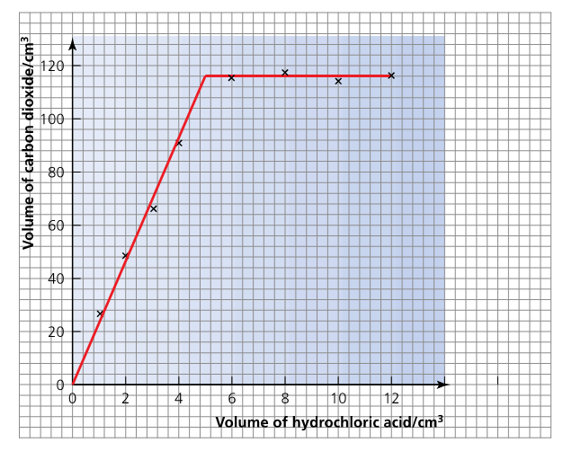
A student carries out a series of eight experiments. Volumes of 2.00moldm⁻³ hydrochloric acid are first added to a boiling tube using a burette. Then the same mass of marble (calcium carbonate) is added to each tube. In each experiment the volume of carbon dioxide given off is collected in a 250cm³ measuring cylinder inverted in water.
Write an equation for the reaction of marble and hydrochloric acid. Include state symbols
CaCO₃(s) + 2HCl(aq)  CaCl₂(aq) + CO₂(g) + H₂O(l)
5

Slide 5
A student carries out a series of eight experiments. Volumes of 2.00moldm⁻³ hydrochloric acid are first added to a boiling tube using a burette. Then the same mass of marble (calcium carbonate) is added to each tube. In each experiment the volume of carbon dioxide given off is collected in a 250cm³ measuring cylinder inverted in water.
What two observations would allow the student to observe that the reaction was complete
The marble would have disappeared and no more bubbling would be observed
5

Slide 6
A student carries out a series of eight experiments. Volumes of 2.00moldm⁻³ hydrochloric acid are first added to a boiling tube using a burette. Then the same mass of marble (calcium carbonate) is added to each tube. In each experiment the volume of carbon dioxide given off is collected in a 250cm³ measuring cylinder inverted in water.
What will be the concentration of the hydrochloric acid in the boiling tube once 8.0 cm³ has been added?
After 5.0 cm³ of acid has been added the acid is neutralised so the 8 cm³ in the boiling tube contains 3 cm³ of unreacted acid (1)
conc. x vol = conc. X vol
2.00 x 3 = ? X 8
Concentration of the acid is therefore (3/8) × 2.0 = 0.75 mol dm^{–3}
5

