Slide 1
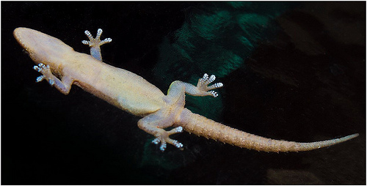
How can a gecko’s feet stick to almost any surface?
Write down your ideas.

Slide 2
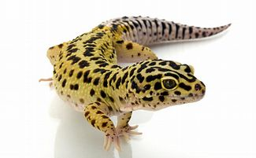
Intermolecular Forces
Learning Objectives:
State the different types of intermolecular bonding
Describe intermolecular forces in terms of permanent and instantaneous dipoles.
Key Words: Intermolecular force, permanent dipole-dipole force, van der Waals’ force

Slide 3
What bonding and structure exists in HCl?
How will this affect it’s properties?

Slide 4
Intermolecular Forces
Strength of Bonds and Forces:
Ionic and covalent bonds are strong.
Ionic bonds hold ions together in a lattice so that at room temperature all ionic compounds are solid.
Covalent bonds hold atoms together by sharing electrons. Many covalent compounds are small molecules with strong covalent bonds within them. These are intra-molecular forces.

Slide 5
Intermolecular Forces
Intermolecular Forces: is an attractive force between neighbouring molecules.
Intermolecular forces are weak compared to covalent bonds.
Intermolecular forces act between different molecules. They are caused by weak attractive forces between very small dipoles in different molecules.
Intra-molecular bonds act within one molecule.

Slide 6
Intermolecular Forces
Intermolecular Forces:
There ate three types of intermolecular forces;
Permanent dipole-dipole interactions
Van der Waals’ forces (induced dipole forces)
Hydrogen bonding.
Bond Type | Relative Strength
Ionic and covalent bonds | 1000
Hydrogen bonds | 50
Dipole-dipole forces | 10
Van der Waals’ forces | 1

Slide 7
Permanent dipole-dipole interactions
A permanent dipole-dipole force: a weak attractive force between permanent dipoles in neighbouring polar molecules.
Polar molecules have a permanent dipole.
The permanent dipole of one molecule attracts the permanent dipole of another.

Slide 8
Van der Waals’ forces
van der Waals’ forces (or induced dipole-dipole interactions) act between all molecules, whether they are polar or non-polar.
They are the weakest intermolecular force.
They act between very small, temporary dipoles in neighbouring molecules.

Slide 9
Van der Waals’ forces
Electrons are always moving in an atom.
Would it be possible for a non-polar molecule or atom to produce a dipole?
Why or why not?

Slide 10
Van der Waals’ forces
Symmetrical Molecule like H₂
Represented by evenly shaded oval
Electrons are mobile – the movement unbalances the distribution of electrons in molecules.

Slide 11
Van der Waals’ forces
Temporary dipoles

Slide 12
Could this happen in a single atom, such as Helium?
If so, how?

Slide 13
Helium

Slide 14
What will happen if two molecules or atoms are near each other and one has a temporary dipole?

Slide 15
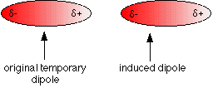

Slide 16
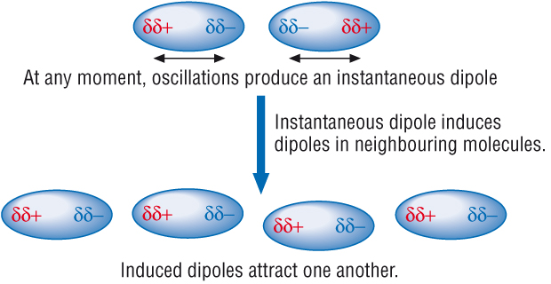

Slide 17
What factors might affect the strength of the van der Waals forces?
The greater the number of electrons → the larger the induced dipole → the greater the van der Waals forces.

Slide 18
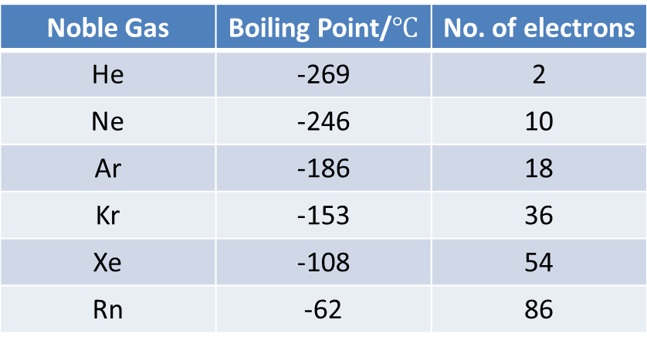
Van der Waals’ forces – Boiling Points
Van der Waals’ forces are the only attractions between non-polar molecules.
Noble Gas | Boiling Point/$℃$ | No. of electrons
He | -269 | 2
Ne | -246 | 10
Ar | -186 | 18
Kr | -153 | 36
Xe | -108 | 54
Rn | -62 | 86
No. of e⁻ increases
Van der Waals’ forces increase
Boiling point increases
If there were no van der Waals’ forces it would be impossible to liquefy the noble gasses or non polar molecules.

Slide 19
Quick Quiz
Explain what a permanent dipole-dipole interaction is.
Explain what van der Waals forces are.
What affects the amount of attraction between molecules?

Slide 20
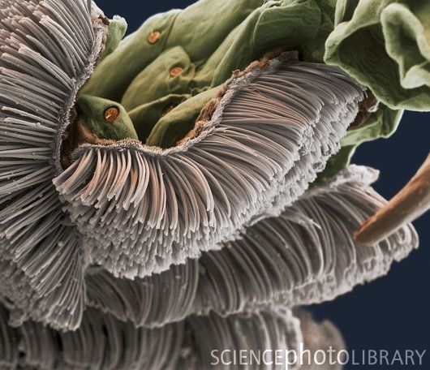
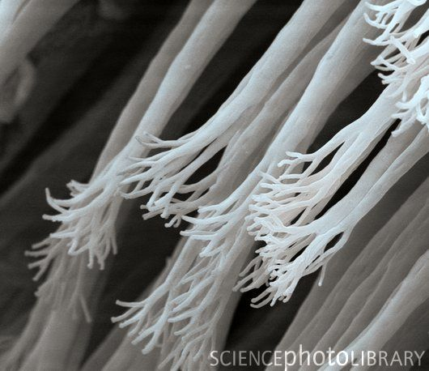

Slide 21
Questions
Describe how van der Waals’ forces arise.
2.The boiling point of the group 7 elements are shown below. The all exist as diatomic molecules.
F₂ = -188$℃$; Cl₂ ₌ -35 $℃$; Br₂ ₌ 59 $℃$; I₂ ₌ 184 $℃$;
Explain this trend in terms of molecular forces.

